Slide 1
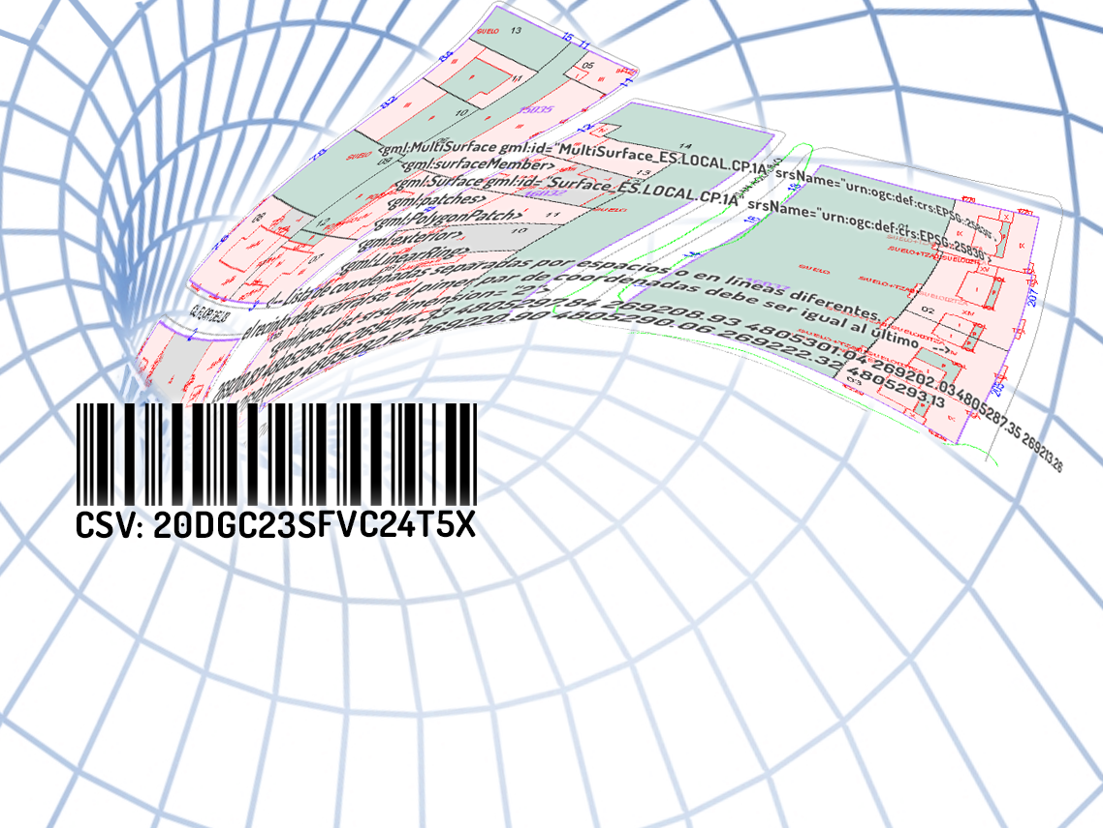
Smart Successful Cadastral New Tools for Real Estate Registration
“all in 16 digits”
Amalia Velasco
Sapanish Directorate General for Cadastre

Slide 2
In Spain the Cadastre and the Property Rights Registry are institutions with differentiated competences which need the coordination of their information for a better identification and description of real estates and an adequate provision of services to citizens and administrations.
We have been trying to coordinate both institutions since 1906
Now
Technologic developments
Social Changes
Political decision
Law 13/2015 for coordination

Slide 3
Law 13/
To give real estate traffic greater legal certainty by incorporating the georeferenced graphic information of the parcels in the Property Rights Registry,
Law 13/2015 implements the coordination:
-using cadastral mapping as the basis of its graphic representation, -allowing simultaneously the updating of the cadastral data.

Slide 4
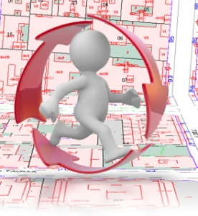
Coordination is not a specific action, it is a gradual process that is
implemented property to property as entries are made in the Property Rights Registry
in the case of division, fusion, segregation, land consolidation of the parcels etc…the citizen had to go both
to the registry (change of the titleholder) and
to the cadastre (change physical and economical data)
Before law 13/2015
Different data
Cadastre or colaborating administration

Slide 5
More transparency
More Efficient.
More Legal certainty
Total change
Once the cadastral data have been incorporated in the Property Rights Registry, the delimitation, location and area of cadastral data are considered to be true for all legal purposes.
The Property Rights Registry`s record and the cadastral map will indicate if the real estate is coordinated and the date of coordination.

Slide 7
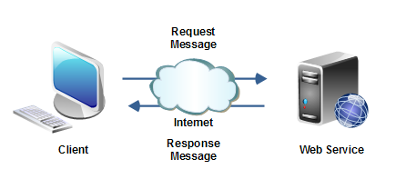
The coordination procedures must be agile and predictable,
Establishing a fluid and safe exchange of information between all the agents involved in the real estate traffic.
Web Services
Unattended machine to machine communication

Slide 8
3 documents
Cadastral certification (with GML)
Alternative geo-referenced representation (in GML)
Graphical validation report
Secure Verification Code
CSV

Slide 10
Coordination will be easier if all the agents involved speak the same language
Graphic representation first

Slide 11
The Directorate General for Cadastre, Registrars and Notaries have had to develop applications for the new coordination process
The process begins with GML INSPIRE of the origin cadastral parcel
it can be obtained at the Electronic Office of Cadastre
Through free access from the screen, as query results.
As a service using the WFS INSPIRE cadastral Parcel
With the cadastral certification

Slide 12
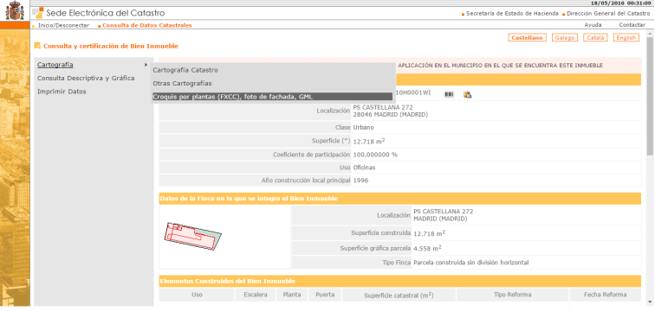
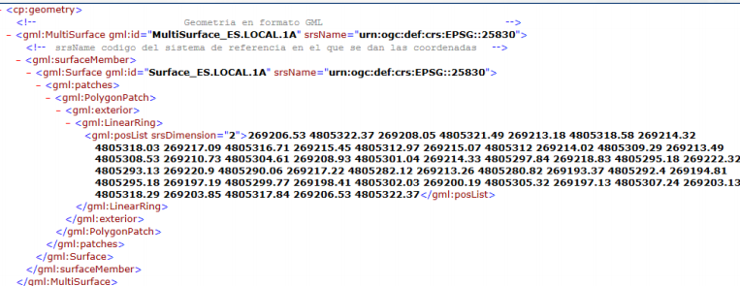
1. Free access from the screen, as query results.
1

Slide 13
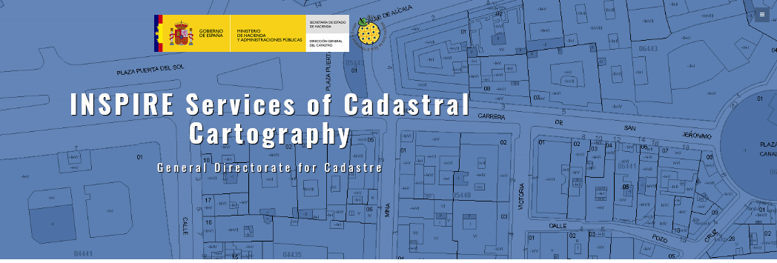
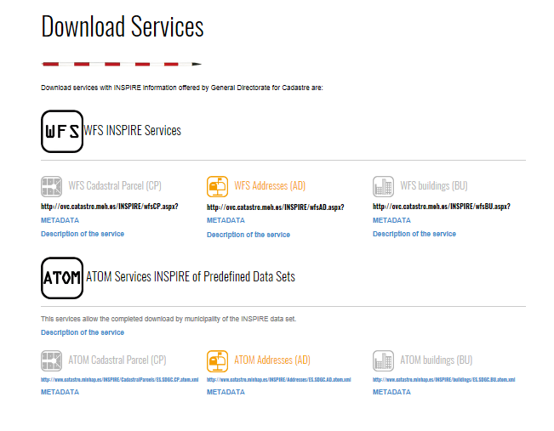
2. As a service using the WFS INSPIRE cadastral Parcel
1

Slide 14
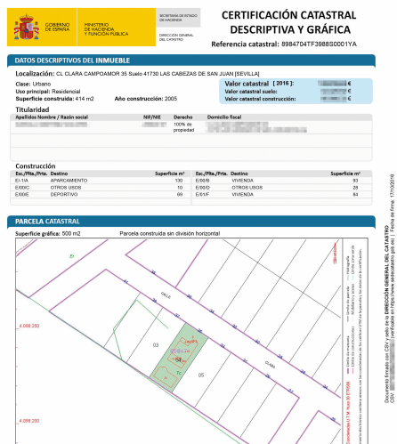
3. With the cadastral certification, obtained by the title holders and public partners agents
The cadastral certification is an electronic document (PDF format).
It includes embedded the GML INSPIRE of cadastral parcel.
The certificate and its attached file are signed electronically using a Secure Verification Code (CSV)
Composed by 16 digits
These 16 digits are the only information that is exchanged

Slide 15
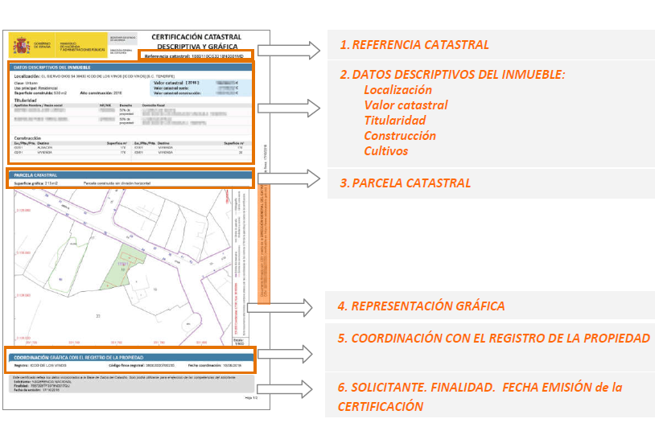
Cadastral certification

Slide 16
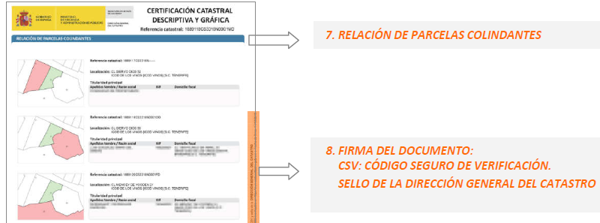
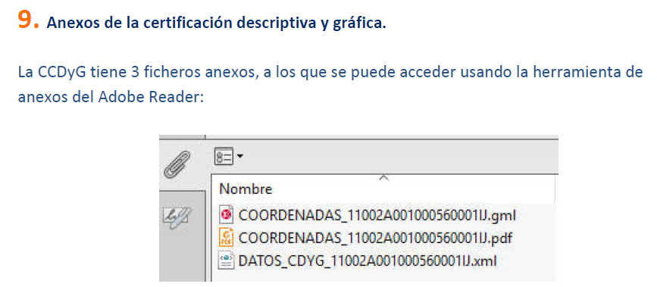

Slide 17
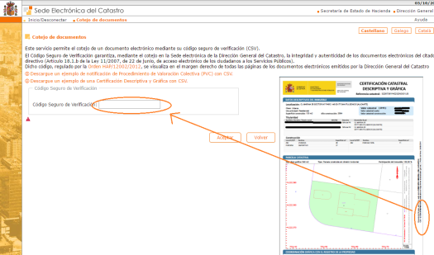
With this code CSV on the document it is possible to access in any moment by internet to the digital file in the Electronic Office of Cadastre.
• Citizens can be sure that the image on the document reflects the true coordinates.
• Applications of notaries and registrars use a web service to access the content of the GML attached file using only the code CSV.

Slide 18
This certificate is now used by citizens to describe the parcel in notaries and registry.

Slide 19
What happend when it is necesary to change the representation of the parcel?
- declarations of citizens: segregations, divisions, joints ..
- land consolidations,
- reparcelling,
- administrative demarcation,
- expropriation
- acts of urban planning and urban managing
- first registration in the PRR or reneval
- cadastral errors
- from the basic cartogrphy (ortho or topographyc map)
- or wrong delimitation of the parcel
- Property Right Register error that change the physsical representation of parcels
Citizens and administrations must provide an alternative geo-referenced representation

Slide 20
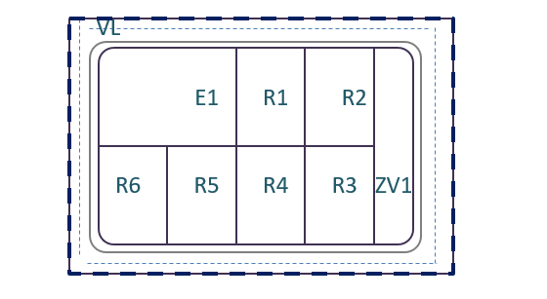
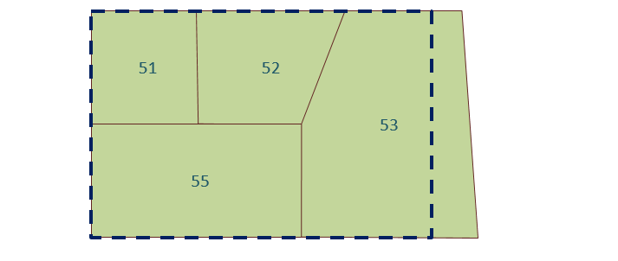
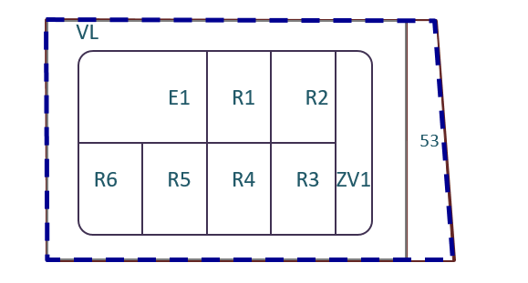
Alternative geo-referenced representation
The cadastral cartography is the basis of the new representation.
The technicians are required to represent the reality as an overlay on the cadastral cartography,
New parcelation
Download GML or other formats: DXF, etc
Modify by private tools (autocad, qgis, etc..)
Include the alternative geo-referenced representation
That must be expreses in GML of CP
Cadastral original data
Alternative georreferen representation

Slide 21
AutoCAD
https://github.com/chapulincatastral/generador-gml
1
https://plugins.qgis.org/plugins/SEC4QGIS/
QGIS: gml, dxf , shapefile from the original cadastral data .

Slide 22
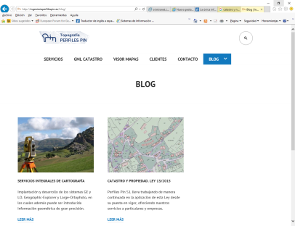
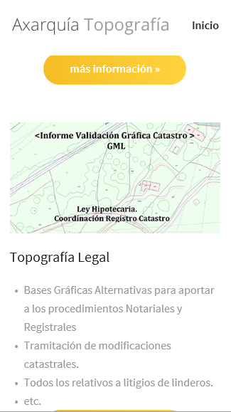
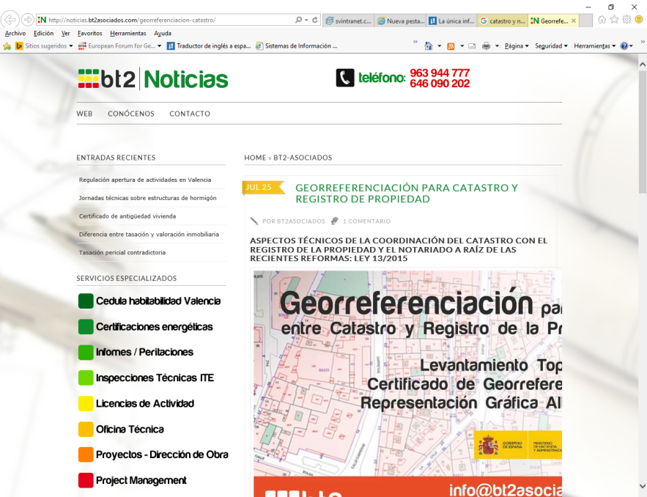
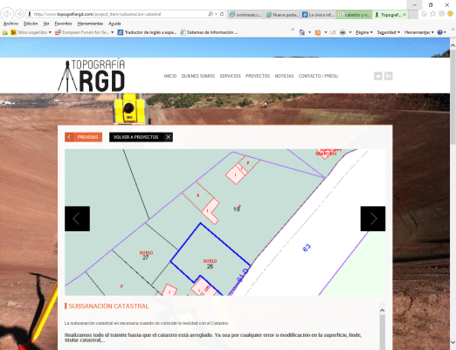
Important: PPP

Slide 23
It is needed to ensure that the new parcels fit in the continuous cadastral index map.
It’s necessary to validate that the perimeters of the new parcels correspond with those of the old parcels to keep the continuity of the map.
Using an interactive service and web service call “Graphical validation report” available in the Electronic Office of Cadastre.

Slide 24
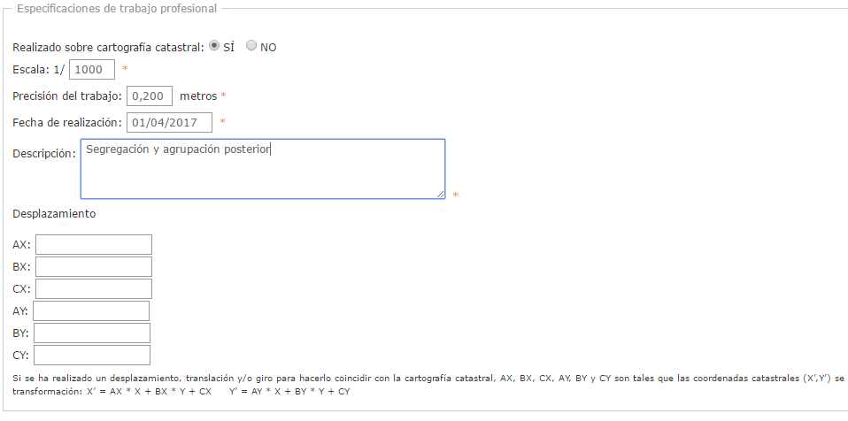
“Graphical validation report”
The Graphical Validation report is obtained from the electronic Office of Cadastre with authentication
Can be obtained by the citizen, or by a technician
If it is obtained by the technical, specification of the professional work will be asked
1

Slide 27
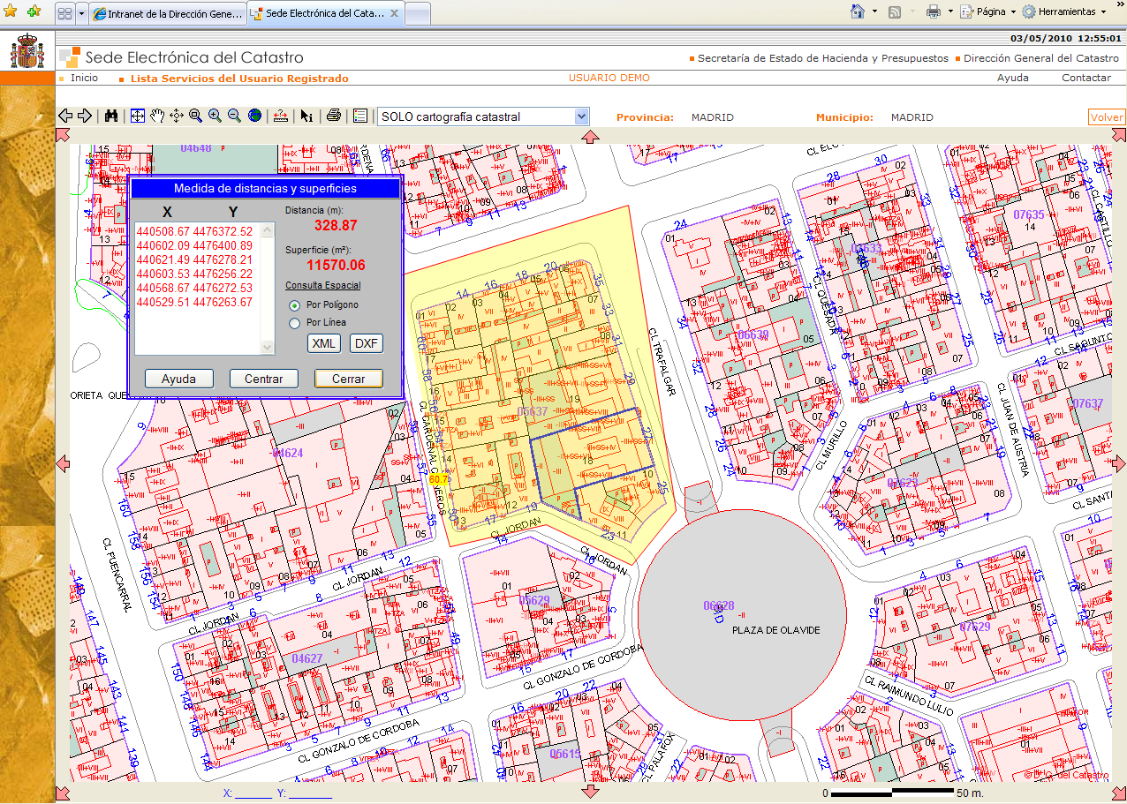

Slide 30
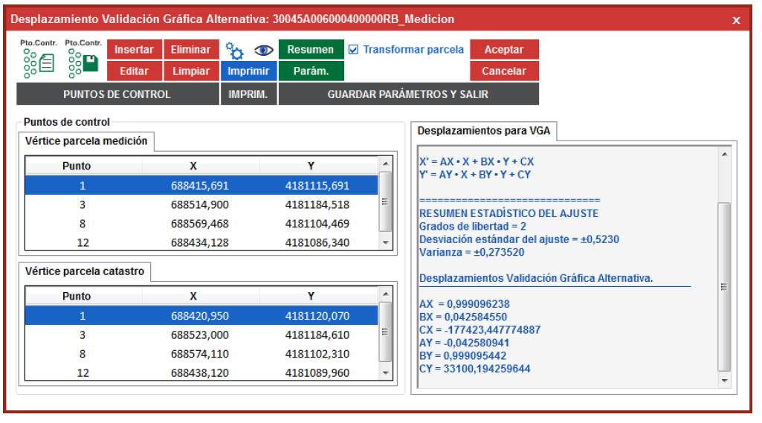
If there are twists or shifts of the cadastral maps, it is necesary to recorder them.
there is software that calculates the best formula of transformation from a set of origing and destination points
1

Slide 32
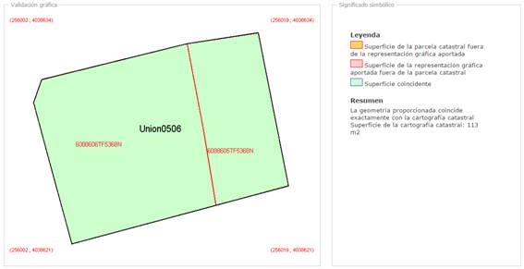
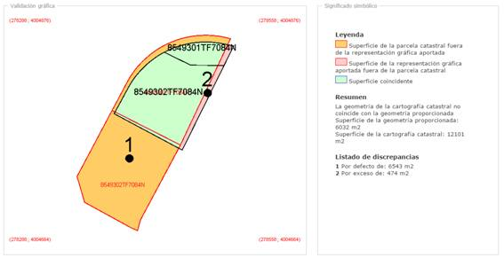
“Graphical validation report”
1
Obligatory to quote to adjacent affected.
Recomended: extend until positive report

Slide 33
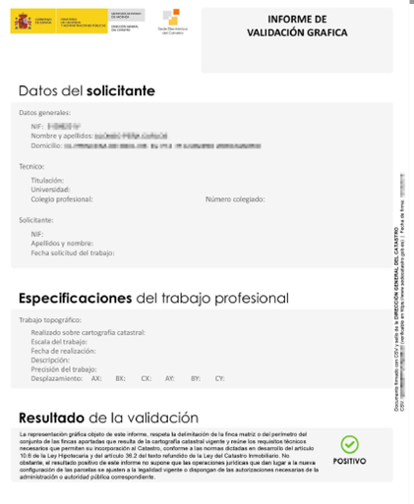
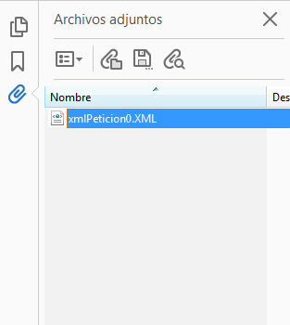
The report is an electronic document signed with the secure verification code.
It has an XML file with all the information.
1

Slide 34
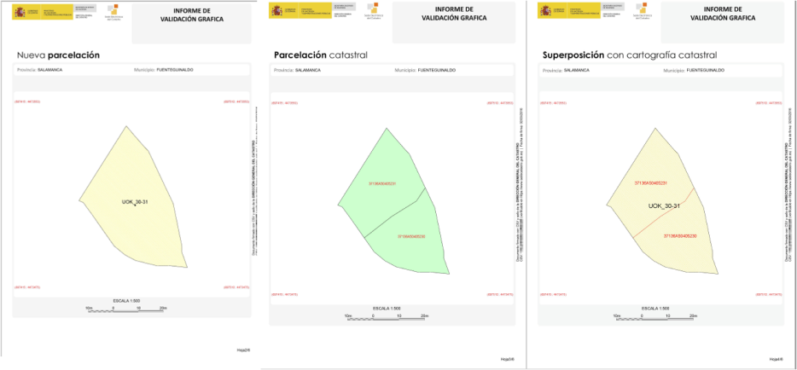

Slide 35
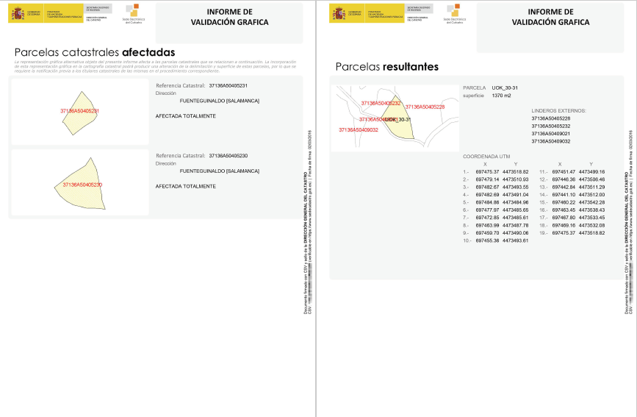

Slide 36
The report avoids physical exchange of files, only de 16 digits are exchange between cadastre and notary
The report shows the new representation and enables the automated capture of its contents preventing transcription errors.
All the exchange of information is made through web services
Notaries don’t need to use GIS. And they can check the content using its CSV code in a service available in the Electronic Office of the Cadastre.
If the validation report is correct, in between 5 days the cadastre send the new cadastral certificate to the Notary

Slide 37
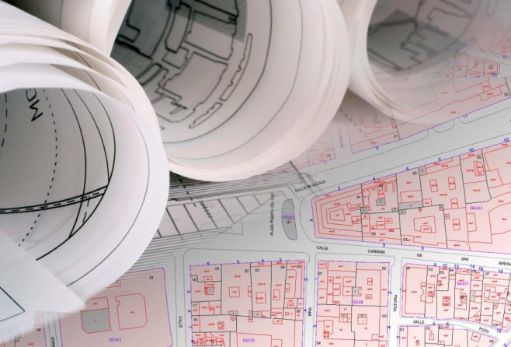
Notaries send to the registrars the deeds with
the new cadastral certificate
Or the graphical validation report of an alternative graphic representation.
The registrar can consider to register the alternative graphic representation because the cadastre is wrong.
The registrar communicates to the cadastre the new representation .
Cadastre corrects the data, incorporates the new representation and send the new cadastral certificate to the registrar

Slide 38
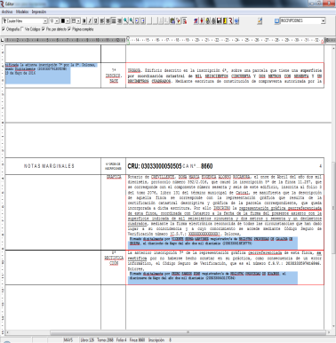
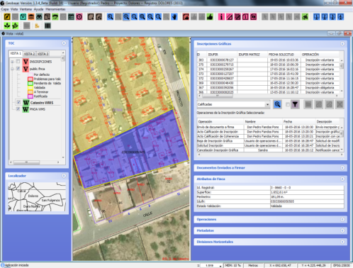
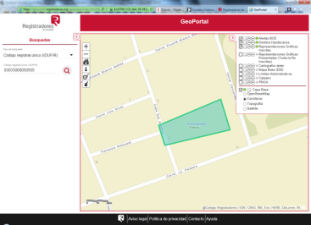
The technical solution developed by the Directorate General of Cadastre allows registrars to link, without the need for specialized GIS tools, the list of coordinates present in the format and its graphic representation.
The coordinates are incorporated to the registration in a paper sheet.

Slide 39
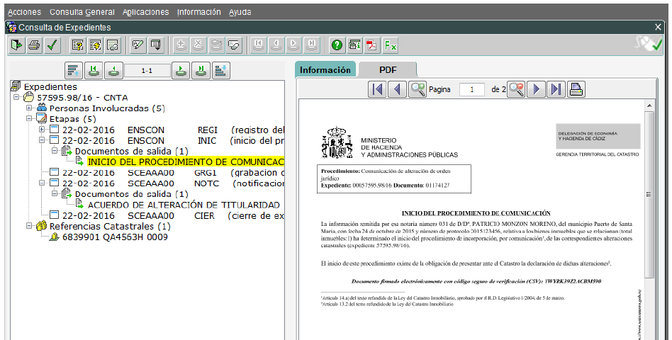
Once the real estate has been registered in the land registry
Automatically, without human supervision in most cases, the information in Cadastre is modified and the documents for the citizens are generated.
Then Notary and registrars have a feedback. Also with the CSV
They can communicate the results to the citizens.
Citizens don’t need to go to the cadastre

Slide 41
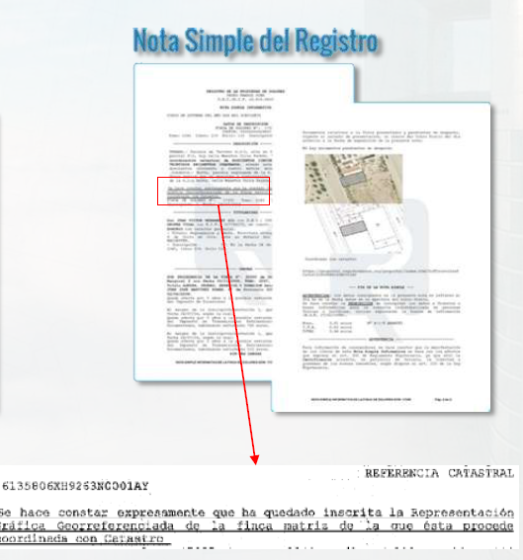

Slide 42
Not only citizens but the public authorities that work in the territory have the duty to communicate to the Cadastre: land consolidations, reparcelling, administrative demarcation, expropriation and acts of urban planning and urban managing
Theses administrations are obliged to provide
an alternative geo-referenced representation
-In GML formt, -Represented on the cadastral cartography, -With technical the validation report by the cadastre
Colaboration with municipalities and other administrations is nedded
More efective
Digital first

Slide 43
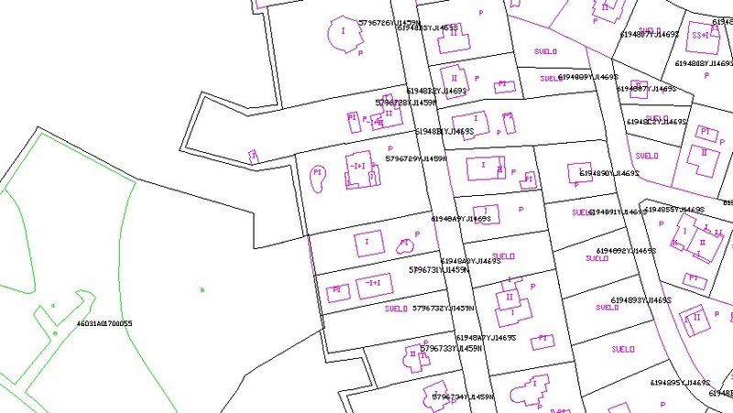
In order to register a building the georreference of its position is also needed
We use then INSPIRE GML BU
The alternative geo-referenced representation is voluntary in several other cases as for example the Georreference of
Crops
Instalations and improvements
Or buildings allready registered

Slide 44
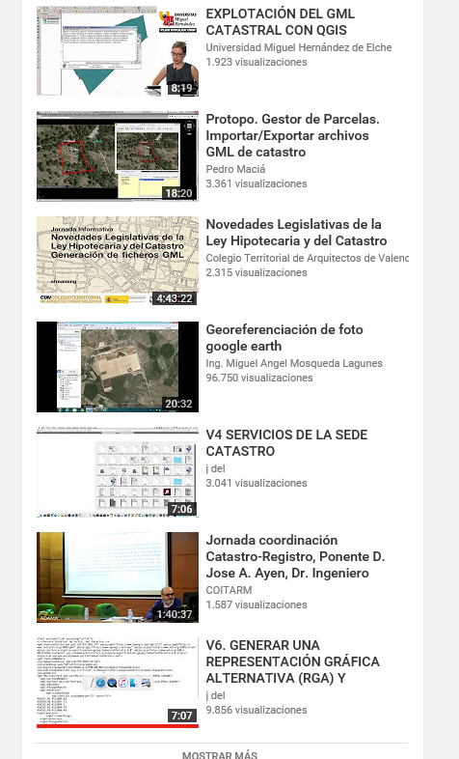
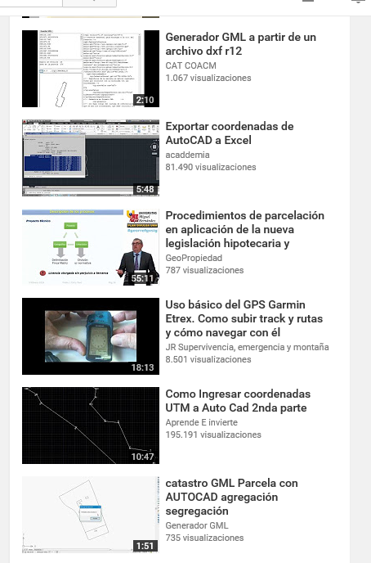
The geo-referencing of the parcels, expressed through the GML INSPIRE format of a cadastral parcel, is now widely used by all agents involved in property transactions in Spain.
44

Slide 45
During 2016 more than seven million certificates and fifty thousand reports were issued.
And this is only the begining because not all the tools where ready and not all the stakeholders prepared

Slide 46
As summary
The key parts of the process are the electronic documents :
-The “Cadastral certification” and
The “Graphic validation report” of a new alternative geo-referenced representation.
Both products can be obtained via web service o interactively by citizens and agents from the Electronic Office of Cadastre.
They include embedded the GML INSPIRE of cadastral parcel and they are signed electronically using a Secure Verification Code (CSV) composed by 16 digits

Slide 47
The Secure Verification Code unequivocally identifies the document in the Documentary catalog of the Directorate General of Cadastre that ensures the authenticity and integrity of its content.
The exchange between the different agents just only needs the 16 digits of these codes.
It avoids the physical exchange of computer files,
allows the visualization of the new representation without GIS tools and enables the automated capture of its contents,
preventing possible transcription errors.

Slide 48
The Smart System of coordination between the Cadastre and the Property Rights Registry is now operational, producing results and involving all agents active in the Real Estate market. The tools, systems and protocols developed by the Directorate General of Cadastre are being widely used.
With the introduction of this system, not only we are making advance in the coordination between Cadastre and Property Rights registry but also we are standardizing the processes within all the actors involved in the real estate sector.
We are enhancing interoperability between them, simplifying administrative procedures and reducing costs,
and increasing legal security, since once the cadastral data have been incorporated and marked as coordinated in the Property Rights Registry, the delimitation, location and area data are considered to be true for all legal purposes.

Slide 49
Many thing to do still. We just have begonen
- Promote the generalization of the use of the sytem to al stakeholders.
- Improve the knoledge beetween the organizations - Monitoring of communications of disparity evidenced in cartography
- Marking of areas which should not be taken as a starting point the cadastral information
- Tratment of the public domain that not cadastred
- Design of joint plans for massive coordination - visualization of coordination internally and externally. Advertising of its effects. - Return of information to the register about the modified subsequent to the coordination.
…………………………………..

Slide 50
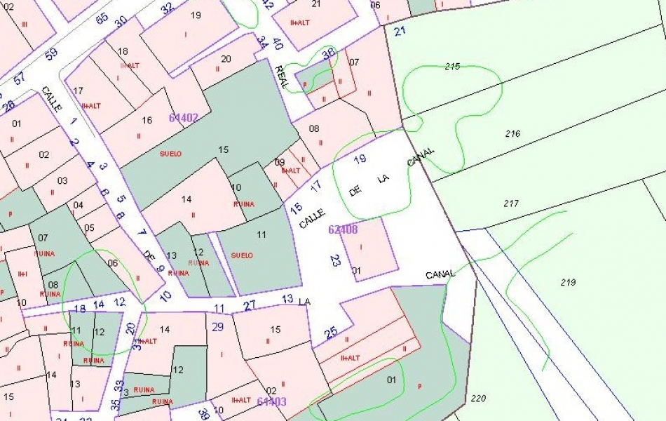
Thanks a lot for your attention

