Slide 2
Unity through Balance
Identity of Estonian Presidency:
Affinity for nature
An innovative digital society
Notes:
The design is based on two narratives ­– affinity for nature and an innovative digitalised society.
These themes introduce the story and essence of Estonians through two very relevant issues: people’s relationship with the natural environment, and the challenges and opportunities that accompany new technologies.
The image of balance aptly reflects our Presidency. Today, more than anything, Europe needs unity ­– in values, ideas and actions. To be able to advance Europe together and take full advantage of all possibilities for development, we must strike a balance between the various opinions, interests and visions of all member states.

Slide 3
Priorities of Estonian Presidency
An open and innovative European economy
Safe and secure Europe
Digital Europe and the free flow of data
Inclusive and sustainable Europe
Notes:
Europe must exploit the benefits of technological progress that is bringing continuous change to citizens, businesses and governments. For this purpose, we will focus on:
developing cross-border e-commerce and e-services for the benefit of consumers, producers and businesses
ensuring modern and secure electronic communications available everywhere across Europe as well as creating a favourable environment for new innovative services
advancing cross-border digital public services to facilitate everyday life.

Slide 4
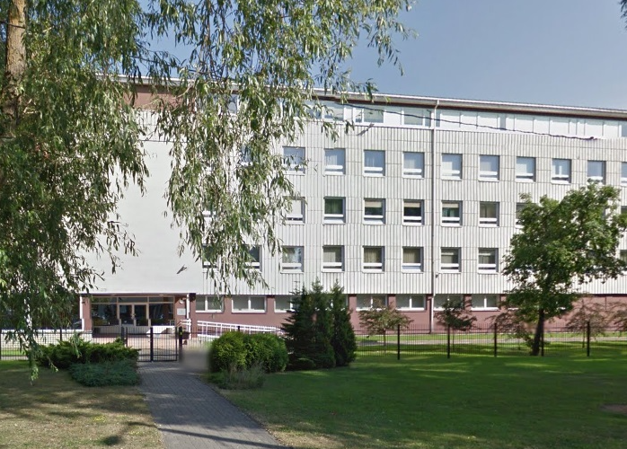
PCC Presidency Estonian Land Board
National centre of competency in land related issues
Biggest producer, manager and distributor of spatial data
Biggest provider of spatial data services
Cadastral registrar

Slide 5
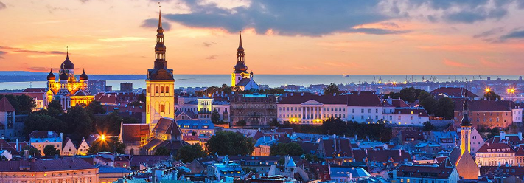
PCC Conference and Plenary
„Towards Digital Europe and Spatially Enabled Societies“

Slide 6
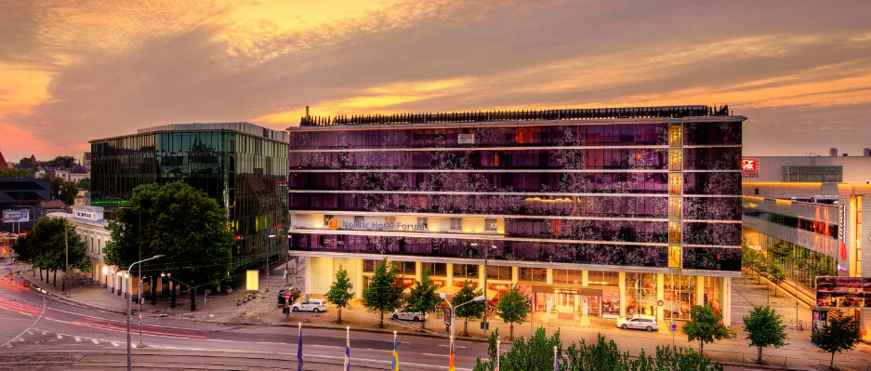
Save the Date: 13-15 November 2017
Venue: Nordic Hotel Forum

Slide 7
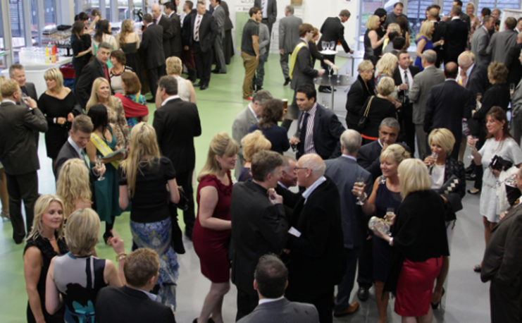
Reasons to come to Tallinn
A perfect place for independent minds to exchange experience.
Here bright ideas meet a can-do spirit
Be part of interesting discussions and social networking

Slide 8
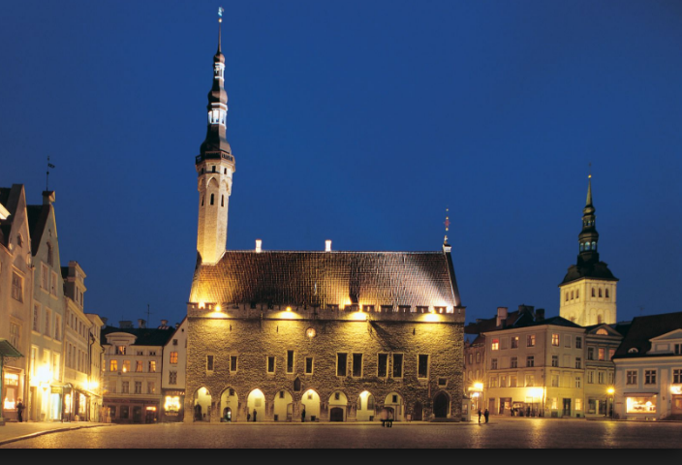
Be charmed by the magic of the Old Town

Slide 9
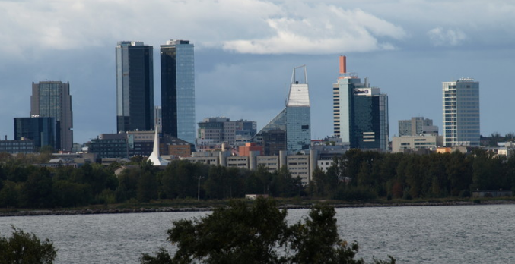
and the youthful glow of the modern city

Slide 10
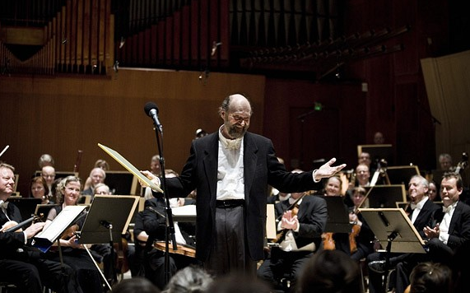
Discover the local cuisine and enjoy the cultural richness

Slide 11
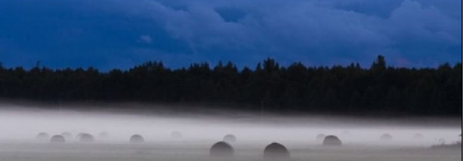
Help us celebrate a hundred years of the
Republic of Estonia
festivities from April 2017 until February 2020

Slide 12
Though the weather in November may be cold and unreliable, the welcome will be warm!

Slide 14
See you in Tallinn!

