Slide 1
Raymond Attard & Omar Hili
Malta Mapping
Past and Future

Slide 2
Maltese Mapping History
The first detailed topographic maps date back to late 19th and early 20th centuries
These were produced by the Works Department
Detail was observed using plane table and ‘chain and offset’
Survey Control was through an extended chain of small triangles
Had a scale of one inch (1”) to the mile
No detail is provided about the projection used
Contains large distortions
Only used today for reference

Slide 3
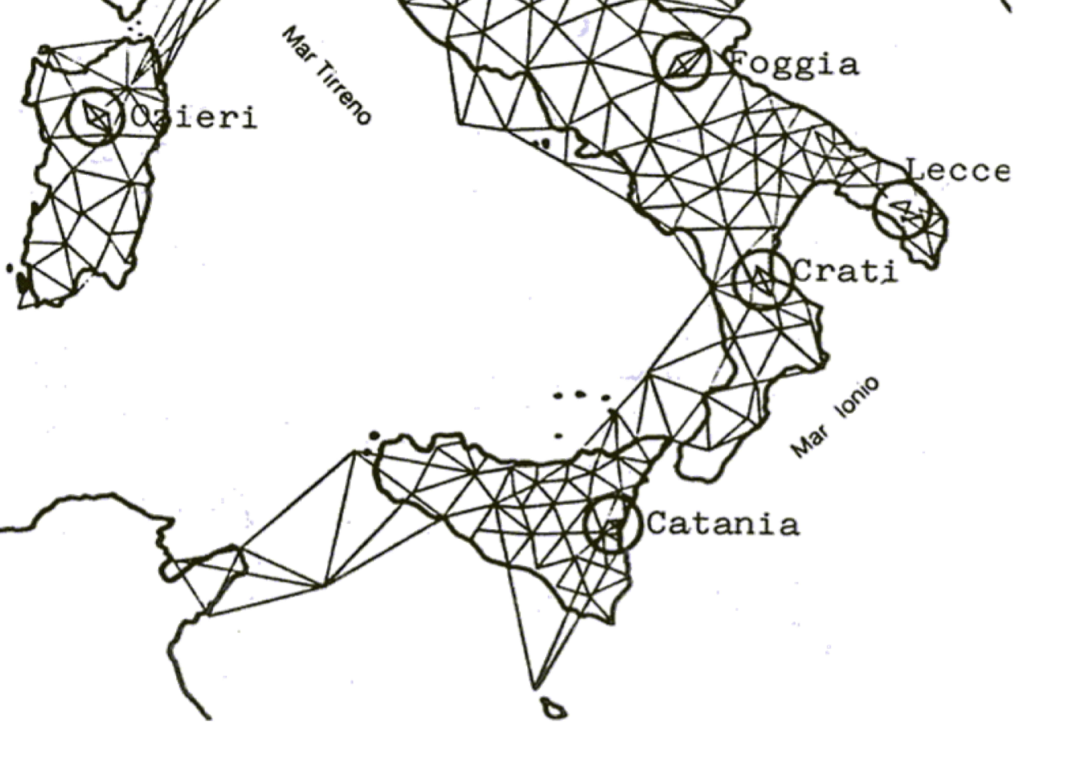
Maltese Mapping History
Early 20th century the Italian Geodetic Network was being re-observed
Included one point on the island of Gozo (1910)
This point, Gordan Lighthouse, still exists today
Malta’s geographical location was determine to a European Network

Slide 4
Maltese Mapping History
Early 1930s a survey team was sent to design, observe and compute the first Geodetic Network
This network was to serve as control for the first aerial survey of Malta
Orientation of the survey was carried out by astronomical observations
The co-ordinates of Gordan Lighthouse were held fixed
For network scale, a precise baseline was measured in Marsa Sports Grounds
Co-ordinates were computed in the Universal Transverse Mercator (UTM) projection
Unfortunately the aerial photographs of this era no longer exist
The complete set of survey sheets still exist

Slide 5
Maltese Mapping History
The oldest aerial photographs date back to 1942
These photographs cover Valletta Harbour Area

Slide 6
Maltese Mapping History
In 1966 a new Geodetic Network was observed
The majority of the 1930 stations were used
The scale of the network was measured electronically
The network was a combination of triangulation and trilateration
The network was adjusted in part by computers
Aerial imagery was captured in 1967
A new and updated set of topographic maps were printed in 1968
The projection used was UTM

Slide 7
Maltese Mapping History
All mapping before 1988 was done by foreign entities
In 1988 the Maltese National Mapping Agency (MNMA) was founded
The Planning Authority (PA) Act 1992
The MNMA became the responsibility of the PA

Slide 8
Maltese Mapping History

Slide 9
The 1988 Basemap
The French Institut Géographique National were tasked to produce the digital basemap
The new basemap was to replace the 1968 survey sheets
Two different scales were to be used
1:1, 000 for urban areas and 1:2,500 for rural areas
A truncated co-ordinate system was to be used (storage space and software)

Slide 10
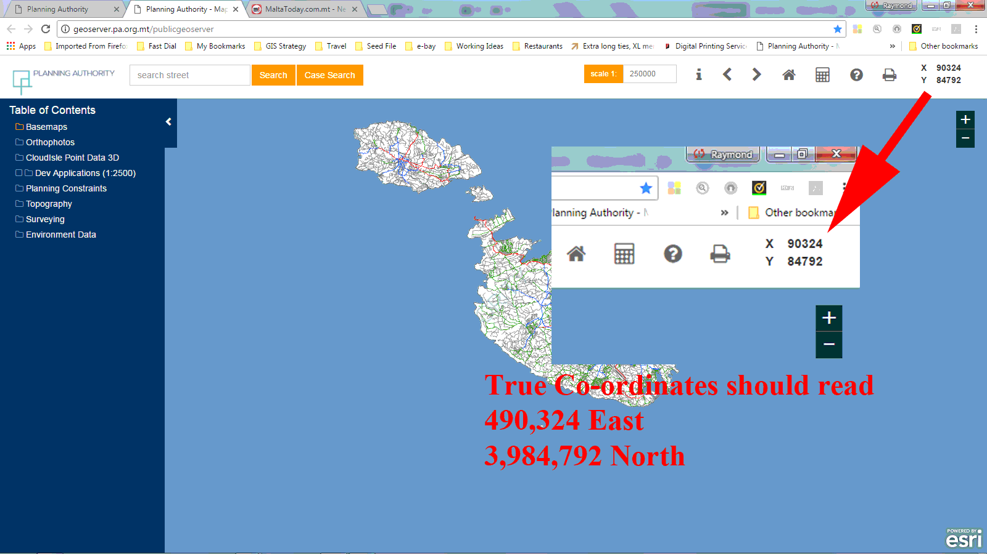
The 1988 Basemap

Slide 11
The 1988 Basemap
The basemap had various issues
Due to the two scales, accuracy of the map was different
Truncation was a major issue in the transformation of co-ordinates
Current software cannot be used to provide on-the-fly transformation
Truncation moved Malta’s true location

Slide 12
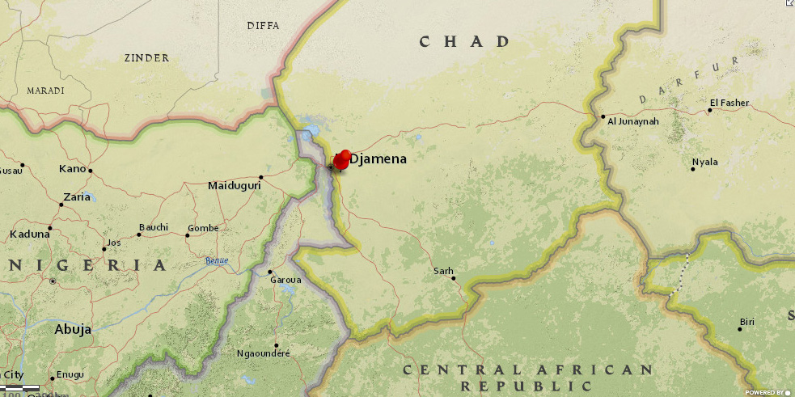
The 1988 Basemap

Slide 13
Map accuracy and projection
Map data is derived from photogrammetric measurements
What is certain about measurements is uncertainty
All maps contain error
Errors due to scale and projection

Slide 14
Map accuracy and projection
A large scale map is more accurate than a small scale map
Rule of thumb – map accuracy is determined by the width of the smallest plottable point, generally 0.2 millimetres, multiplied by the scale
The current base map has two scales
Applying the rule, the accuracy of the map is (0.2x1000) and (0.2x2500) – accuracies are 0.20 and 0.50 metres respectively
The different scales has caused and is still causing problems to some professions, such as Land Surveyors – if in doubt, a larger scale survey (1:500 or higher) is carried out

Slide 15
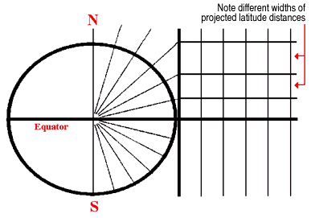
Map accuracy and projection
With paper maps the cartographers challenge was to represent the curved surface of the earth onto a plane
A map projection is a mathematical transformation from a curved surface to a plane

Slide 16
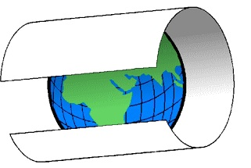
Map accuracy and projection
Malta’s projection is the Universal Transverse Mercator
A cylindrical projection
As with all projections, corrections have to be applied to distances measured on the earth’s surface

Slide 17
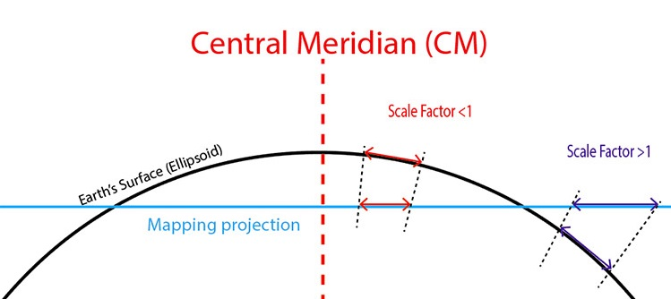
Map accuracy and projection
Scale Factor
Height Factor
Grid Convergence – difference between the convergence of longitudes and the UTM rectangular grid system

Slide 18
The Future
Moving from a paper to paperless
Computer mapping
With computer mapping there is a trend that maps can be produced at any scale and maintain the same accuracy – this made be true for plotting but not accuracy

Slide 19
The Future
Is scale still important today?
Yes and No

