Slide 1
Introduction of Restricted Territories Information System and registration of restricted territories in Cadastre IS in Latvia
Alvis Rudzītis
System Analyst of Division of Restricted Territories
The State Land Service of the Republic of Latvia

Slide 2
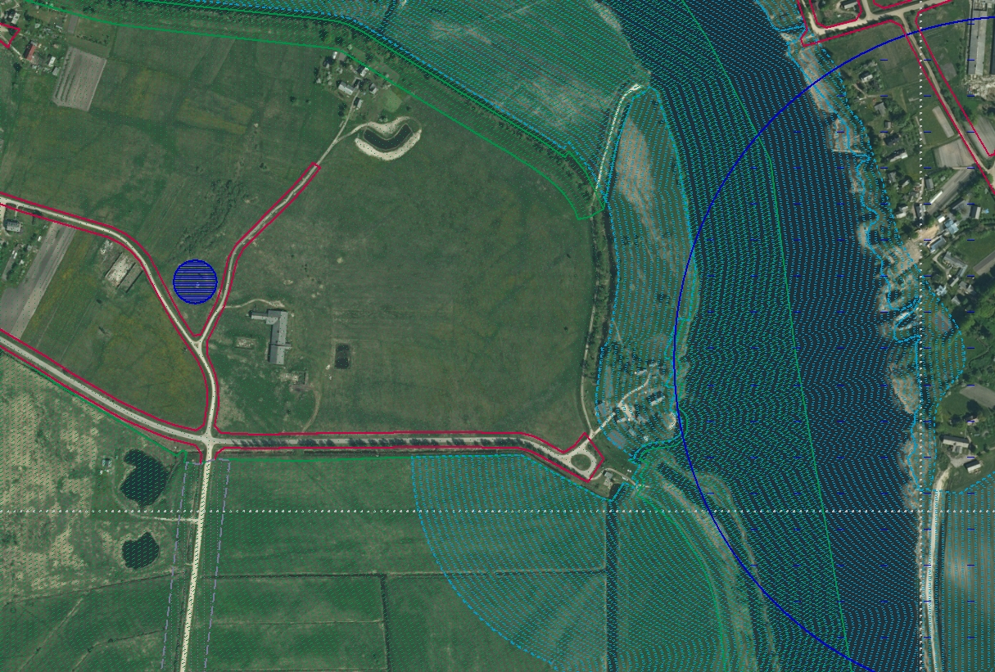
Restricted Territories Information System (RTIS) is State Information System with the goal to provide society with actual and publicly available information in one place about restricted territories and objects which have protection zones.

Slide 3
Data providers (1)
State Forest Service
Environmental and natural resources protection zones
The State Inspection for Heritage Protection
Nature Conservation Agency
Exploitation protection zones
State stock company «Latvian Air Traffic»
Latvian Environment, Geology and Meteorology Centre
Sanitary protection zones
Maritime Administration of Latvia
Security protection zones
Institute of Food Safety, Animal Health and Environment - "BIOR"
State Centre for Defence Military Objects and Procurement
Other protection zones if such are provided by the law
Ministry of Transport
Structure of the State Border Guard
Special areas of conservation
State PLC «Real Properties of Ministry of Agriculture»
Objects
Engineering communications’ network proprietors
119 municipalities

Slide 4
Data providers (2)
SMALL
~ 70% of amount
serves ~ 5 % data
Data is not electronically available or provider have small amount of data
SOLUTION:
Online WEB editing
AVERAGE
~ 25% of amount
serves ~ 30% data
Data is stored in files
SOLUTION:
File transfer using FTP server
LARGE
~ 5% of amount
serves ~65% data
Have their GIS systems
SOLUTION:
Individually adapted Data Transformation models

Slide 5
CHALLENGES and solutions
SMALL
Have to draw data manually when data is changed
SOLUTION:
Trying to change data input from WEB editing to FTP if data amount is growing
AVERAGE
Have to tailor data to fit specification
SOLUTION:
Provide unchanging data structure and try to define data transformation model or use developed RTIS resource file
LARGE
Have to keep data structure unchanged
SOLUTION:
Put effort in making data transformation model once and supply with data automatically

Slide 6
Restricted Territories IS – accumulated data amount so far
On the 1st of May there were approx. 1 million of objects and approx. 1 million of restricted territories included in RTIS
Amount of Data holders: 25
Almost all restricted territories (protection zones) are automatically generated and up-to-date regarding Cadastre and Administrative territories changes

Slide 7
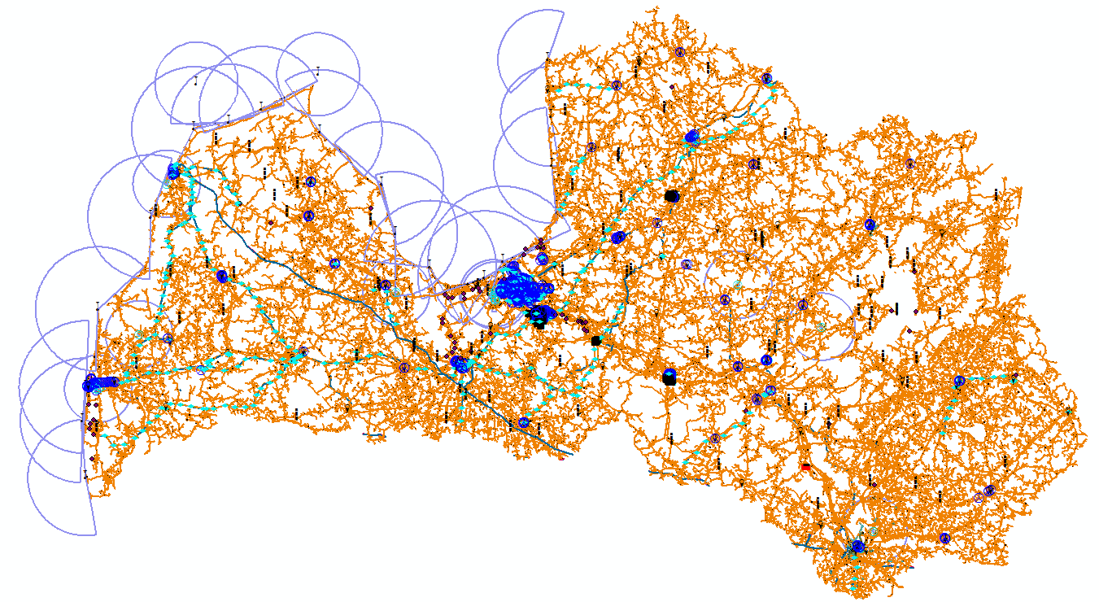
Restricted Territories IS – data in a small scale

Slide 8
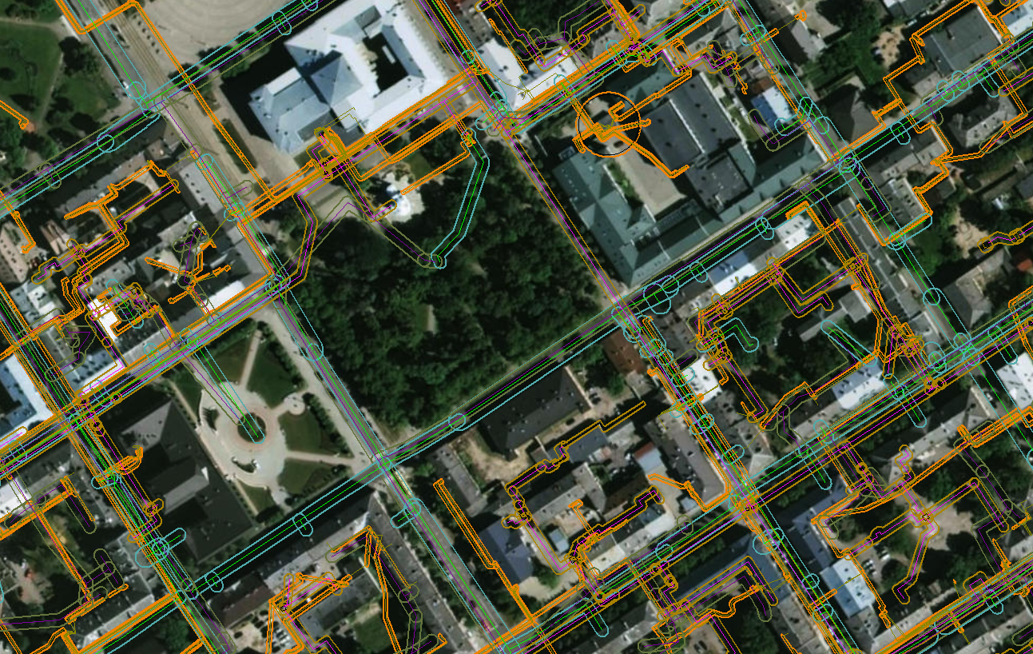
Restricted Territories IS – data in a large scale

Slide 9
Current registration of encumbrances in Cadastre
Sources of protection zones and other encumbered territories
Spatial plan
Cadastre Information System
Creates plans of encumbrances
Collects information
Surveyor
Field works
There are registered all encumbrances from plan in textual data;
There are depicted only road servitudes in spatial data
Land use planning project
Municipality decisions etc.
Detailed plan

Slide 10
Dynamics of encumbrances registration in Cadastre

Slide 11
Legislation now…
…requires that encumbrances will be registered in Cadastre from Restricted territories IS
Legislation
National Real Estate Cadastre Law
Restricted Territories Information System Law
Cabinet of Ministers Regulations Nr.263 «Regulations on the registration of Cadastre items and updating of the Cadastre data» (Encumbrances in Cadastre from Restricted Territories IS from Restricted Territories IS will be launched )
Cabinet of Ministers Regulations Nr.61 «Regulations on Restricted Territories Information System establishment and maintenance and restricted territories and encumbrances classification»

Slide 12
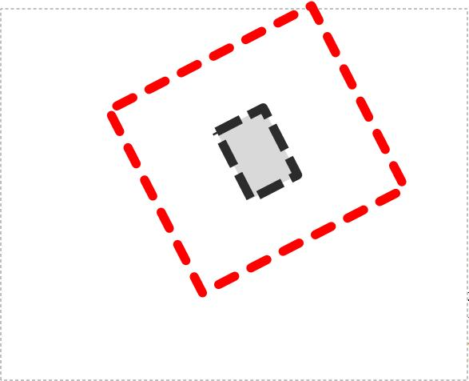
Intersection of Restricted Territories IS data and cadastral map
l.p.
3.
Cadastre
l.p.
1
2.
4.
6.
5.
l.p.
Result after intersection
=
Encumbrance in Cadastre
l.p.
l.p.
RTIS
Restricted territory

Slide 13
Intersection result

Slide 14
Cadastral map after intersection
Land parcel from cadastral map where are depicted encumbrances from intersected data of RTIS.
Land parcel from cadastral map where are shown encumbered and unencumbered areas.

Slide 15
Future vision for frequency of data registration and updating in Cadastre
Mass update with encumbrances from intersection with Restricted Territories IS data twice a year:
1st of May,
1st of December.
If information in Cadastre is changed, also encumbrances from intersection with Restricted Territories IS data is updated.
Since the new registration of encumbrances affect the Cadastral Value of Real Property, it is necessary to change mass valuation model.

Slide 16
Research: number of encumbrances in Cadastre now/after intersection with RTIS
408% more
than now

Slide 17
Future (1)
Data registration process in RTIS was started in the beginning of 2016
From the 1st of January 2018 data publishing will be started with one exception: infrastructure objects should be published from 1st of July 2017
Currently RTIS data registration in Cadastre as encumbrances is in research stage. Process in production is planned to launch in the beginning of 2020

Slide 18
Future (2)
E-services
Data browsing without contract
Read-only spatial data of Restricted Territories IS
Data browsing with contract
a) Download spatial data of Restricted Territories IS
b) Data request for restricted territories
c) Data provider’s objects with restricted territories

Slide 19
Future (3)
Problems
Data with different accuracy submitted.
Restricted Territories IS will be «refilled» gradually.
Society must be informed about changes of cadastral values.
There won’t be data of all restricted territories at the beginning.

Slide 20
Future (4)
Benefits
Data of encumbrances in Cadastre are depicted and up to date.
Society has access to data.
Less inconvenience for data providers. They won’t need to initiate cadastral surveying of land to register up to date encumbrances in Cadastre.
Research shows that the number of encumbrances will significantly increase in Cadastre if Restricted Territories IS will be «full».
Society will have easy access to information about an encumbered territory in his/her property.

Slide 21
Thanks for attention!
ATIS@VZD.GOV.LV

