Slide 1
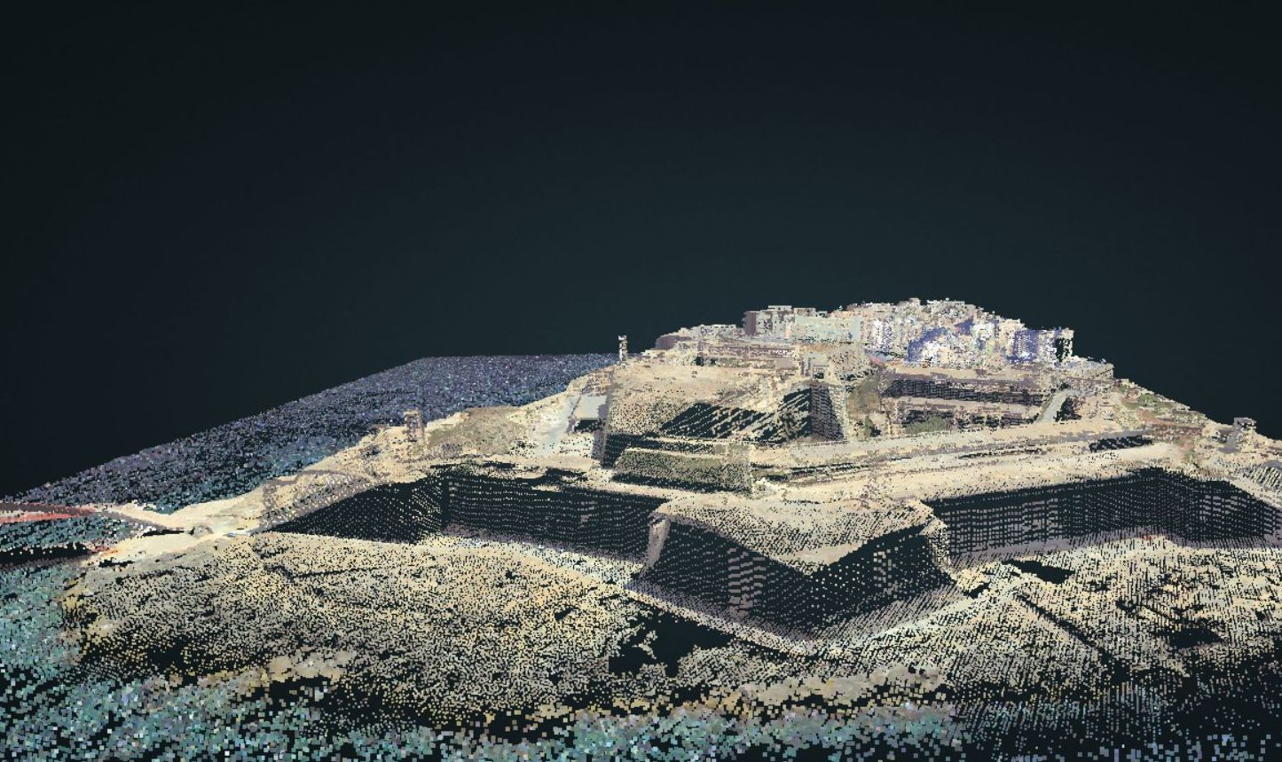
Emergent Realities of Spatial Information Systems
Spatial Conceptualisation as a stepping stone in the transition of
Real-Virtual World Interactionism
The Current Technological Trends in Land Registration Conference
5th May 2017
Prof Saviour Formosa
saviour.formosa@um.edu.mt

Slide 2
Visualisation
Found it?

Slide 3
Visualisation
Better?

Slide 4

Visualisation
Vase or Faces?

Slide 5
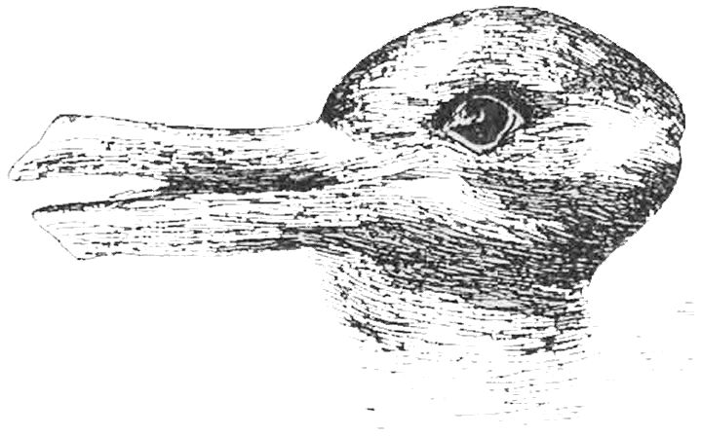
Visualisation
Duck or Rabbit?

Slide 6

Visualisation
My Wife
My Mother in Law

Slide 7

Visualisation
The Rorschach Inkblot Diagnostic

Slide 8
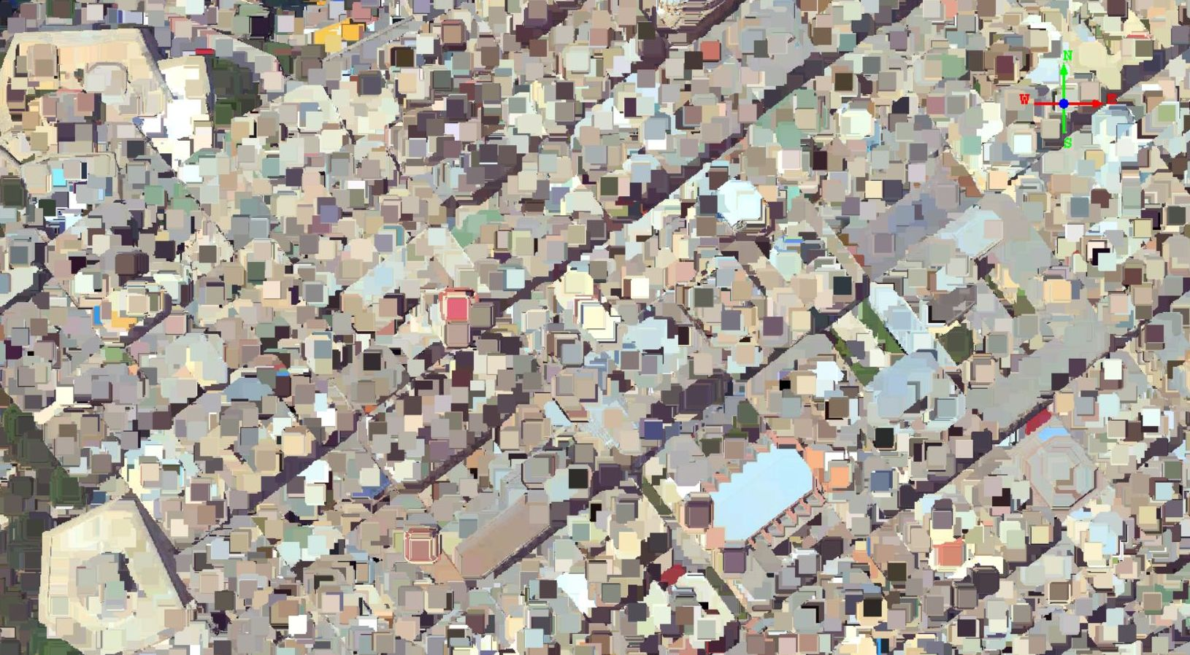
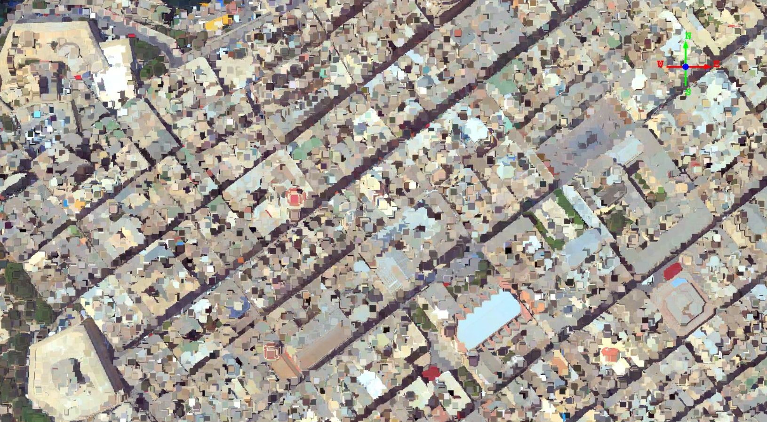
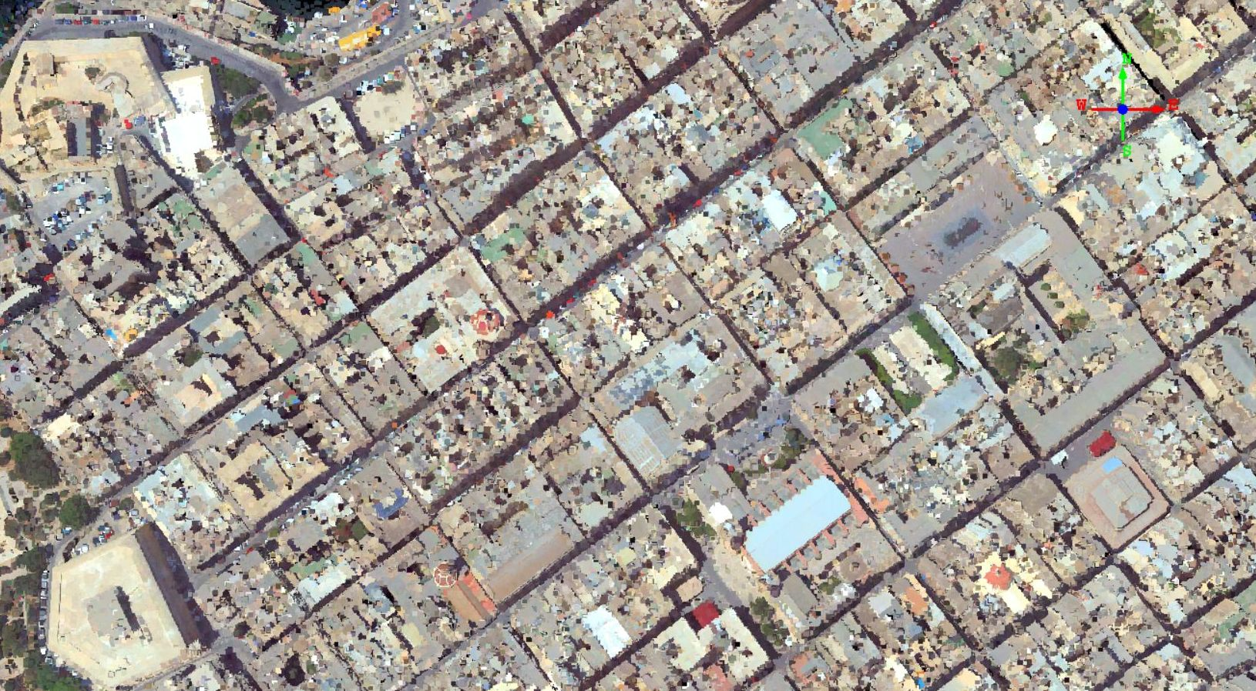
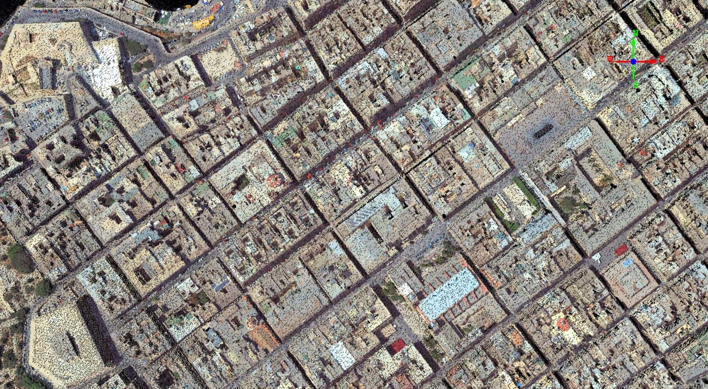
Visualisation
Maps – Easy No?

Slide 9
Visualisation
Maps – Easy No?

Slide 10

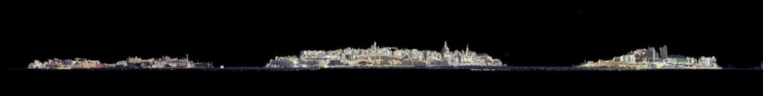

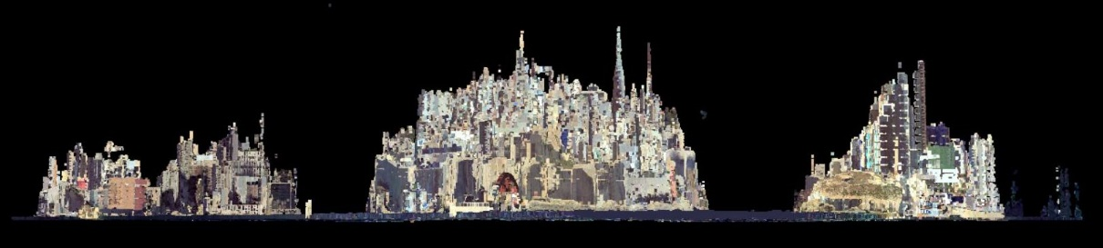
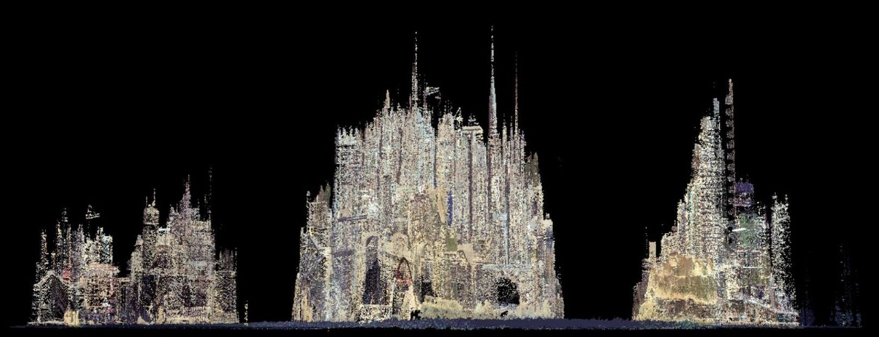
Visualization - Visualisation
Z
S
Imagine the Valletta Grand Harbour Vista

Slide 11
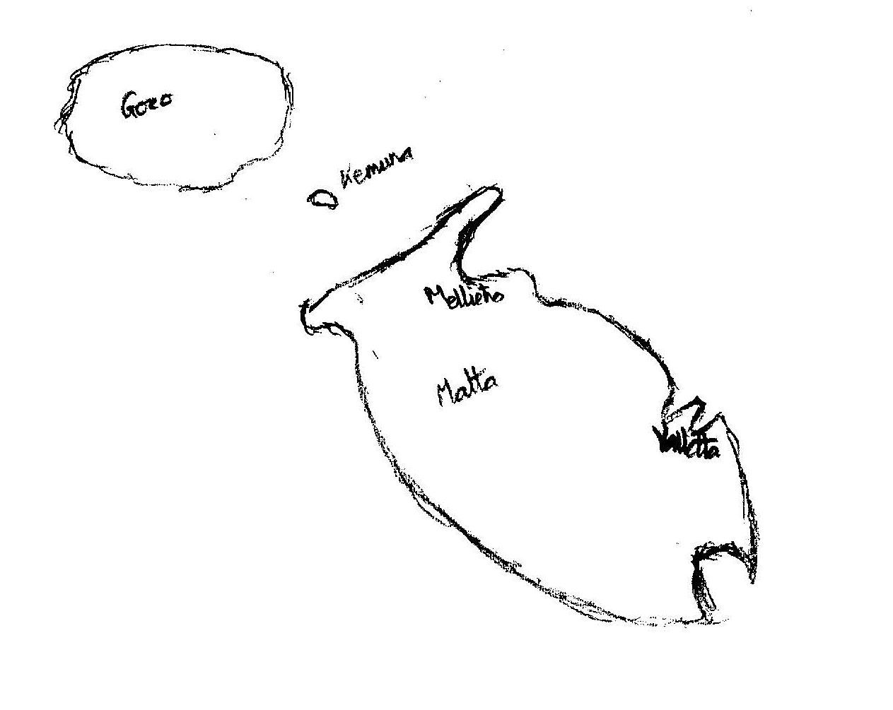
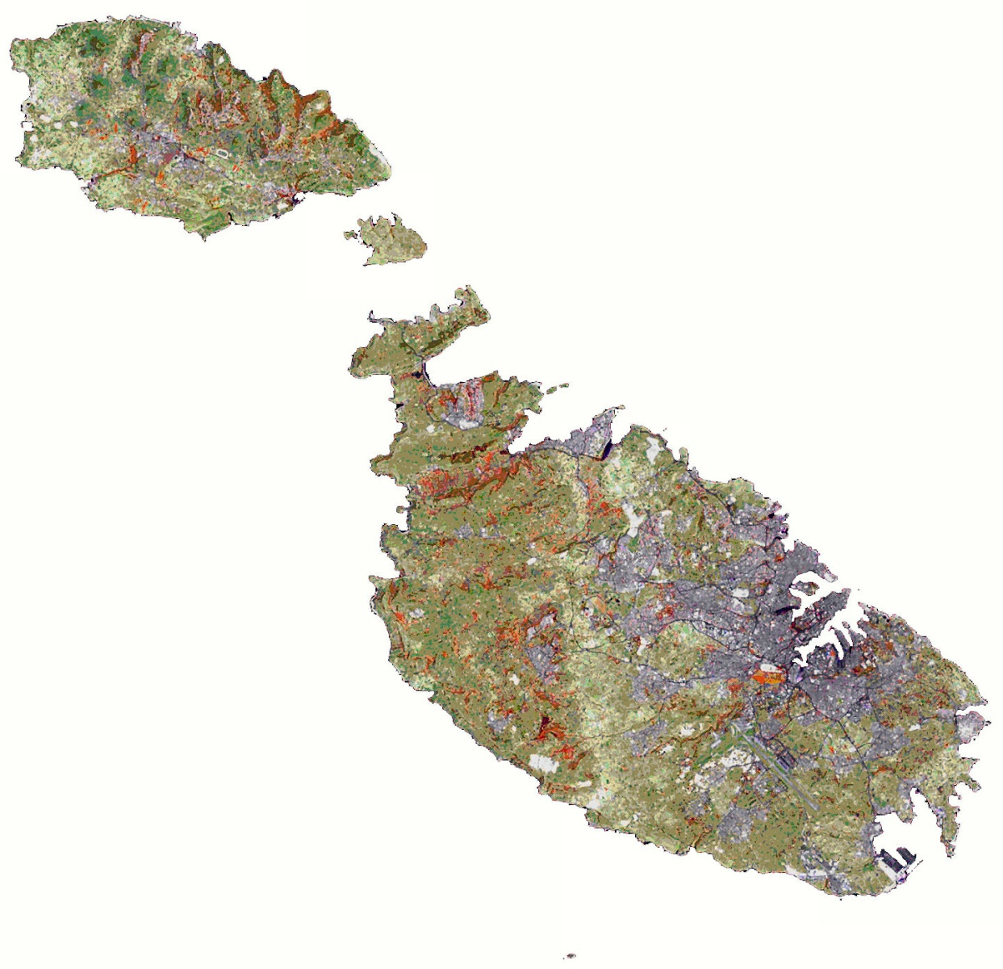
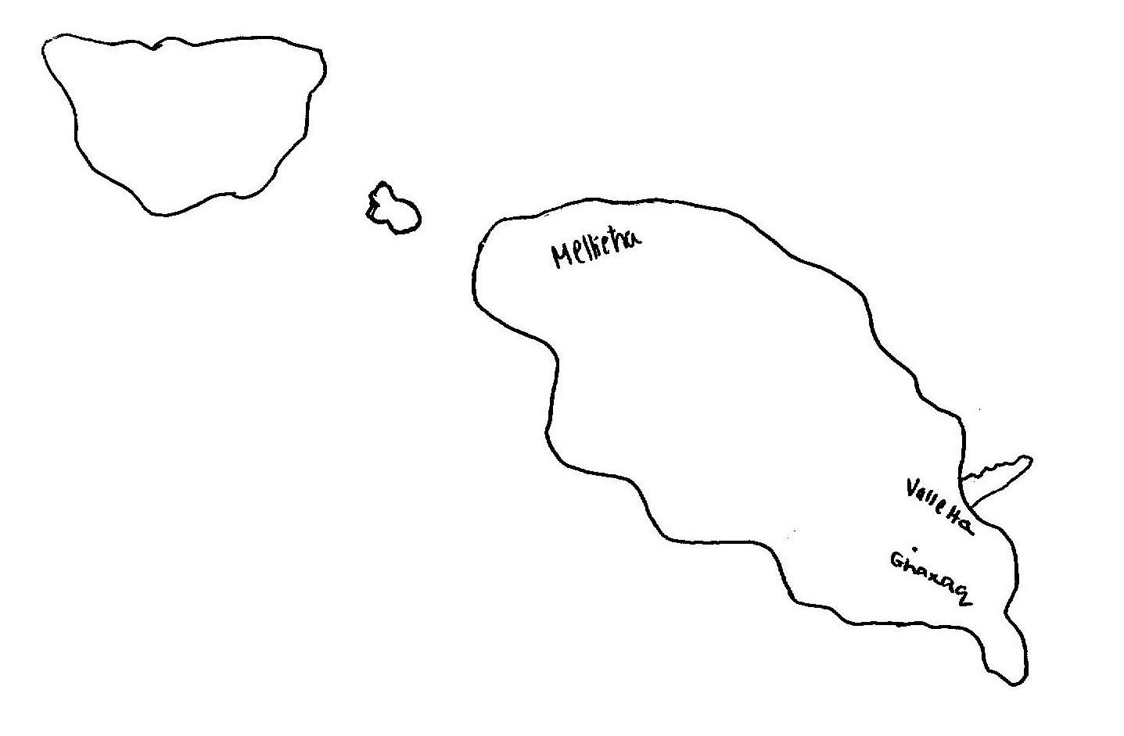
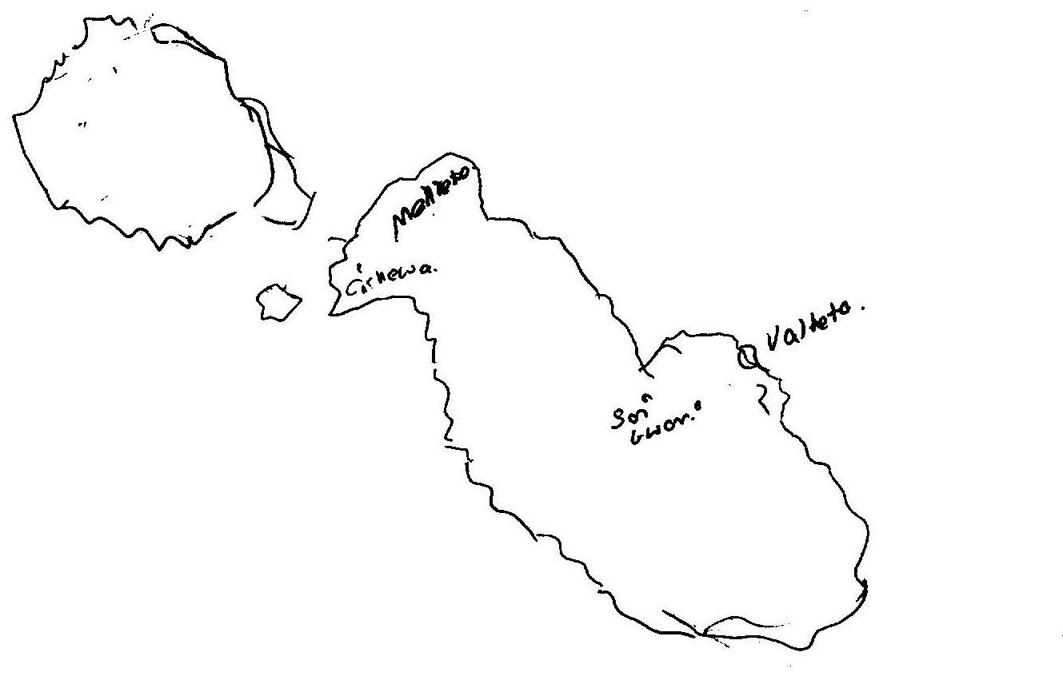
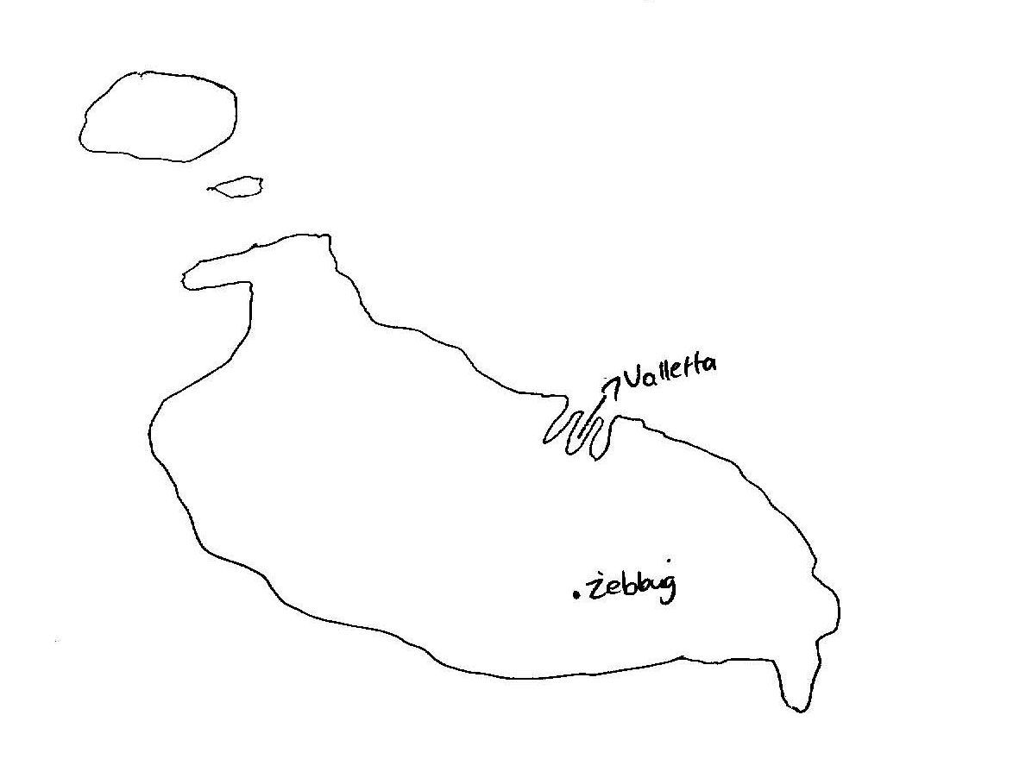
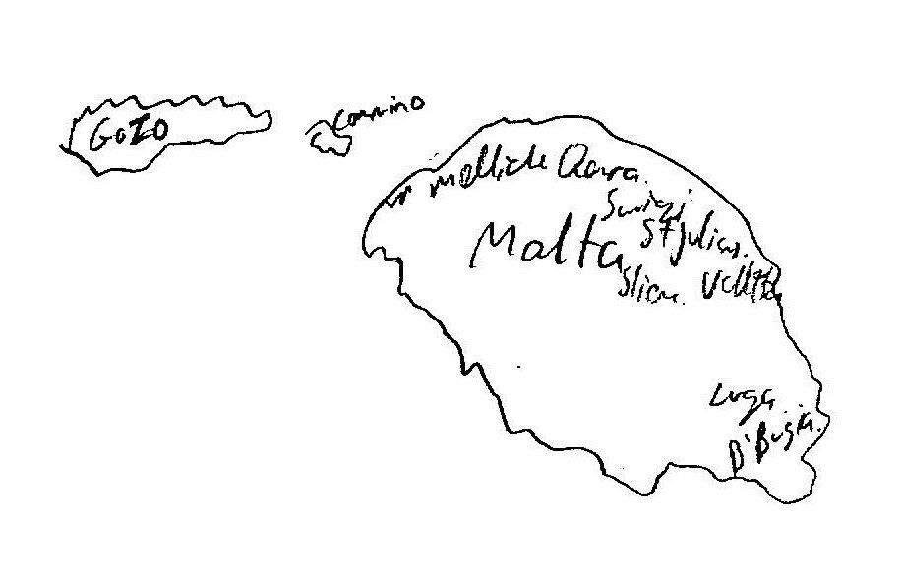
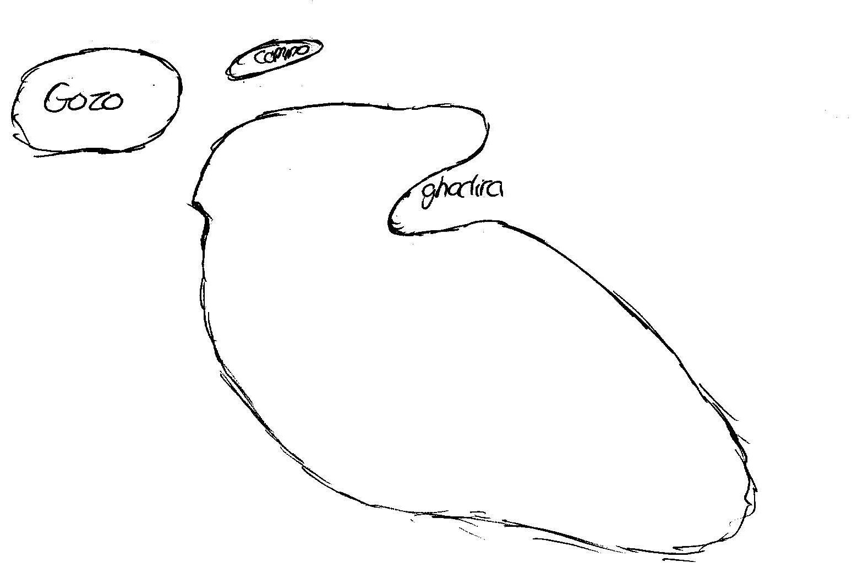
Visualisation – Sample Group
Imagine the Maltese Islands and locate Valletta

Slide 12
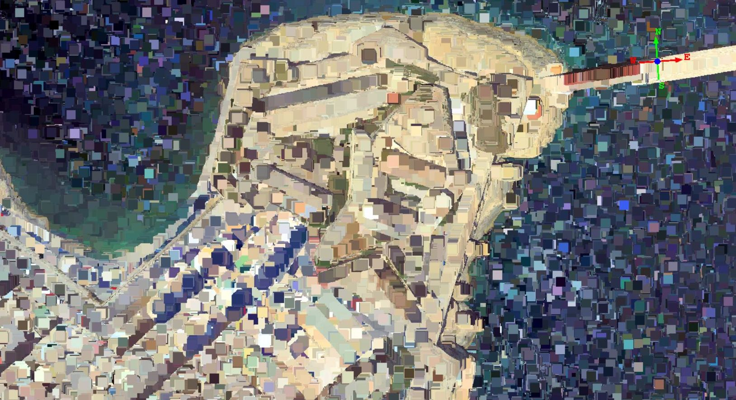
Setting the baselines for a virtual world

Slide 13
Is there a need to convert the Real to Virtual?
Who might use this information? Who are the players – end-users?
What does the process entail? What ‘outside of the box’ options are there?
Where can it be deployed? (economies of scale)
Why should visualization be brought in?
When would it be best to introduce spatial information?
How can we employ visualisation for social change?
Why Not?
W6H

Slide 14
The Situation and the Thematic Reality
A data dearth: most data is in analogue format
Access and limitations/moratoria spread across the different entities
Cleaning the data where available is done manually
Spatial issues:
  Projections and conversions of whole state has proven a ‘nightmare’ (EEA shift)
  Geocoding is based on street centre points which does not allow for real locational analysis
  Streets are non-networked
  Address point database does not exist…
However, major steps have been made to create an NSDI based on the requirements from the INSPIRE Directive, together with a pivot from the CLC activities, the Aarhus Convention and other data-related legislation such as that required for reporting to the EEA (European Environment Agency).

Slide 15
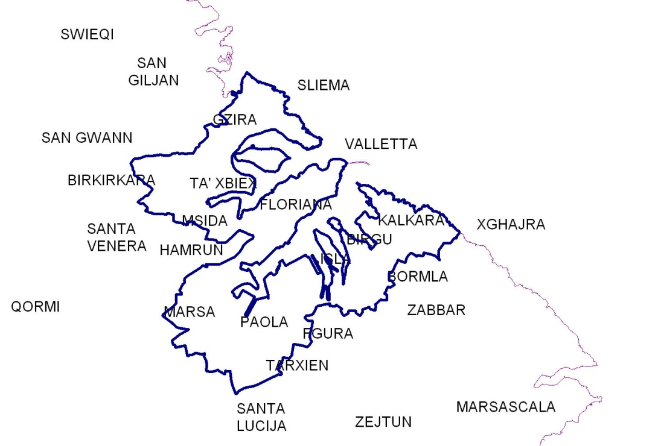

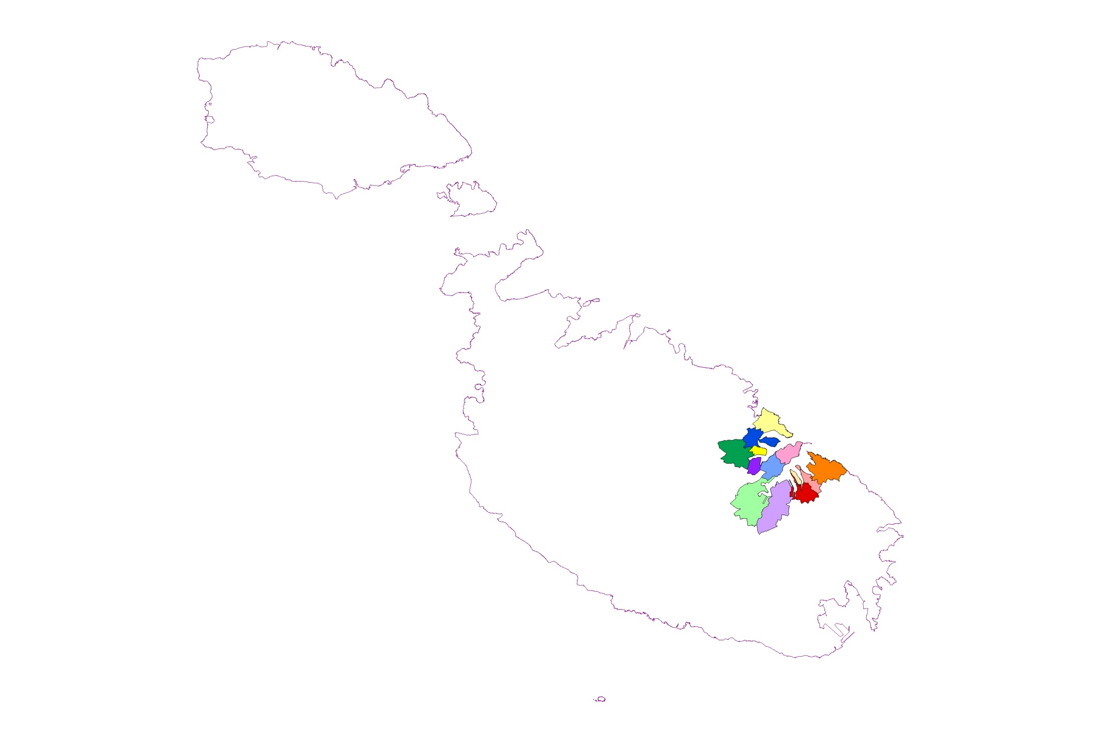
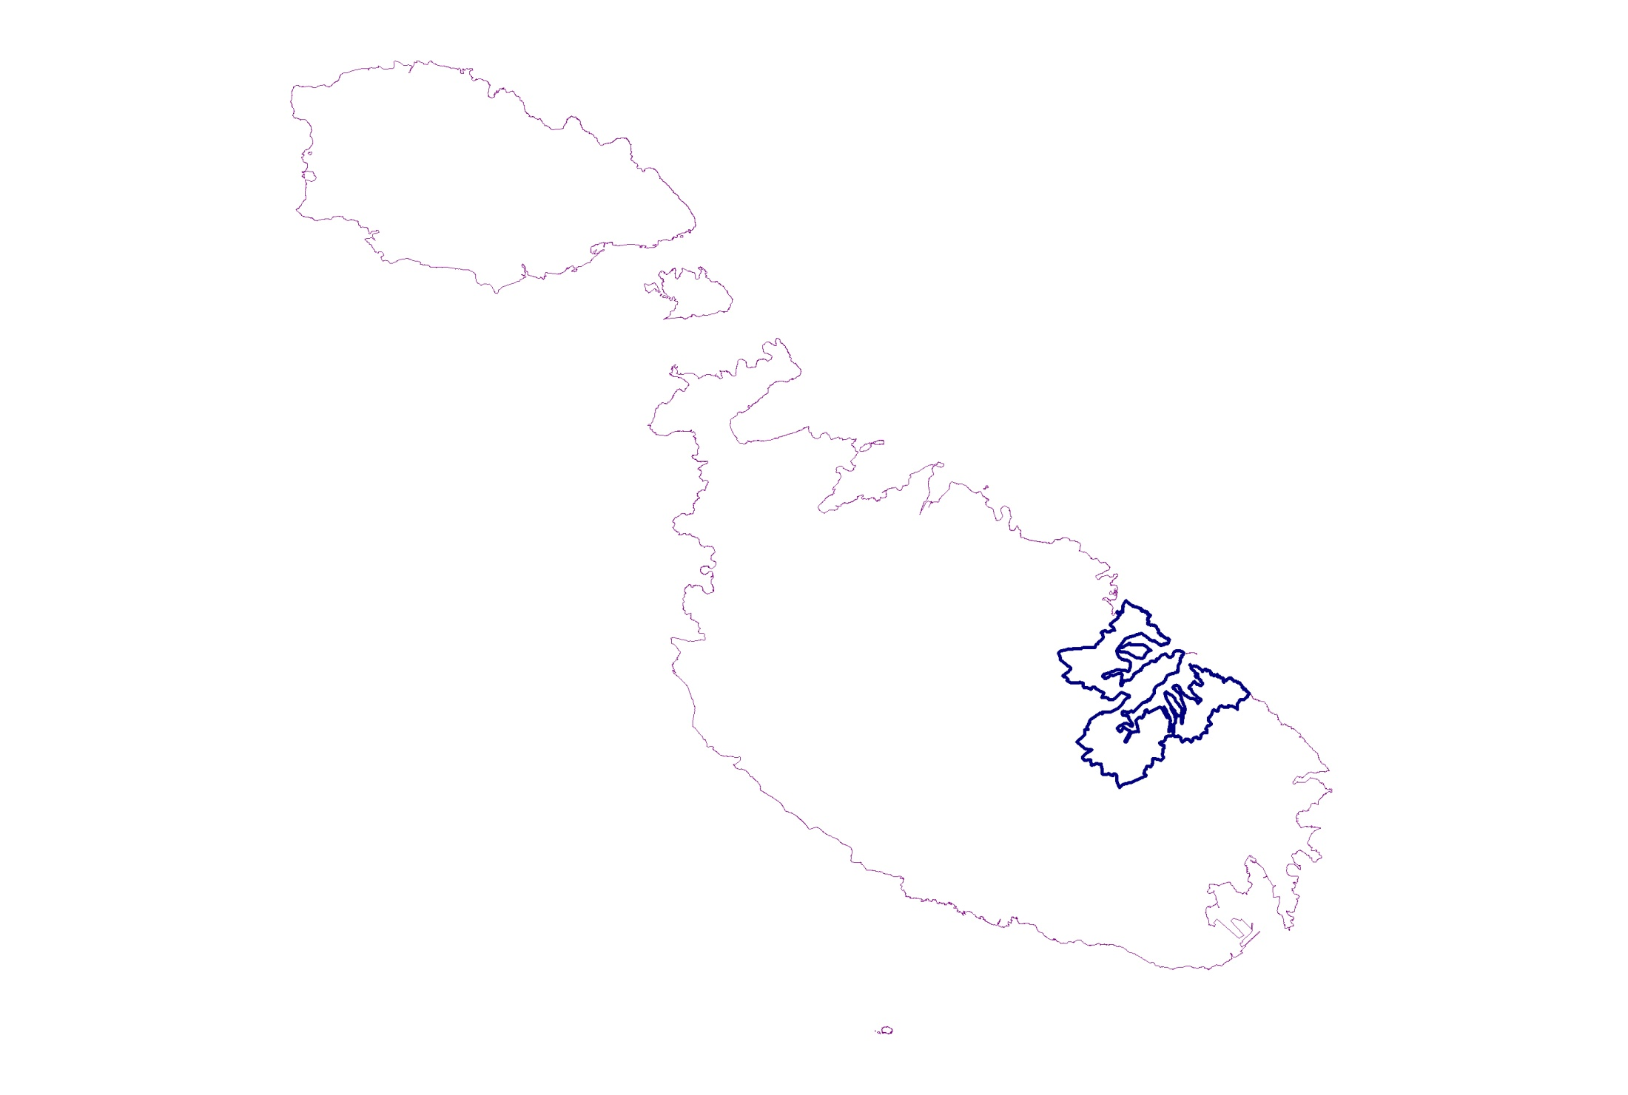
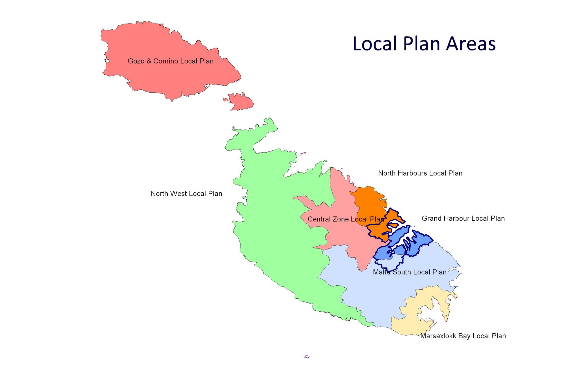
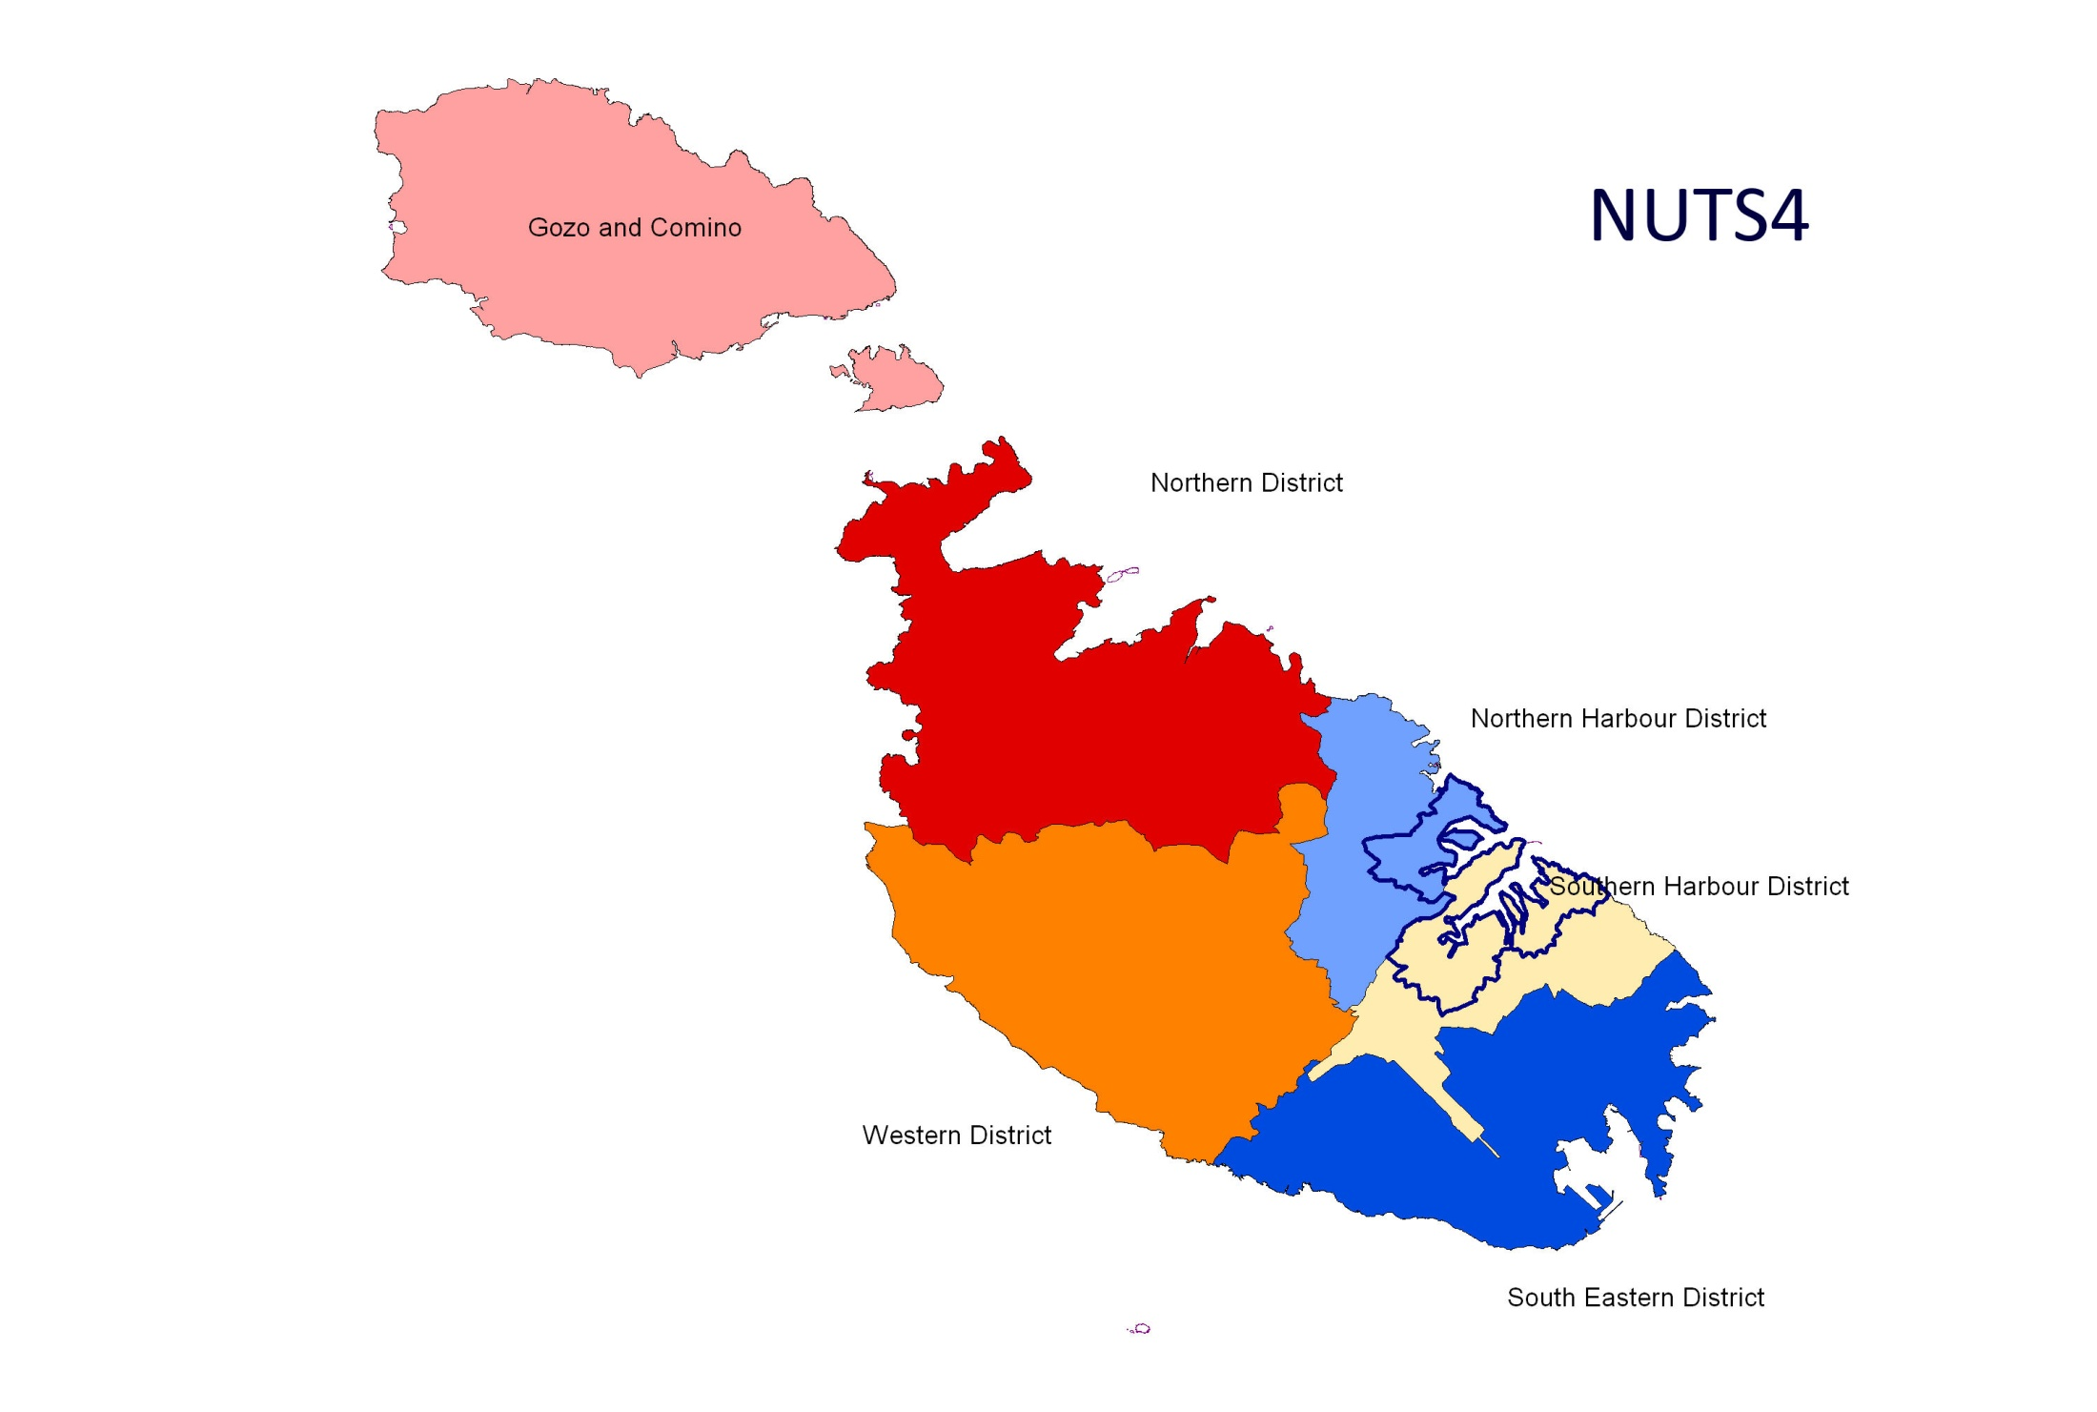
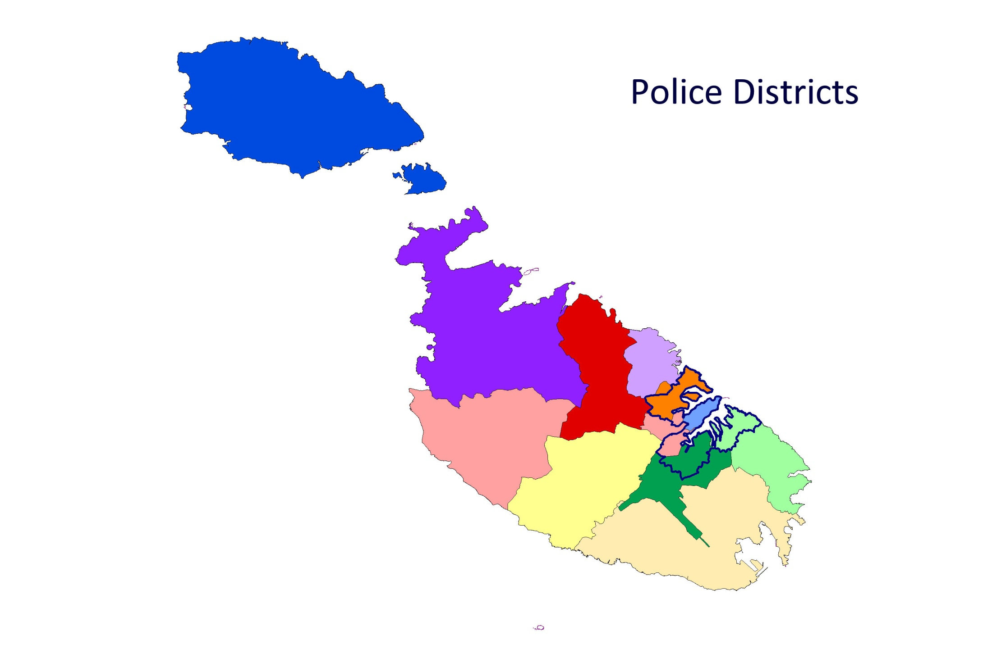
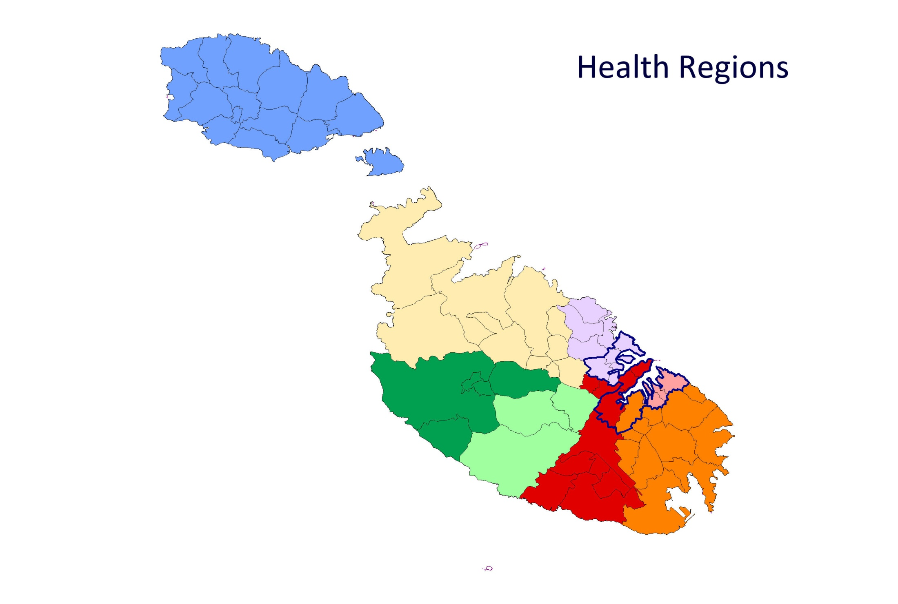
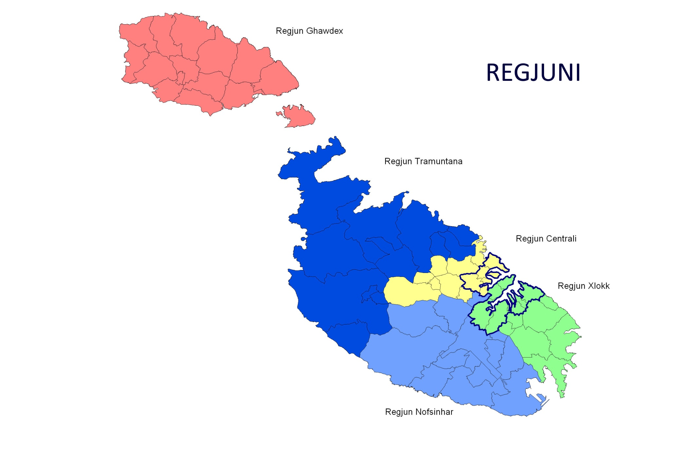
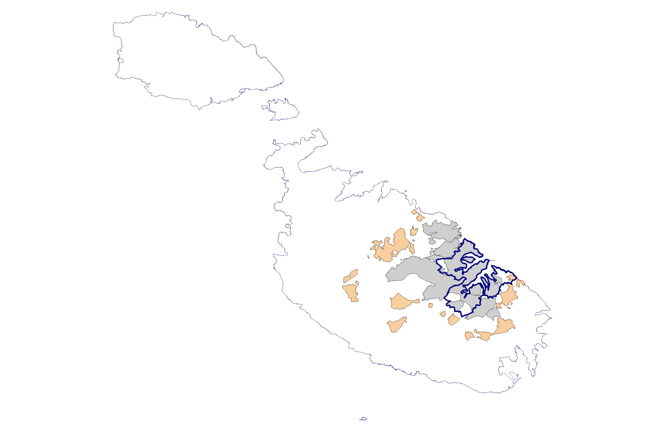
Overlaying Nightmare? Entities not Congruent

Slide 16


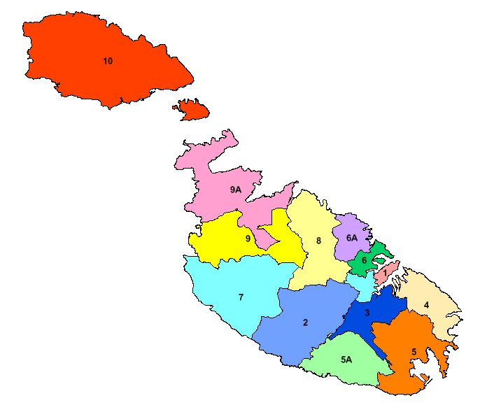


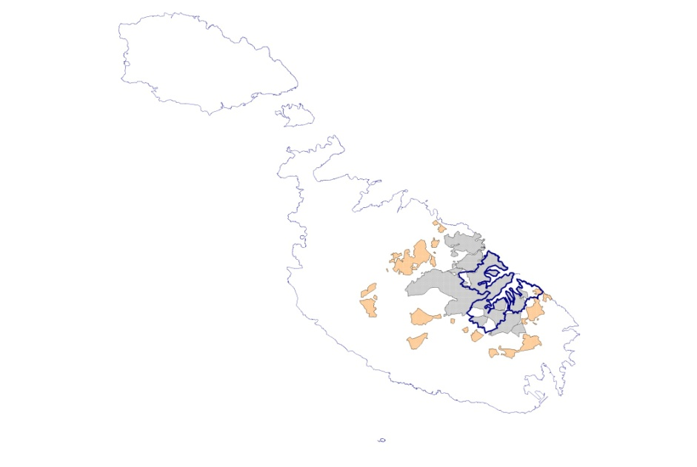
Overlaying Nightmare? Entities not Congruent
Police Districts

Slide 17
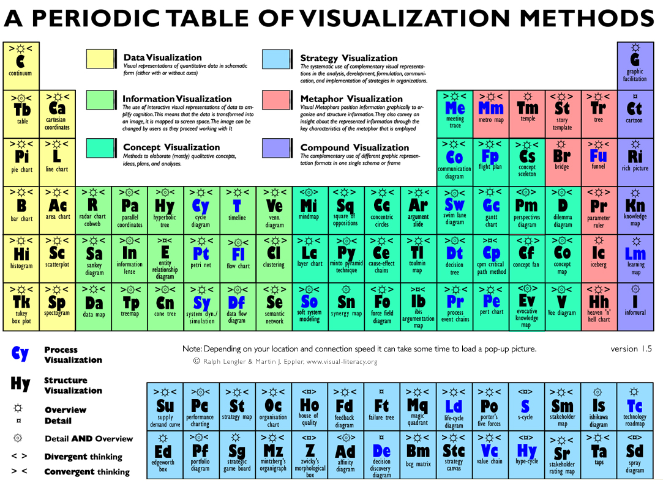
Available Tools
http://www.visual-literacy.org/index.html

Slide 18
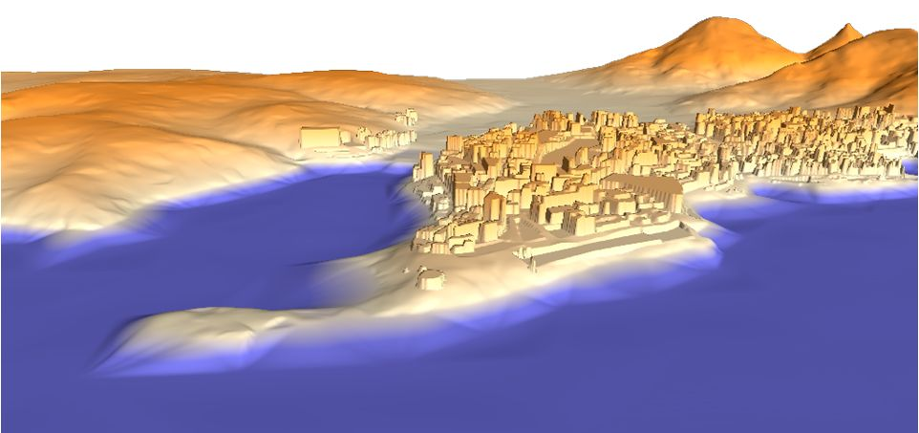
Limitations
However we cannot visualize the effects of new development in 3D solely using professional tools:
- neither in interactive mode
- nor for behavioral analysis
- nor for predictive analysis
Thus integrative data within
gaming might be explored
as a solution

Slide 19
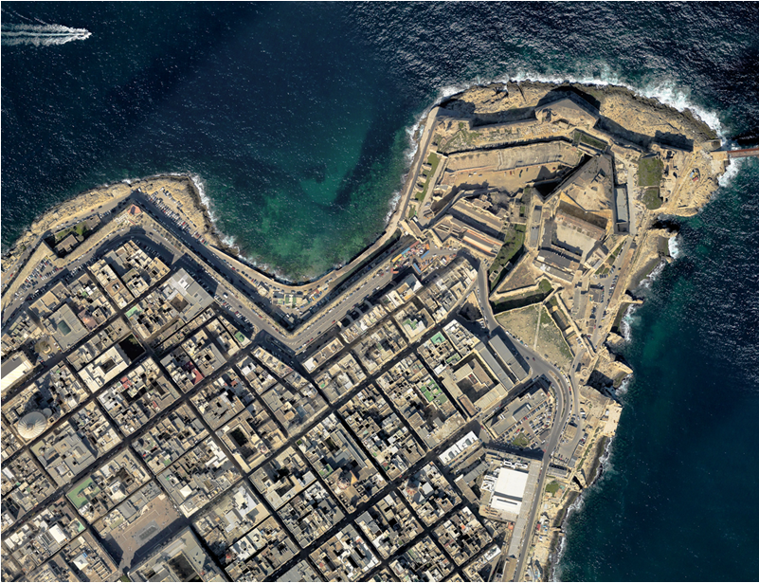
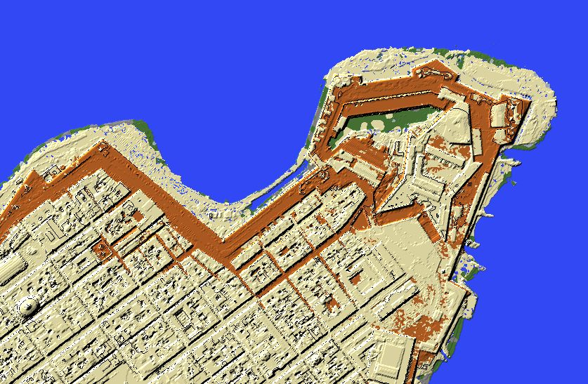
Visualising the Real before acquiring the Virtual

Slide 20
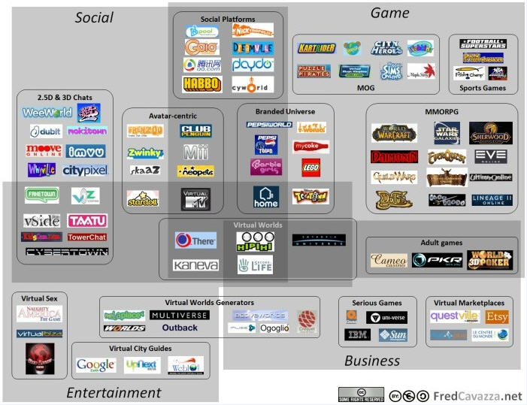

Slide 21

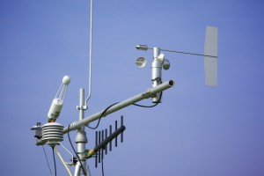

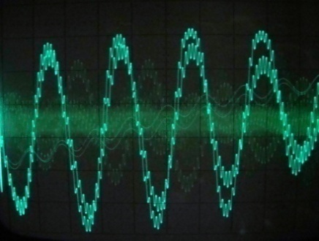

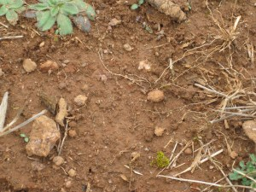


ERDF 156:
Developing National Environmental Monitoring Infrastructure and Capacity
Operational Programme I – Cohesion Policy 2007-2013
Investing in Competitiveness for a Better Quality of Life
Project part-financed by the European Union
European Regional Development Fund (ERDF)
Co-financing rate: 85% EU funds; 15% National Funds
Investing in your future

Slide 22
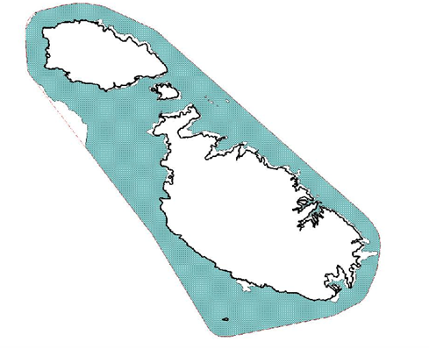
Information Resources
Deliveries included a terrestrial LIDAR Scan (Topographic Light Detection and Ranging (LiDAR)) which resulted in a baseline map for the Maltese Islands infrastructure and landcover/landuse analysis which is required for the monitoring of structures that impact on noise levels, enforcement issues, resource monitoring and risk prediction, amongst others.
Bathymetric LIDAR aerial survey for depths of 0 m to 15m within 1 nautical mile from the Maltese coastline and a ship-based bathymetric scan employing acoustic side scan sonar which will enable the creation of new nautical charts as well as bathymetric outputs that will help in marine spatial planning.

Slide 23
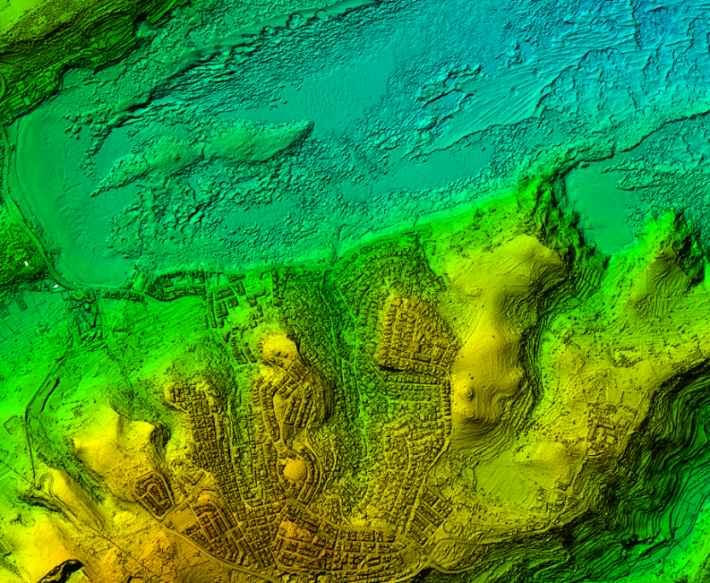
Integrated Information

Slide 24
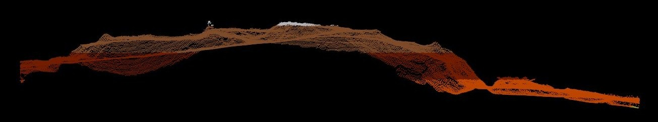
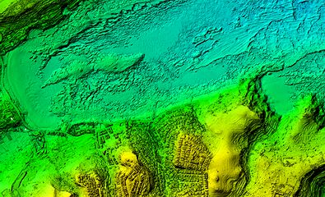
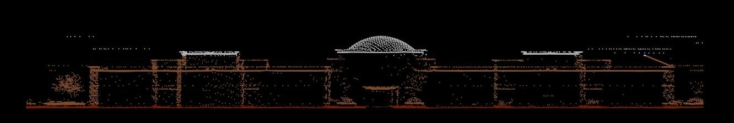
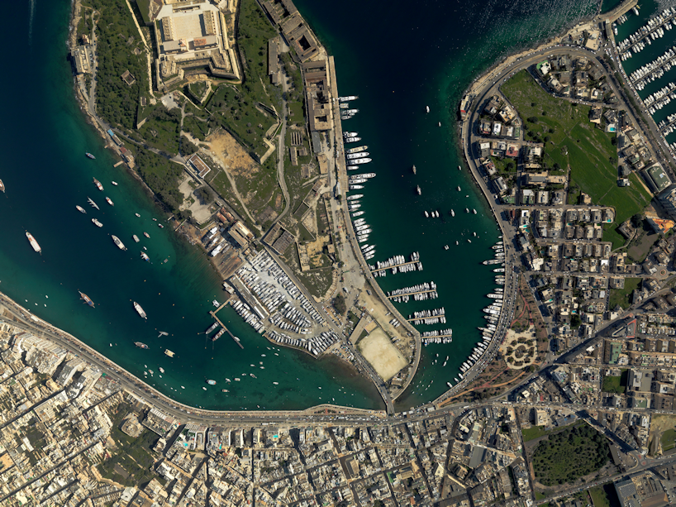
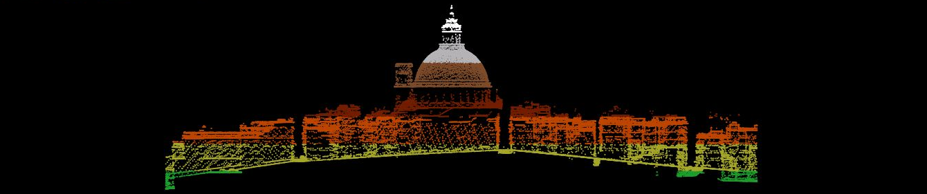

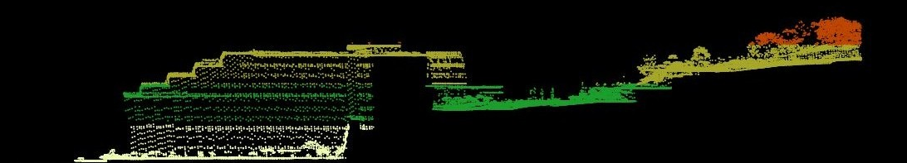
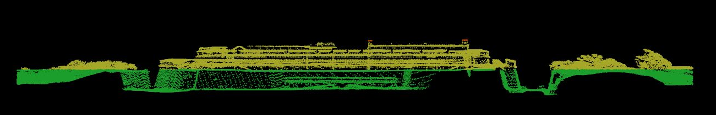
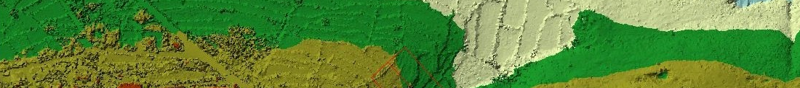
Integrative steps

Slide 25
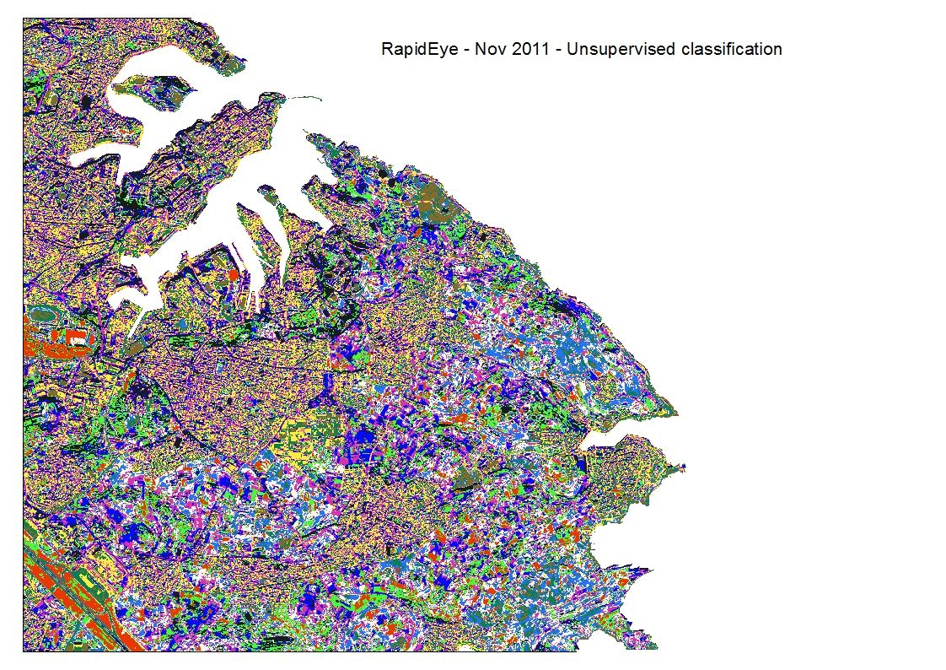
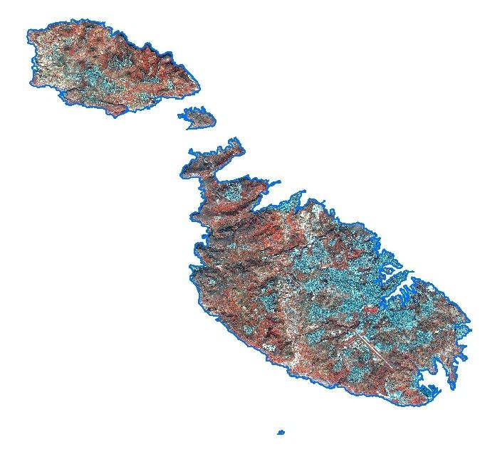
An output: Landcover – analysis (5m – 5 bands RGB-NIR-Red Edge)
ERDF156 Outputs

Slide 26
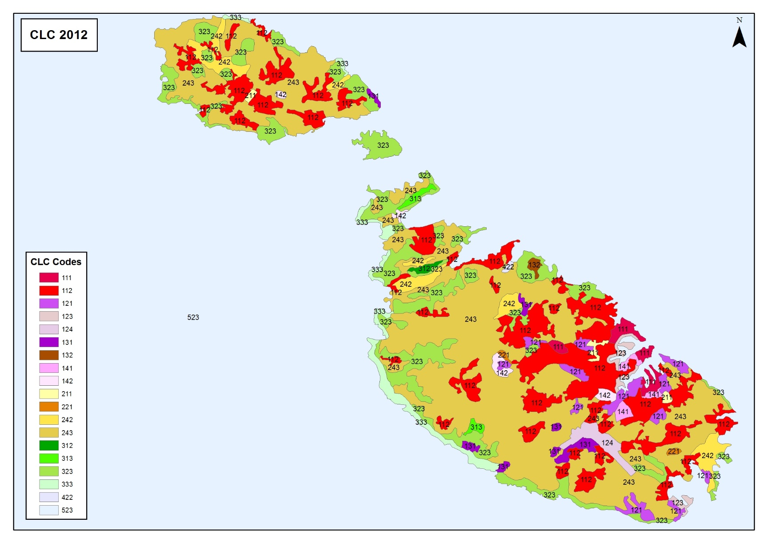
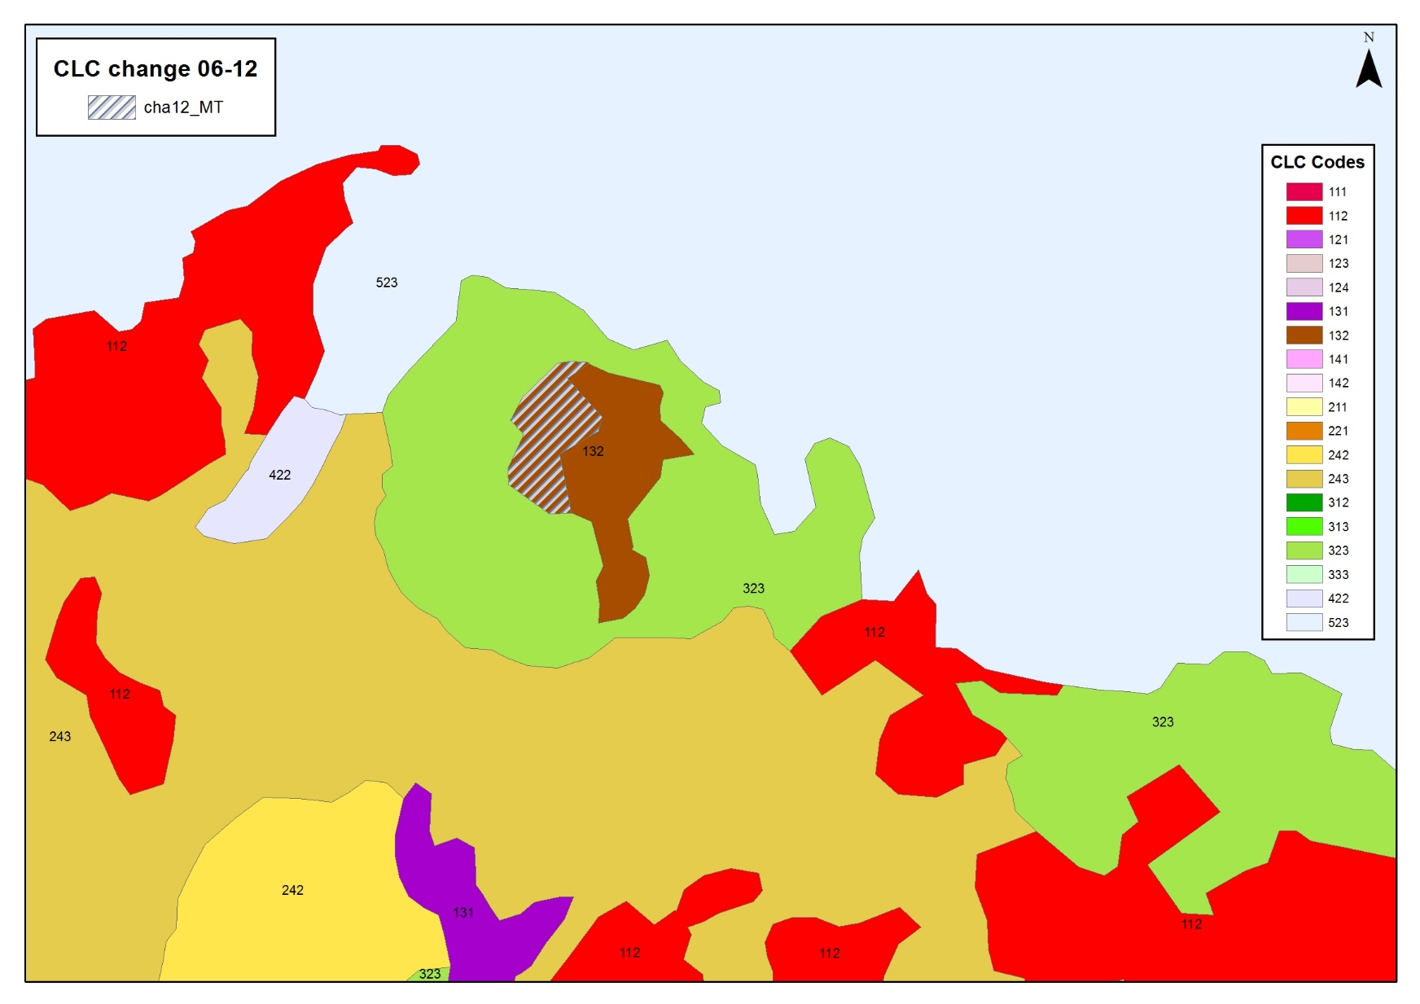


An output: EEA – CLC2012 (SPOT, IRS, RapidEye – Malta 20m HRL)
ERDF156 Outputs

Slide 27





An output: watercourse / watershed extraction
ERDF156 Outputs

Slide 28


ERDF156 Outputs
Employing base data
2012
LiDAR
Light Detection and Ranging
DSM and DTM of the Islands
average point density
4.3 Pts./m²
height accuracy
> 5 cm
orthoimage mosaic with a resolution of 16 cm

Slide 29

New Policies
Transitional Progress
26/04/2017

Slide 30





Inter-disciplinary Inclusion
Transitional Progress

Slide 31





Inter-disciplinary Inclusion
Transitional Progress

Slide 32



New data sources
Transitional Progress

Slide 33



New data sources: Forensics
Transitional Progress

Slide 34



However, usage is very limited
Mediums to aid interaction
GIS
Virtualisation
Gaming

Slide 35

Breaking the Ice

Slide 36

However, usage is very limited
SimCity

Slide 37

Unity3D

Slide 38


Virtual Worlds

Slide 39

MC

Slide 40

Case Study – Valletta – Captured Points

Slide 41

Case Study – Valletta - LiDAR

Slide 42

Case Study – Valletta - TIN

Slide 43

Case Study – Valletta – RGB Height

Slide 44

Case Study – Valletta – Thematic

Slide 45

Case Study – Valletta – St Elmo Heights

Slide 46

Case Study – Valletta – Minecrafted

Slide 47

Case Study – Valletta – Minecrafted

Slide 48

Case Study – Skorba

Slide 49

Case Study – Immersion - Hypogeum

Slide 50


SIntegraM
Spatial Data Integration for the Maltese Islands:
Developing Integrated National Spatial Information Capacity

Slide 51
The Situation
Due to the various national/EU data creation obligations, Malta is committed to upgrade the national’s spatial data capacity, which is currently not integrated and does not follow a coherent process but is based on an approach where each organisation has built its own systems that do not communicate with other entities’ systems. This project aims at ensuring that the underlying infrastructure and capacity is available in order to deliver information and analysis as per national, EU and other international requirements.
However….
Needed….
Spatial Infrastructure is hampered by:
an old basemap
non-earth data
ancient technology
silo-effect and inter-governmental data _charging
lack of integration
limited human resources and training
Enhancement of data, systems, infrastructure, exchange and training:
identification of information gaps in the data cycle
identification of data being created
creation of new basemaps
integration of all data in a national system
creation of data exchange security protocols
building of infrastructure
training of experts

Slide 52

The Operational Aspects
Operational Issues emanating from Entities Representatives
    To identify the current datasets pertaining to GI
    To list critical datasets that are crucial for integrative
    purposes (as per above)
    To highlight the necessity of sourcing and creating datasets
    from a non-spatial to spatial format
    To identify current and essential (but not present) knowledge
    and skills within each entity responsible for GI inclusive of
    parastatal and other governmental entities
    To identify current processes/methodologies that are in place
    and to aid the application and implementation process to
    identify, align, streamline and implement integration

Slide 53

The Scope: 5+1+2
To develop a national spatial data infrastructure and capacity for Malta, with the focus on 5+1+2 main themes:
  Developing a new Basemap for the Maltese Islands
  Aligning all spatial data in a common projection (removing the current truncated data system)
  Creating an online dissemination and analysis spatial information system
  Building the necessary infrastructure to enable the entire data cycle (design-input-analysis-output-reporting)
  Building the necessary infrastructure to future preparedness
  Building human capacity in the spatial themes
  Adhering to the INSPIRE Directive and relevant legislation
  Creating a series of protocols that enable the free exchange of data and knowledge across the entities

Slide 54




The Scope: 5
Strategy for National Spatial Data Integration across the spectrum of governmental entities. Creation of inventory, metadata, lineages, protocols, legislation, software options...
Basemap creation at various scales
Data acquisition of imagery, lidar, oblique, infra-red...
Integrated Datasets and systems in a common format and projection
Acquisition of Systems for the management of spatial data (servers, workstations, software...)
Acquisition of Analytical Tools for real-time investigation (predictive tools, immersive environments).
Acquisition of Equipment for future preparedness (aerial, terrestrial and marine technologies).
Dissemination Tools for the distribution and reporting of data to the Public, Scientific Domains and EU/International Reporting.

Slide 55

The Scope: +1
Identification of the Spatial Knowledge in terms of capacity and training needs currently involved in the GI field, requirements, lacunae ... in various fields: GIS, geomatics, land survey and thematic fields (data gatherers and refiners, data analysis and reporting, information specialists, preparedness specialists, legal experts)
L4 – L5 Courses for field workers, ICT
L6 – L7 sponsorship for analysts, systems creators, programmers
Entity-based Training for users in the various entities to ensure spatial understanding and continuity
Public training on systems usage and input to
government
Media Train for publicity and dissemination

Slide 56

The Scope: +2
Legislation Drivers Requirement to adhere to the INSPIRE Directive where relevant and to create protocols for other spatial date not currently under INSPIRE. To identify other relevant data legislation and draft a manual to procedures
Identification of spatial data flows at national and international level
Drafting of Protocols for data and information exchange based on a common approach to the data cycle
Drafting of Policy for the free exchange of data across the governmental entities

Slide 57

Scenarios
Period Virtual Worlds
Fantastic city generation
Immersive environments
Teaching through walkabouts
Archaeological surveying (Marine and Terrestrial)
Sea level Rise
Inundation and flood zones
Socio-Cultural
Enforcement – change analysis
Post-Disaster Management

Slide 58

Thank You
Thank You
Professor Saviour Formosa
saviour.formosa@um.edu.mt

