Slide 1
Geospatial Information, SDGs and UN-GGIM
Carol Agius
UN-GGIM: Europe Administrator & KEN Coordinator
Joint PCC & EULIS Conference
Malta, 5th May 2017

Slide 2
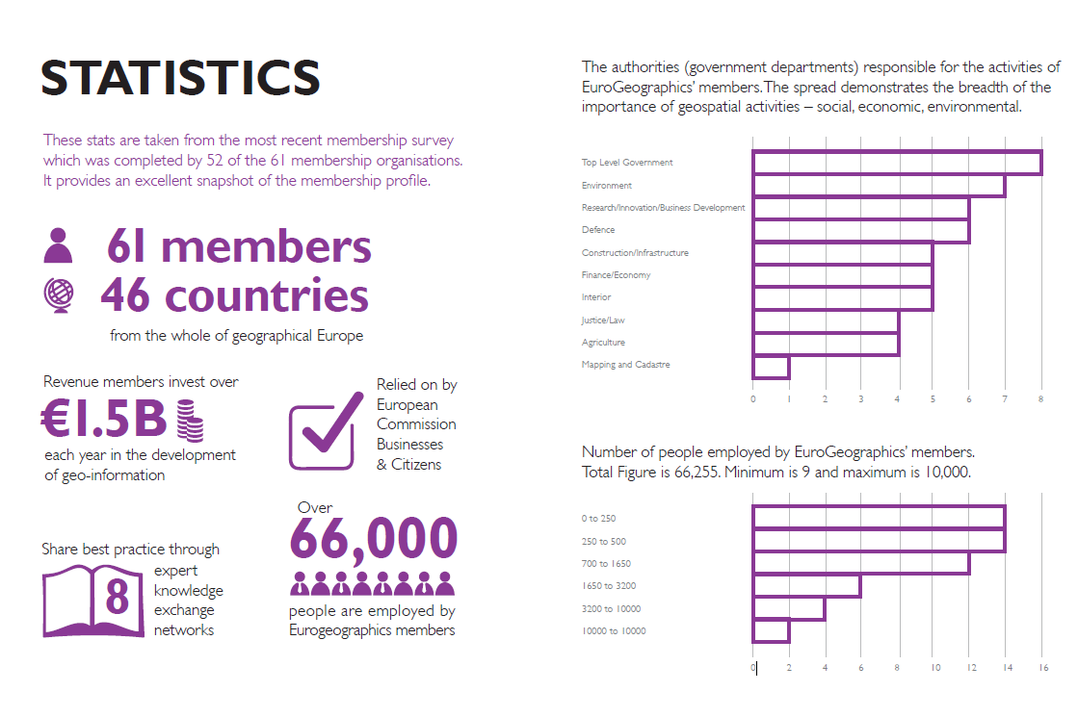

Slide 3


















EuroGeographics - our Network
Notes:
We have good connections to other organisations – working together

Slide 4

EuroGeographics – Activities
  Pan-European
  Products
  Representation & Strategic Communications
EuroGlobalMap (Open Data)
EuroBoundaryMap
EuroRegionalMap
EuroDEM
Political ownership of geo-information +
European Location Strategy
  Interoperability
  Projects
  Knowledge Exchange
  Networks
The European Location Framework + EuroGeoNames + State Boundaries of Europe
Business Interoperability,
Cadastre and Land Registry,
Emergency Mapping,
INSPIRE,
Policy,
Quality.
Notes:
Main activities of our Association are Representing Member’s Interests; Transferring Knowledge, developing capacities; Interoperability Projects and
Pan-European Products

Slide 5
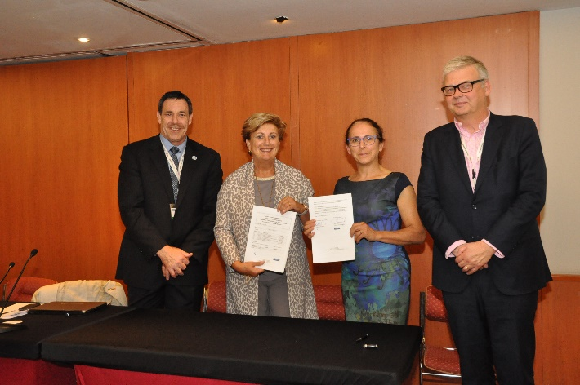
UN-GGIM: Europe Secretariat
The Netherlands is responsible for the Secretariat to UN-GGIM: Europe
Continued support from EuroGeographics, which funds and provides the secretariat service by agreement with Kadaster Netherlands.
Renewed the agreement with Kadaster for another 2 years, covering period 2017 -2018

Slide 7
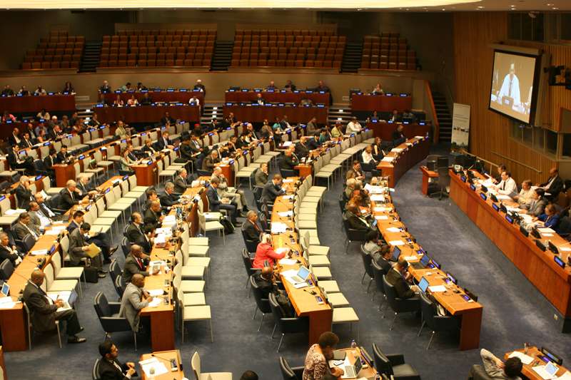
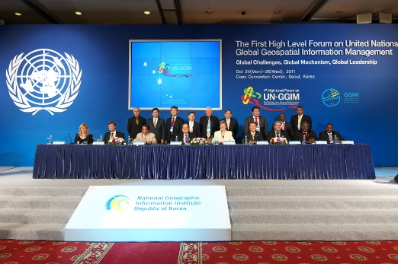
UN-GGIM: Aims and objectives
Reporting to ECOSOC, a formal inter-governmental UN Committee of Experts to:
Discuss, enhance and coordinate Global Geospatial Information Management activities by involving Member States at the highest level.
Work with Governments to make joint decisions and set directions on the use of geospatial information within national and global policy frameworks.
Address global issues and contribute collective knowledge as a community with shared interests and concerns.
Develop effective strategies to build geospatial capacity in developing countries.
To make accurate, reliable and authoritative geospatial information readily available to support national, regional and global development.

Slide 8
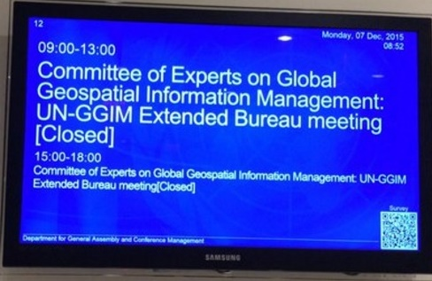
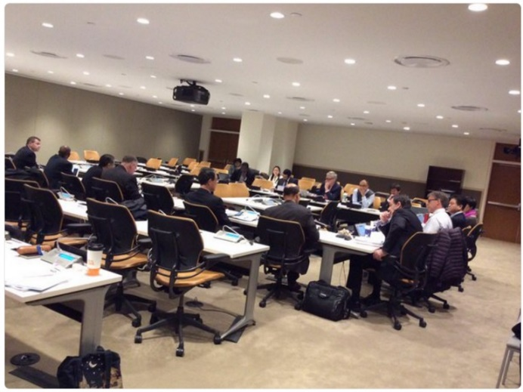

Global Coordination
UN-GGIM Extended Bureau: UN-GGIM co-chairs, Chairs of the Regional committee, the Secretariat and leads of the UN-GGIM thematic networks
Three UN-GGIM Extended Bureau meetings held over the course of the year.
The focus of these meetings is to organise the work of the Committee globally and across the regions.
Particular focus last year was given to the preparation for the Programme Review of the work of the Committee of Experts over the past five years.
Now looking forward – ‘UN-GGIM 2.0’, what happens next? Drafting UN-GGIM strategic framework 2017 -2021

Slide 9
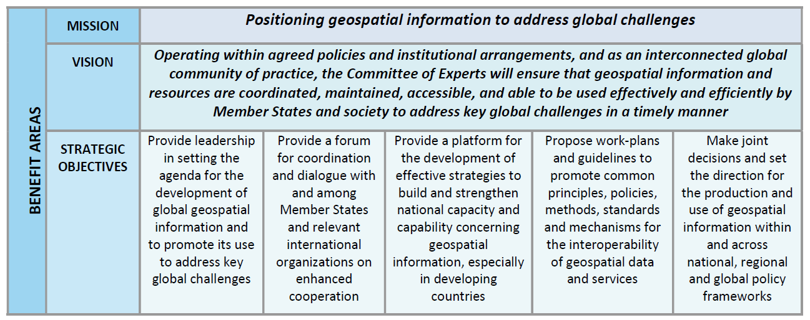

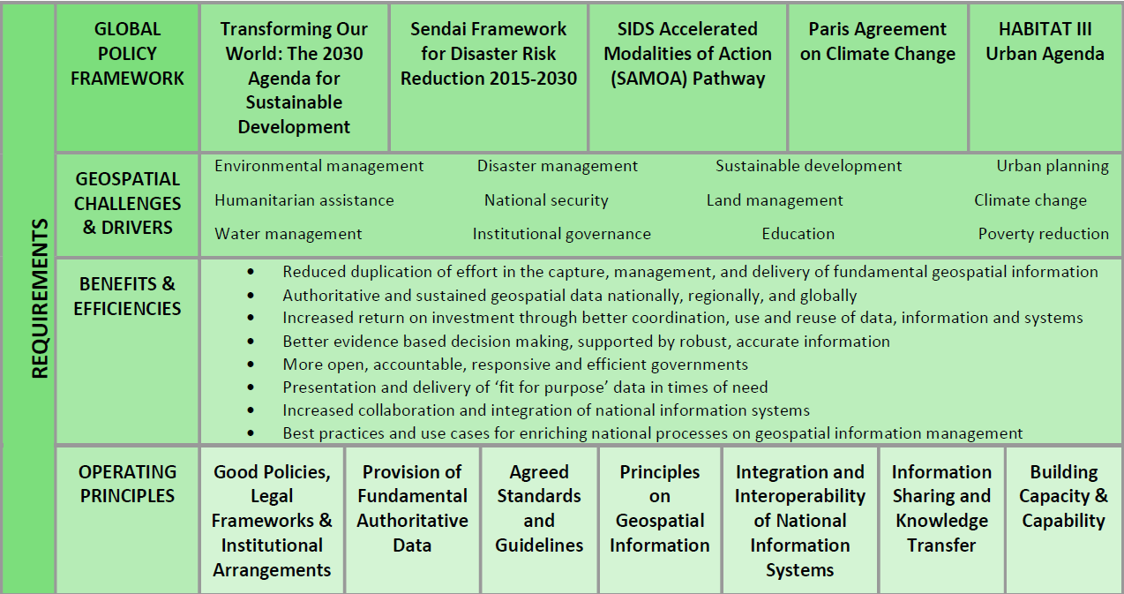
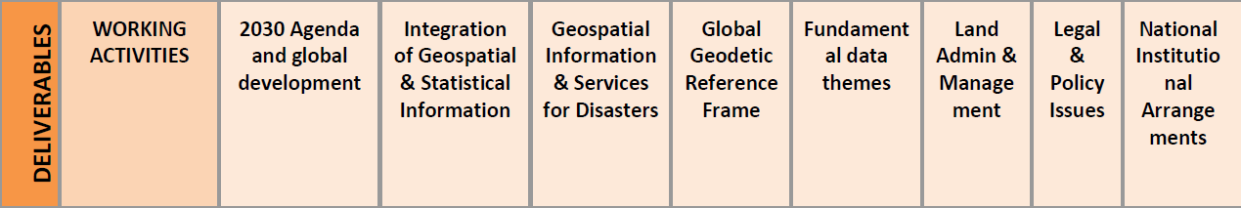

Slide 10


Sustainable data for sustainable development
The monitoring of the MDGs taught us that data are an indispensable element of the development agenda:
Despite improvement, critical data for development policymaking are still lacking.
Real-time data are needed to deliver better decisions faster.
Geospatial data can support monitoring in many aspects of development, from health care to natural resource management.
New technology is changing the way data are collected and disseminated.
Global standards and an integrated statistics system are key elements for effective monitoring.
Data should be open, easily accessible and effective for decision-making.
http://www.un.org/millenniumgoals/

Slide 11


Global Development Agenda
2030 Agenda for Sustainable Development — adopted by world leaders in September 2015 at an historic UN Summit
On 1 January 2016, the 17 Sustainable Development Goals (SDGs) officially came into force.
Over the next fifteen years, with these new Goals that universally apply to all, countries will mobilize efforts to end all forms of poverty, fight inequalities and tackle climate change, while ensuring that no one is left behind.
The SDGs, also known as Global Goals, build on the success of the Millennium Development Goals (MDGs) and aim to go further to end all forms of poverty.
The new Goals are unique in that they call for action by all countries, poor, rich and middle-income to promote prosperity while protecting the planet.

Slide 12
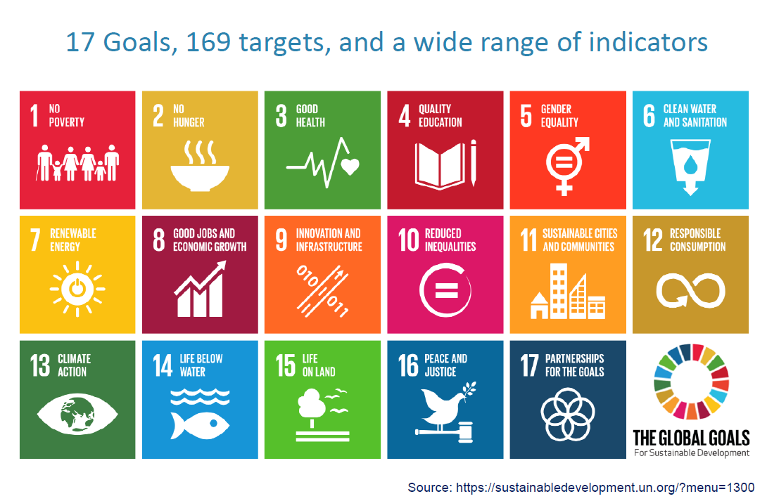

Slide 13



Goal 1: End poverty in all its forms everywhere
1.4. By 2030, ensure that all men and women, in particular the poor and the vulnerable, have equal rights to economic resources, as well as access to basic services, ownership and control over land and other forms of property, inheritance, natural resources, appropriate new technology and financial services, including microfinance.
Goal 11: Make cities inclusive, safe, resilient and sustainable
11.7 By 2030, provide universal access to safe, inclusive and accessible, green and public spaces, in particular for women and children, older persons and persons with disabilities

Slide 14

Goal 17: Strengthen the means of implementation and revitalize the Global
Partnership for Sustainable Development
17.18. By 2020, enhance capacity-building support to developing countries, including for least developed countries and small island developing States, to increase significantly the availability of high-quality, timely and reliable data disaggregated by income, gender, age, race, ethnicity, migratory status, disability, geographic location and other characteristics relevant in national contexts

Slide 15
Follow up and review:
76. We will support developing countries, particularly African countries, least developed countries, small island developing States and landlocked developing countries, in strengthening the capacity of national statistical offices and data systems to ensure access to high quality, timely, reliable and disaggregated data. We will promote transparent and accountable scaling-up of appropriate public-private cooperation to exploit the contribution to be made by a wide range of data, including Earth observations and geospatial information, while ensuring national ownership in supporting and tracking progress.

Slide 16
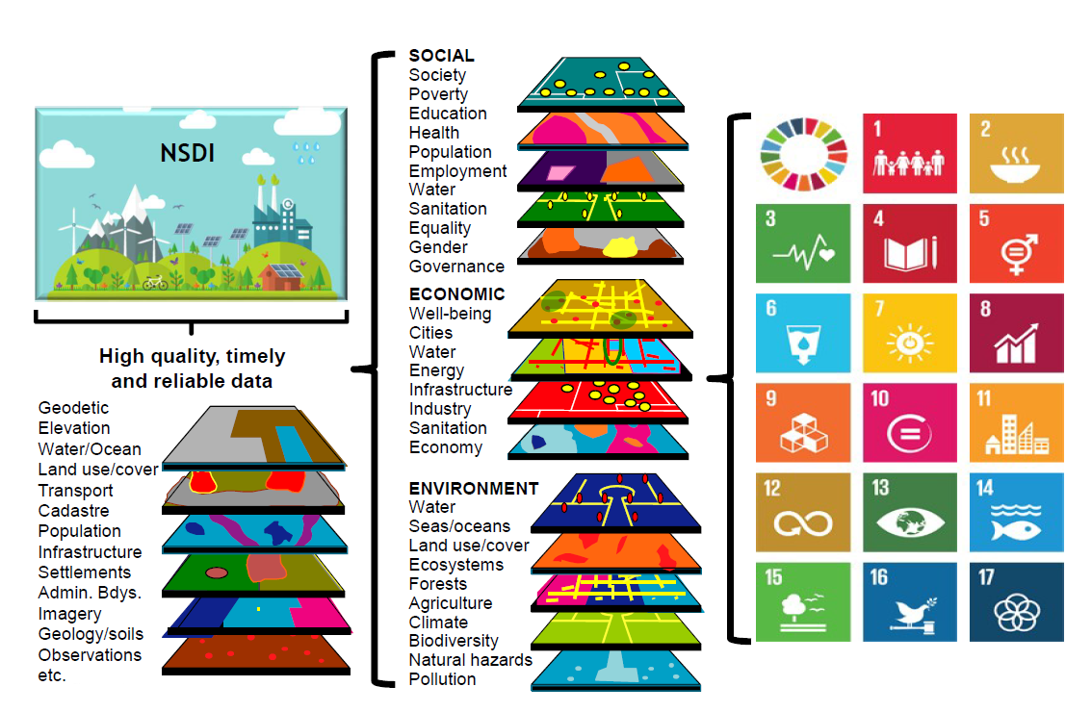

Slide 17
The Geospatial Value Proposition
Maximizing the value of geospatial information to capture elements of the 2030 Agenda will be a critical development path for many national geospatial information agencies in the coming 5-10 years.
For many countries, especially developing countries, sustainable development will provide a tangible policy “trigger” to accelerate the development and adoption of legal and technical geospatial standards; openness and exchange of data and metadata; interoperability of data and information systems; and integration of statistical and geospatial information, including its management and exchange.
The 2030 Agenda is a means to accelerate the development and expansion of NSDI strategies with commensurate levels of sustainable implementation and maturity. It also provide a strong consensus on the need to integrate the NSDI within national government’s development plans.

Slide 18
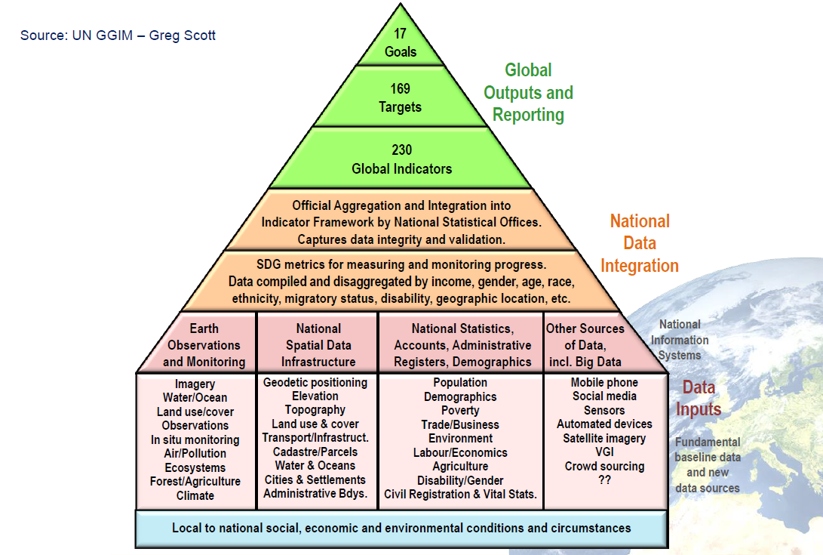

Slide 19
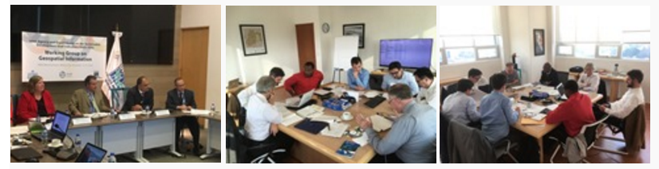
UN-GGIM Expert and Working Groups
IAEG-SDGs Working Group on Geospatial Information
EG: Integration of Statistical and Geospatial Information
EG: Land Administration and Management
WG: Global Geodetic Reference Frame (Sub-Committee)
WG: Geospatial Information and Services for Disasters
WG: Trends in National Institutional Arrangements
WG: Fundamental Data Themes

Slide 20
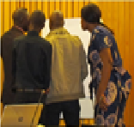

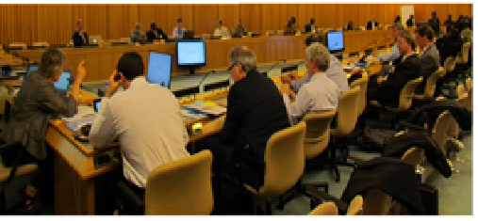
UN-GGIM: WG Fundamental Data
The Experts Committee mandated UN-GGIM: Europe to establish and lead a Global Working Group on Global Fundamental Geospatial Data Themes.
UN-GGIM: Europe ExCom acts as the steering group for WG Fundamental Data.
The ExCom appointed the UK to lead UN-GGIM: WG Fundamental Data, UN-GGIM: Europe is the permanent secretariat to the Working Group.
A working group established with 16 members from UN Member States and three from observer organisations, has drafted Terms of Reference
Global consultations have been held at 3 international events, the UN-GGIM HLF in Addis Ababa, the GWF16 Conference in Rotterdam and GGIM6 in New York.
An interim report on the progress submitted at GGIM6
WG Fundamental Data aims to finalise its work within 18 months for presentation at GGIM7
It is expected that the Working Group will produce a first draft of a Resolution on Global Fundamental Geospatial Data Themes for the consideration of the Committee of Experts with the possibility of taking this to the General Assembly.

Slide 21
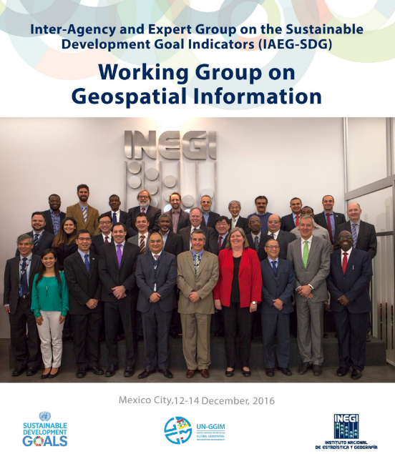
IAEG-SDGs Working Group on Geospatial Information
Co-chaired by Sweden & Mexico
Provide expertise and advice to the IAEG-SDGs and the larger statistical community as to how geospatial information, Earth observations and other new data sources can reliably and consistently contribute to the indicators.
Review options and provide guidance to IAEG-SDGs, as to the role of NSOs in considering geospatial information and earth observations, as well as other Big Data, as a means to contribute to and validate datasets as part of official statistics for SDG indicators.
It is envisioned that the Working Group will build on existing work and ongoing working mechanisms among stakeholders, and will consult widely regarding the current status of methodologies and geospatial data collection and input tools as a starting point.
  1st Meeting – 4 August 2016, UNHQ New York
  2nd Meeting, 12 - 14 December 2016, Mexico City
  3rd Meeting, 8 - 10 May 2017, Kunming

Slide 22
UNITED NATIONS EXPERT GROUP ON LAND ADMINISTRATION AND MANAGEMENT
Chaired by the Netherlands, co-chaired by Lesotho
Major Objectives:
  1.Play a leading role at the policy level by raising political awareness and highlighting the importance to decision makers of the need for timely and fit for purpose land administration and management and
  2. Encourage the use of geospatial information tools and systems to improve the legal certainty of all citizens in the world with respect to the registration of the relation between people and land.
First meeting UN-GE-LAM, Addis Ababa HLF April 2016
The Netherlands 14 & 15 March, 2017

Slide 23
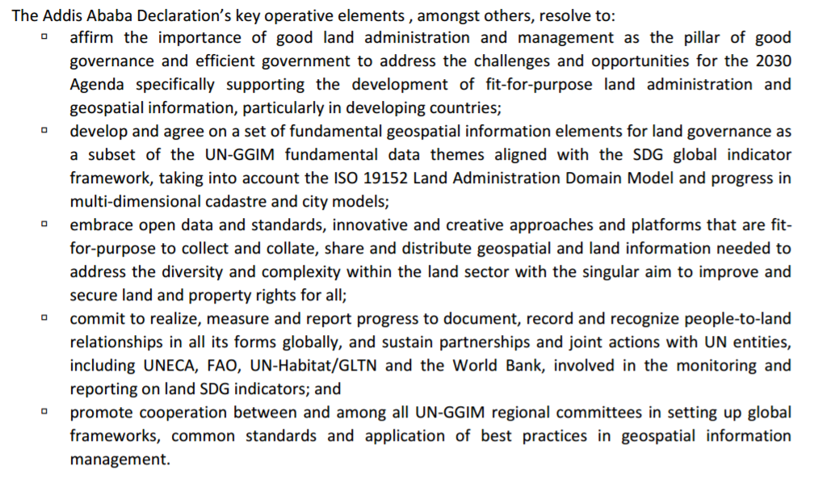
tion Management Towards Good Land Governance for the 2030 Agenda
http://ggim.un.org/docs/Addis%20Declaration%20Final%2022Apr2016.pdf

Slide 24
Delft Meeting - Outcomes
The Expert Group agrees –
a) The overarching focus is to improve tenure security and better land and property rights for all. The indicators are meant to assist in review and follow-up, measure and monitor progress.
b) The continuing need to advocate policies that promotes
  i) affordable access to basic geospatial dataset
  ii) avoid duplication particularly in mapping (collect once for a multiplicity of purpose and use),
  iii) data sharing,
  iv) interoperability,
  v) timeliness and quality.
c) The tenure security atlas should provide and visualise the state-of-play of tenure security at all levels. The atlas should also support the monitoring of progress of tenure-based SDG.

Slide 25
Delft Meeting – Agreed tasks
The Expert Group agrees to the following task, in order of priority:
a) Develop a global framework for land administration
that captures key elements or principles essential for a universal, efficient, effective and sustainable land administration system that will provide tenure security for all. b) Together with the global framework, provide guidance for appropriate methodological approaches and standards that will accelerate the proportion of global population’s relationship to land that will be documented, recorded and recognized, currently estimated at 25%-30%. This will include key legal, institutional and geospatial elements that will include access to basic datasets and image libraries.
c) Establish a liaison group to support the upcoming ISO-TC211 and OGC revision of ISO 19152 – Land Administration Domain Model with the aim to improve awareness and understanding, enhance advocacy and knowledge sharing.

Slide 26

Conclusions
In order to achieve the SDG’s and to have legal certainty for all citizens in the world, good geospatial information management and sound land administration are important prerequisites.
The objective of UN-GGIM (UN-EG-LAM) is to play a leading role at the policy level, by raising awareness and to encourage the use of geospatial information management for land administration purposes.

