Slide 1
Polish Integrated System of Real Estate Information –
Process of establishing and impact of cadastral data quality
Head Office of Geodesy and Cartography
Warsaw, 20 November 2014 r.

Slide 2
AGENDA
Integrated System of Real Estate Information - ZSIN
ZSIN architecture
Legal basis
Data Quality Model
ZSIN Project
ZSIN Project-Stage II

Slide 3
Ustaw
Legal basis
Act of 17 May 1989 – Geodetic and Cartographic Law article 7a and 24b (amendment of 5 June 2014)
the President of the Head Office of Geodesy and Cartography: initiates and coordinates activities relating to development of an integrated system of real estate information
creates and maintains the Integrated System of Real Estate Information (an IT system), while cooperating with other public administration institutions.
Notes:
Amendment to the Geodetic and Cartographic Law in 2010 introduced a number of new regulations, thus adjusting the Geodetic and Cartographic Law to the requirements of the „INSPIRE” Directive.
The Geodetic and Cartographic Law defines the legal and organizational framework for ZSIN.
The law implies that ZSIN will be implemented by means of cooperation between numerous public administration institutions (local governments, self-governments, ministries, etc.).
The principal role in this project is performed by the Head of Geodesy and Cartography, who initiates and coordinates all activities under the project.

Slide 4
Legal basis
Decree of the Council of Ministers of 17 January 2013 r. on the Integrated System of Real Estate Information
The Decree describes:
manner, procedure and technical standards for creating and maintaining the Integrated System of Real Estate Information (ZSIN);
content, form and means of communicating the notifications of data changes, that are being implemented within different public registers, which contribute to the Integrated System of Real Estate Information .
Notes:
The decree defines the manner, procedure and technical standards for creating and maintaining the Integrated System of Real Estate Information (ZSIN). It is a legal act implementing the Geodetic and Cartographic Law.
It does als define the content, form and means of communicating (via the ZSIN technical infrastrukture) the notifications of data changes, that are being implemented within the following databases: the Land and Building Register (EGiB), the Land and Mortgage Register as well as PESEL.

Slide 5
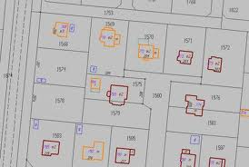
Legal basis
Decree of the Minister of Administration and Digitization of 29 Nov. 2013 r.
Changing the Decree on the Land and Building Register (EGiB)
adjusting the legal requirements;
harmonizing EGiB with other data sets;
unification of data sets maintained at local level;
GML – (Geography Markup Language) as data exchange format.
Notes:
The amendment of the decree is also related to the need of adjusting it to the requirements of the INSPIRE directive.
The main assumption is to harmonize the Land and Building Register within the numerous local databases.
The amendment is also aimed at harmonizing the Land and Building Register with other data sources within the nationac geodesic and cartographic resource.

Slide 6
Foundations of the ZSIN architecture
The local cadastral systems (EGiB), the electronic system of Land nad Mortgage Register (New Land Book) and other external systems included in ZSIN, will be equipped with communication modules, allowing for exchange of data using web services.
Lokalne systemy EGiB, system Nowa Księga Wieczysta (NKW) oraz inne zewnętrzne systemy dziedzinowe włączone do ZSIN będą wyposażone w moduły komunikacyjne, które umożliwią wymianę danych za pomocą usług sieciowych (WebServices).
Notes:
Thanks to the adopted concept and implemented solutions, the ZSIN system can exchange information with any other systems (from other instutitions) using the standard spatial data services.
Thanks to its web services, ZSIN will allow the Head Office of Geodesy and Cartography to cooperate with other institutions. It will also create an environment facilitating the exchange of information and knowledge between these institutions, thus fulfilling the interoperability requirements.

Slide 7
Central Repository of Copies of Cadastral Data
Central Repository (e-services):
Centralne Repozytorium
Will allow for implementation of functionalities aimed at:
verification of compliance between the Cadatral data and data registered in the Land and Mortgage Register,
providing the public administration institutions with integrated cadastral data,
spatial analyses, monitoring data quality in Real Estate Cadastre,
verification of data by the courts maintaining the Land and Mortgage Register .
Current updates of Real Estate Cadastre
New data in Real Estate Cadastre
Modified data in Central Repository
Notes:
The Central Repository of Copies of EGiB Data, which is maintained in form of multiple (scattered) databases, is an element of ZSIN.
The Central Repository allows for saving, updating and safe storage of data sets, as well as:
data visualization,
performing spatial analyses,
providing access to data,
monitoring coherence and quality of data sets within the Land and Building Register – both o a regional and central level.

Slide 8
The foundations of Quality Model
Evaluation of Cadastral data quality according to:
Decree of the Minister of Regional Development of 29 March 2001 on the Land and Building Register
(amendment of 2013)
documentation of the previously used cadastral data control software
the norm PN-EN ISO 19 157 Geographic information – Data quality
D 8.4 ESDIN Quality Final Report – Part A, October 2010
D 8.4 ESDIN Quality Final Report – Part C, v. 1.0, October 2010
Basing on documentation developed under the project: European Spatial Data (Content+)
Notes:
The Land and Building Register is a reference data set for various other spatial data registers. Therefore, the quality of its data has a serious impact on data quality in related registers.
Data stored in the Land and Building Register are being used for: spatial planing, calculating tax obligations, registering real estate in the Land and Mortgage Registers, public statistics, etc.
Quality of data stored in the Land and Building Register is necessary in order to maintain confidence among its customers (data users).
In order to define the quality of data in the Land and Building Register, it was necessary to elaborate a set of control procedures, which will be used to evaluate data quality. Thus, a coherent data quality model of the Land and Building Register has been defined.
The Quality Model adopted for ZSIN is compliant with the ISO requirements.

Slide 9
Elements of the Quality Model
Description of quality of the Cadastral data set uses the elements of quality from the norm ISO 19157
QUALITY MODEL
TEMPORAL QUALITY
LOGICAL CONSISTENCY
POSITIONAL ACCURACY
THEMATIC ACCURACY
USABILITY ELEMENT
COMPLETENESS
Notes:
In order to describe the quality of Cadastral data, we used the elements and sub-elements defined in the norm: ISO 19157.
The norm defines the following elements of quality:
(Kompletność) Completness – existence and non-existence of of objects, their attributes and relations in the data set,
(Spójność logiczna) Logical consistency – the level of compliance with the logical rules of data structure, attributes,
(Dokładność położenia) Positional accuracy – accuracy of position of the objects,
(Dokładność czasowa) Temporal quality – accuracy of the attributes relating to time, as well as relations between the objects,
(Dokładność tematyczna)Thematic accuracy – accuracy of the quantitative attributes, as well as qualitative attributes, classifications of objects and relations among them,
(Używalność) Usability element – an element drawing from the user requirements.

Slide 10
Range of data sets
Within the Cadastral Data Quality Model, the following features are subject to controll:
Objects
Attributes
Relations
Notes:
The Cadastral Data Quality Model defines the following attributes that are subject to control:
Objects – a set of objects’ appearances,
Attributes – elements characterizing individual objects,
Relations – relations between the objects.

Slide 11
Data quality evaluation method
Within the cadastral data quality model the direct method: internal and external has been used.
Data quality methods (ISO 19157)
direct
external
internal
indirect
The Quality Model defines if controls are automatic or manual.
Automatic controls are executed on a complete data set.
Manual controls, due to time needed for control, are executed on data samples.
Notes:
The cadastral data quality model used the direct method. It consists of evaluating quality of the data set by means of comparing these data with external or internal reference data.
The quality model defines, if controls are automatic or manual:
automatic controls - usually executed on a complete data set. This allows to collect information of the real quality of the entire data set, without the need to use human ressources for performing the control,
Manual controls – which, due to time needed for control (generating high costs), are executed on data samples.

Slide 12
Control of Cadastral data
The Cadastral Data Quality Model includes control factors, developed with the aim of using the model to control data of the Real Estate Cadastre .
Cadastral vector data sets as GML files
Data control of Cadastral data suppliers
Correctness control before loading data to the Central Repository
Periodical verification of cadastral data
Notes:
The Cadastral Data Quality Model includes control factors, developed with the aim of using the model to control data delivered by the suppliers, or during the periodical data verification.
Data control cover both the thematic and technologic accuracy, i.e. the data registration method, technical parameters, topology, compliance to data exchange standards, correctness and completeness of data, meeting accuracy requirements.
The quality model is not static – therefore, it will be constantly modified and updated, following the development of control methods and improvement of data quality.

Slide 13
Project origins
The project is being realized by the Surveyor General of Poland with the assistance of the Head Office of Geodesy and Cartography.
The initial work on the project „ZSIN – Stage I” begun in 2010 r.,
with regulating the legal basis for ZSIN, by means of amendment of the Geodetic and Cartographic Law.
The ZSIN – Stage I Project obtained funding within the European Regional Development Fund, from the Innovative Economy Programme 2007-2013.
Notes:
The initial work on the project „ZSIN – Stage I” begun in 2010 r., with regulating the legal basis for ZSIN, by means of amendment of the Geodetic and Cartographic Law, in line with the requirements imposed by the INSPIRE directive.
The ZSIN – Stage I Project obtained funding within the European Regional Development Fund, from the Innovative Economy Programme 2007-2013
The leading role in the project is in hands of Surveyor General of Poland

Slide 14
ZSIN – Stage I
The ZSIN – Stage I Project
ZSIN – Stage I is a public project, aimed at improving efficiency and effectiveness of public administration.
Development of a countrywide technical infrastructure
Improved quality of Cadastral Data
Development of a Central Repository of Copies of Cadastral Data
ZSIN
STAGE– I
Deadline:
September 2015r.
Notes:
The ZSIN – Stage I Project consists of:
- development of a countrywide technical infrastructure as well as a Central Repository of Copies of EGiB Data, which will constitute the main component of ZSIN,
-improving quality of data stored in EGiB.
The System will improve the processes od data collection and exchange, as well as updating and providing access to information on real estate, which are stored in the Land and Building Register and the Land and Mortgage Register. The ultimate result will be the higher reliability of these public registers.
Project start: 09.2011 – Deadline: 09.2015 r.

Slide 15
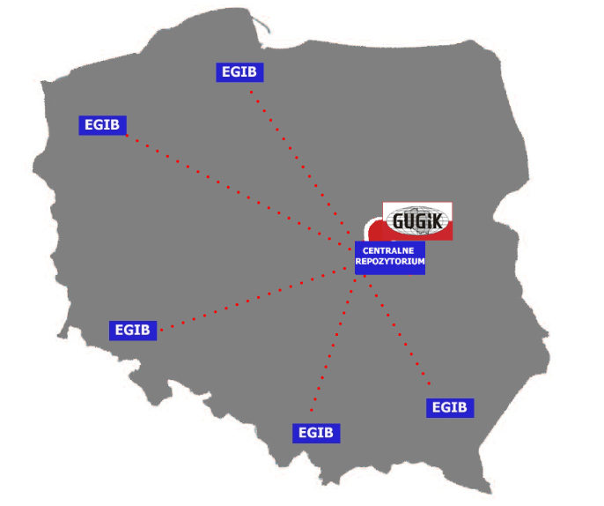
Land and Building Register/ Real Estate Cadastre (EGiB)
The ZSIN – Stage I Project includes:
Conversion of Cadastral Data into new harmonised data model
Adjusting the data in EGIB to requirements imposed by ZSIN under the modernization procedures.
Scope of activities covers the area of:
5 Regions
58 Counties
Notes:
The present quality of data stored in the Land and Building Register draws from a number of factors, including the historic developments during hundreds of years. The register has originally been set up on source maps dating back to the times when Poland was divided between the three neighbouring countries (Austria, Germany and Russia).
Different methods, measurement units as well as low quality of these source maps determines inferior quality of the databases used nowadays. Nevertheless, data quality is being constantly improved during the updating processes, while development of the ZSIN system will allow for its improvement on a large area of the country, htanks to modernization and conversion of analogue sources.
The ZSIN-Stage I covers the area of:
5 regions
58 districts
Adjusting data sources to ZSIN will mean conversion cadastral data into new data model from the entire couties (58) in local an IT system, comleting data on buildings and appartments within those buildings, improving quality of registered data as well as bringing those data to a standardized form.

Slide 16
The ZSIN Project – Stage II
The ZSIN Project – Stage II will cover the entire country.
larger access to information and data on real estate
EGiB
EGiB
EGiB
higher quality and accuracy of cadastral data due to modernization
EGiB
EGiB
loading more EGIB databases to the Central Repository of Copies of Cadastral Data
implementing e-services covering the entire country
Notes:
The ZSIN Project – Stage II wil lbe a continuation of the current project, aiming at further adjustment of the data stored in the Land and Building Register to the requirements of ZSIN (on a larger scale in terms of area and themes covered).
The proncipal assumptions of the ZSIN Project – Stage II:
adjusting the data stored in the Real Estate Cadastre(EGiB) to the requirements of ZSIN and further improvement in their quality,
implementing more of the Cadastral databases to the Central Repository of Copies of Cadastral Data, which will allow to integrate the scattered resources,
reducing maintenance costs;
increasing accessibility of information and data on real estate.

Slide 17
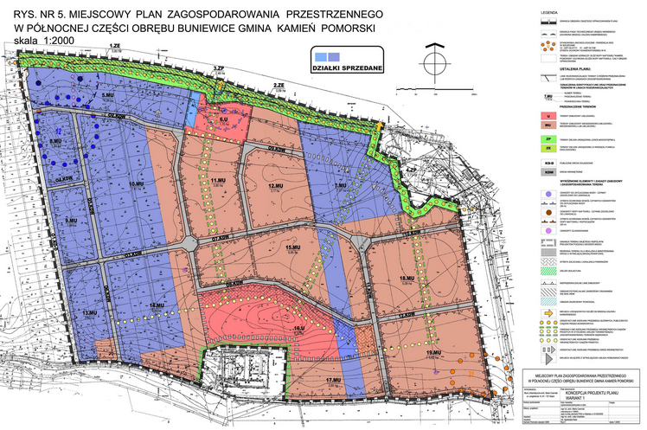
The ZSIN Project – Stage II
Connecting following standardized system containing data set concerning real esate.
Creating conditions that will support the sale/purchase of real estate thanks to:
synchronized data models in both the Real Estate Cadastre (EGiB) and the Land and Mortgage Register (NKW);
notarial deed in electronic form.
Notes:
The new project will also include implementing the standardized local development plans into ZSIN.
The plans also include creating conditions that will support the sale/purchase of real estate thanks to:
synchronized data models in both the Land and Building Register (EGiB) and the Land and Mortgage Register (NKW);
standardizing the structure of notarial deed in electronic form.

Slide 18
Thank you for your attention
Head Office of Geodesy and Cartography
Wspólna 2 Street
Warsaw, Poland

