Slide 1
The Registry of Territorial Identification, Addresses and Real Estates
Jaroslav Bačina

Slide 2
BASIC REGISTERS

Slide 3
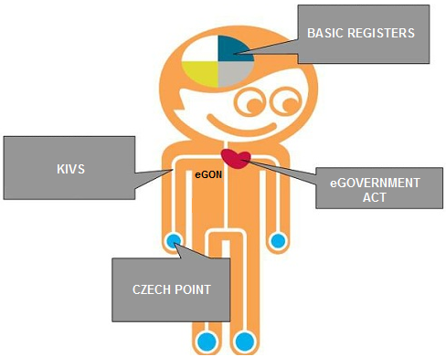
eGovernment in the Czech Republic

Slide 4
Basic registers:
ROB – register of inhabitants
ROS – register of persons – holds the data of companies and governmental agencies
RUIAN – register of territorial identification, addresses and real estates
RPP – register of rights and responsibilities of public authorities – holds the data about administrative decisions
Financed through state budget

Slide 5
Basic registers characteristics:
Central information source for public authorities – over 2529 public authorities connected
Collect data once, use many times
Elimination of duplicated data and discrepencies
Shared services on central, regional and local levels - the so-called reference data is adopted by all authorities as verified and up-to-date.
Secure data interchange between information systems of public administration
Improvement of the quality of services provided by the State Administration

Slide 6
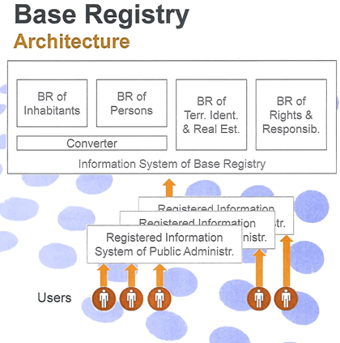
Basic Registers

Slide 7
Current status of Basic Registers:
Legislation complete - Act No. 111/2009 on Basic Registers and implementing Decree No. 359/2011
Systems implemented, installed and fully operated since 1. 7. 2013
Editing systems connected and working on near real time base
reader systems connected

Slide 8
The Registry of Territorial Identification, Addresses and Real Estates - RÚIAN
The largest Basic Register within the eGovernment
Responsible public authority: Czech Office for Surveying, Mapping and Cadastre
No personal data
Unique data resource of addresses for state administration
Operated since 1. 7. 2012

Slide 9
The Registry of Territorial Identification, Addresses and Real Estates - RÚIAN
The RÚIAN keeps information about territorial identification and addresses which is binding for the whole state administration
Content of the RÚIAN:
descriptive and location data about
territorial features and units
purpose territorial features
addresses
links among data

Slide 10
RÚIAN
Editors of the RÚIAN:
Municipalities
Building Authorities
Czech Statistical Office
Czech Office for Surveying, Mapping and Cadastre (ČÚZK)
Online updating
Reference data is recorded by two editing information systems (other systems reading them only):
Information System of the Cadastre of Real Estates (ISKN)
Information System of Territorial Identification (ISÚI)

Slide 11
How to get RÚIAN data?
Data of the RÚIAN is available via Public Remote Access:
free of charge
no registration of the clients
only informative data
http://vdp.cuzk.cz

Slide 12
Exchange format
Everybody can download RÚIAN data from http://vdp.cuzk.cz/
Free download without any registration
RÚIAN data is provided in exchange format
GML 3. 2. 1.
- format inspired by INSPIRE specification
All data – provided on a monthly basis
Changes – provided on a daily basis

Slide 13
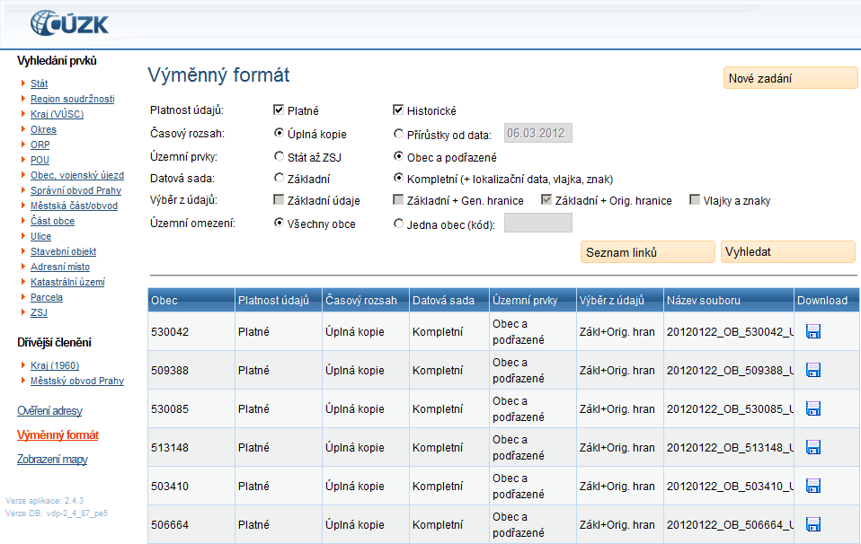
Download settings

Slide 14
Accesses to RÚIAN - statistics

Slide 15
6 253
towns
80 500
Streets
Administrative units in Prague
Urban districts
in Prague
Cadastral units
15 070
21 050 000
Parts of towns
MO/MČ
Plots of land
4 010 000
Buildings
2 910 000
1.1.2014
Address Points
Electoral districts

Slide 16
Records in the RÚIAN
Some records in the RÚIAN have constitutive character.
Parts of towns
Records concerning the streets, other public areas or the parts of towns are effective by the entry into the RÚIAN.
Allocation of building number is effective by the entry into the RÚIAN.
Streets
Buildings

Slide 17
Records of the buildings in RÚIAN
RÚIAN contains the records of the buildings registered in the Cadastre of Real Estates and some other buildings according to its special definition
Records of the buildings are kept by Building Authorities using editing information system ISÚI.
ČÚZK, which uses an editing information system ISKN, keeps the following records:
outlines of the buildings according to Cadastre of Real Estates
land use
type of conservation of the land

Slide 18
Records of the addresses in RÚIAN
Unique structure of the addresses according to Decree
No. 359/2011
Addresses recorded in the RÚIAN are binding for the whole state administration.
Records of the addresses are carried out by municipalities, which use editing information system ISÚI.
Verification of the links between addresses and buildings.

Slide 19
Thank you for your attention.
jaroslav.bacina@cuzk.cz

