Slide 1
The national archive of urban street numbers (ANNCSU)
Rome, 21/11/2014
Agenzia delle Entrate – Largo Leopardi, 5 00185 – Roma

Slide 2
Agenda
Relevant legislation
Preliminary remarks
Activities carried out so far
Activities in progress
ANNCSU and ANPR
ANNCSU and permanent census
ANNCSU kick off

Slide 3
Relevant legislation
Law by decree, 18 Oct. 2012, n. 179, amended by law 17 Dec. 2012, n. 221 (Growth decree - Digital Agenda’s implementation)
Art. 3, provides the issuing of DPCM that establishes
ANNCSU contents
obligations and procedures for updating ANNCSU
instructions to access ANNCSU
criteria for the interoperability of ANNCSU with other relevant national and regional databases
set the deadline for completing the CENSUS OF POPULATION AND HOUSING , conducted by ISTAT ANNUALLY and no more ten-yearly
Art. 2, provides the issuing of DPCM that establishes
Anagrafe nazionale della popolazione residente (ANPR)
“Resident population’s national register ”

Slide 4
Relevant legislation
Regolamento anagrafico (DPR 223/1989) - Registry office regulation
Art. 41
Each circulation area must have its own distinct name
The same name can not be attributed to two different circulation areas of the same type, even if included in different administrative fractions
Art. 42
The doors and other access from the circulation area, within the building of any kind, must be provided with appropriate house numbers, in accordance with the rules set by ISTAT
Art. 45
In each Municipality there is an office in charge of drawing up and updating street names and house numbers, following the ISTAT instructions
Art. 47
In preparation for the general population census, the Municipalities must update street names and house numbers, in order to adjust them to the factual situation

Slide 5
Agenda
Relevant legislation
Preliminary remarks
Activities carried out so far
Activities in progress
ANNCSU and ANPR
ANNCSU and permanent census
ANNCSU kick off

Slide 6
Definitions
Street names’ register: list of the circulation areas in a Municipality, each one identified by a toponym;
Circulation areas: any space open to the public and doomed to the transit;
Addresses’ register: Street names’ register including house numbers;
Toponym: name that a Municipality assigns to each circulation area
House number: number that identifies the access to buildings in the circulation area
STREET GUIDE
DUG. STREET NAME STREET N. EXPONENT
STRADARIO
VIA GIUSEPPE GARIBALDI
VIA CRISTOFORO COLOMBO
VIA DEI CICLAMINI
VIALE DELL’OCEANO PACIFICO
PIAZZALE DEI NAVIGATORI
VICOLO DEI PASTORI
SALITA DEI FRANCESCANI
VIA DEI CORAZZIERI
DUG | DENOMINAZIONE | CIVICO | ESPONENTE
VIA | GIUSEPPE GARIBALDI | 1
VIA | GIUSEPPE GARIBALDI | 2
VIA | GIUSEPPE GARIBALDI | 3
VIA | GIUSEPPE GARIBALDI | 3 | A
VIA | GIUSEPPE GARIBALDI | 3 | B
VIA | GIUSEPPE GARIBALDI | 5
VIA | GIUSEPPE GARIBALDI | 7
VIA | GIUSEPPE GARIBALDI | 8

Slide 7



Municipal Street names’ registers
Just a very small number of Municipalities make their street names’ register available on their institutional website and assure their periodic update

Slide 8


Use by the Public Administrations of Municipal street names’ registers
Many Public Administrations and Corporations generally use one or more internal archives to retrieve addresses. These archives often are not consistent with each other, they are useful for specific offices, they need huge activities of periodical checking and updating, through archives bought on the market.

Slide 9
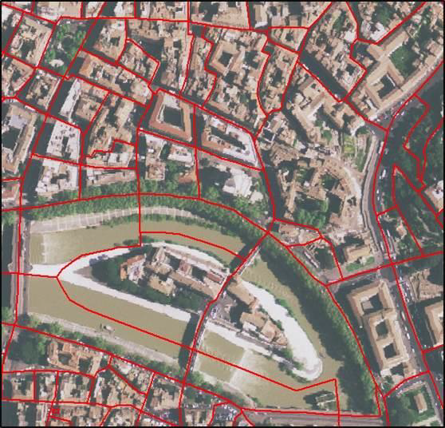
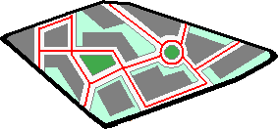
Use by Istat of street names’ registers
Istat is a Public Research Center providing official statistics available for citizens and public decision makers. It takes ten-yearly general census (agriculture; industry and services; population and buildings).
In preparation for a census, the following duties are very important:
Topography: partitioning of the territory
in different census sections
“Ecografica”: Street names’s registers drawing up

Slide 10

Use by Agenzia delle Entrate of street names’ registers
The «Agenzia delle Entrate» started a programme of activities for the quality improvement of the Cadastral system data with processes of information standardization and certification in order to improve the quality of cadastral addresses (included and updated in the database by professionals).
Since referential Municipal Street names’ registers were generally unavailable, Agenzia delle Entrate has carried out periodical checks and updates also through comparison with street names’ registers bought on the market.
This activity led to the creation of referential Street names’ registers for internal use and for the provision to the professionals in charge of drawing up cadastral updating documents (Docfa).

Slide 11

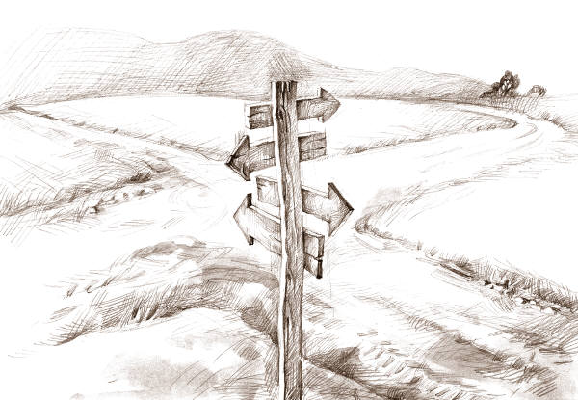
Use by Municipalities of street names’ registers
Even the Municipalities, in charge of holding street names’ registers, sometimes do not use a single street names’ register but multiple, not perfectly consistent with each other, managed independently by individual offices (Registry office, Technical Office, Tributes Office, Toponomy, ...)

Slide 12






Digitalization of archives
The increasing digitalization of archives and the consequent need for integration between them has made even more urgent the need to have certified and encoded toponomic data

Slide 13




ANNCSU
ANNCSU aims to meet the need strongly felt by public administrations and corporations to have a single national register that contains certified information on street names and house numbers, to be used as a reference in all the processes in which the address element is used.
ANNCSU

Slide 14



Organization of ANNCSU
ISTAT defines rules and criteria for the updating and the standardization of data included in the archive, as well as the levels of information quality
Agenzia delle Entrate manages the archive, through the taxation information system that guarantees safe holding, accessibility to services and assistance to users, according to the quality standards already adopted by the Agenzia
The Municipalities carry out the regular updating of the archive on the basis of the instructions contained in the Registry office regulation (DPR 223/1989), the technical guidelines issued by ISTAT and within the informatic talks rules established by Agenzia delle Entrate
ANNCSU

Slide 15
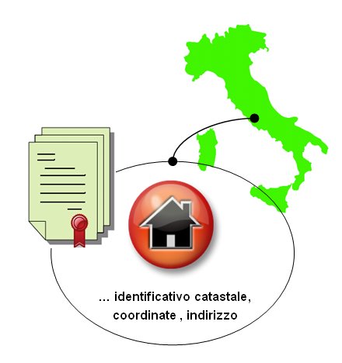
Municipality Role
Registry regulation
Art. 45
States that “in each municipality the office in charge of drawing up Street Guides must carry out the compilation and updating of the Street Guide as indicated by the Central Statistics Office”.
Artt.
41-42
Require that any circulation area, located in the municipal territory, must have its own distinct name and any access to buildings in the circulation area must be provided with a specific street number.
Therefore the Municipality has a central role having the task to integrate, correct and certify the toponyms and the street numbers contained in the archive, and to keep this information updated.
Cadastral identifier, coordinates, address

Slide 16
Agenda
Relevant legislation
Preliminary remarks
Activities carried out so far
Activities in progress
ANNCSU and ANPR
ANNCSU and permanent census
ANNCSU kick off

Slide 17
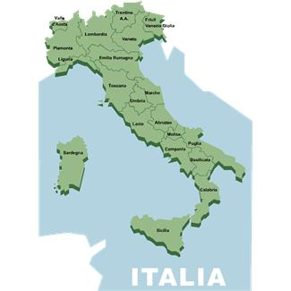

Agreement Agenzia - Istat
On the 21st of June 2010, Agenzia delle Entrate and Istat signed an agreement for the establishment of a House numbers and street names’ national register (ANSC).

Slide 18

First ANSC establishment
First ANSC establishment, which contains the Street names’ registers of all the Italian Municipalities, was initially carried out on the basis of toponyms contained in the addresses of the housing units in the cadastral database, integrated with external sources on the market.
DB cadastre
ANSC

Slide 19



Preparatory activities for the Census in 2011
7.585
ANSC
ANSC
509
RNC

Slide 20
Preparatory activities for the Census in 2011
7.585
ANSC
At the end of the activities, for 7.585 Municipalities, the certification of almost all of the roads (99.6%) was acquired on ANSC. The municipalities involved in the activity of certification, even the ones less technologically advanced, now have their own computerized and certified street names’ register.

Slide 21





Census 2011
7.585
509

Slide 22
Agenda
Relevant legislation
Preliminary remarks
Activities carried out so far
Activities in progress
ANNCSU and ANPR
ANNCSU and permanent census
ANNCSU kick off

Slide 23
Post-census checks
Once the census was completed, Istat carried out the analysis and the intersection of the toponymic data (House numbers and street names) contained in the following archives, provided by the municipalities or used during the 15th census, in order to detect any misalignment and asked to Municipalities to integrate and validate the data provided on the “Portale per i Comuni", updating them with the factual situation at the validation date.
ANSC
RNC
EDI
SGR
Verification inspection
of street numbers
(only for the 509 largest municipalities)
House numbers
and street names’ national register
Archive of
buildings:
addresses of
buildings
of the census
Survey
management system:
addresses of
individuals and
families of the
census
which covered the
entire municipal
territory for ANSC
municipalities and
the suburban part
for RNC
municipalities

Slide 24




Post-census checks
COMUNI
SW of
certification
Activity of
certification
SW di certificazione
Operazione di Certificazione
Completata al 100%
100% Completed
RNC
Archivi comunali
Municipal Archives
Cadastre
addresses
Housing units
< 20.000 inhabitants
Surveying
of street numbers
(509 Municipalities)
7.585 Municipalities
509 Municipalities
SGR
Chief towns
and
> 20.000 inhabitants
Archive of addresses of individuals/ families in the population
External sources
Street names
Resolutions
ANSC
EDI
House numbers and street names’ national register
Archive of addresses of buildings collected during the census
Misalignments
Operazione di linkage
Activity of
linkage
Operazione di Aggiornamento e consolidamento in corso
SW of check
and update
Activity of
updating and
consolidation in progress

Slide 25
Post-census checks
From ANSC to ANNCSU
Address Book
SGR
Address Book
EDI
Address Book
RNC
509 municipalities
Address Book
ANSC
(7.585 +509) municipalities
11.5 millions
9.5 millions
9.5 millions
16.6 millions
Activity of linkage
Integrated Archive of street numbers of all the Municipalities
(more than 26 millions)
Strengthening of ANSC in ANNCSU, through the integration of the archives

Slide 26
Steps and results - Activities in progress [1/2]
The activities currently underway consist of the following stages:
Provision of data processed by Istat to Agenzia delle Entrate for subsequent inclusion in “Portale per i Comuni”
Training provided by Agenzia delle Entrate to Municipalities about the functions for the management of toponymy on “Portale per i Comuni”
Start processing of toponyms by Municipalities
Process Step
Municipalities for which the data provided by Istat are available
8,091
Municipalities that participated in the training course:
7,384
Municipalities that have started the activities:
6,864
Results –
As of
18 November 2014

Slide 27
Steps and results - Activities in progress [2/2]
The activities currently underway, consist of the following stages:
Istat’s Nulla osta (needed to allow Municipalities to begin the processing of street numbers)
Municipalities’ certification of street numbering
Municipalities’ attestation of completion of work on toponyms
Process Step
Municipalities that have signed a certificate of completion of work on toponyms:
6,216
Municipalities for which Istat issued the Nulla Osta:
4,518
Municipalities that have signed a certificate of completion of work on street numbering:
2,781
Results –
As of
18 November 2014

Slide 28

ANNCSU and cadastral addresses
Since 2011 Agenzia delle Entrate started to use the data of ANSC to verify the quality of the cadastral addresses
It is going on with automatic or manual processes of amendment of all those names that do not match perfectly with those of the circulation areas certified by the municipalities
At a later stage, the house numbers of ANNCSU will be used to verify and correct house numbers used in the cadastral addresses
The changes made to toponyms are visible in the cadastral survey

Slide 29
Agenda
Relevant legislation
Preliminary remarks
Activities carried out so far
Activities in progress
ANNCSU and ANPR
ANNCSU and permanent census
ANNCSU kick off

Slide 30

ANNCSU and ANPR
Communication of rules and timing
Street guides Update
Registry update
MUNICIPALITIES
Rules, timing, technical specifications
Resolution
Registry variation
Check - keeping of the rules
Update
Update
SW of ANPR update
HOME OFFICE
SW of street
guides update
SW of verification
Street names
House numbers
Street Code
Sections for Census
ANNCSU
(ex ANSC)
ANPR
House numbers and street names’ national register
National Archive of
resident population

Slide 31
Agenda
Relevant legislation
Preliminary remarks
Activities carried out so far
Activities in progress
ANNCSU and ANPR
ANNCSU and permanent census
ANNCSU kick off

Slide 32

ANNCSU and permanent census
ANNCSU allows the user to have a real-time availability of the names of the circulation areas for the whole national territory and it is therefore an essential element to allow Istat to carry out the permanent census of population and buildings.
The implementation of the permanent census will be made by exploiting the collection of administrative data held by public administrations, in order to reduce the needs, costs and timing of the collection of such data, through site inspections.

Slide 33
Agenda
Relevant legislation
Preliminary remarks
Activities carried out so far
Activities in progress
ANNCSU and ANPR
ANNCSU and permanent census
ANNCSU kick off

Slide 34
ANNCSU Components
METHODS
AND
RULES
DICTIONARIES
Instructions for street names and house numbers
Dictionary of Species and Names
Normalization and matching;
Geocoding of the census
sections
Municipal register of streets and house numbers
ANNCSU
Data entry and certification;
Archives consultation
Holding, updating and drawing up of registers
MUNICIPAL
REGISTER
REGULATOR
BY ISTAT

Slide 35
ANNCSU Components
METHODS AND NORMS: set of norms and technical regulations, aimed at the standardization and normalization of the names of circulation areas and house numbers
DICTIONARIES
  DICTIONARY OF SPECIES (DUG)
  DICTIONARY OF STREET NAMES
MUNICIPAL REGISTERS: House numbers and street names’ Municipal register, Municipal Office in charge of ANNCSU updating
NORMALIZER: IT tool (whose requirements must be defined by Istat) which will allow to verify whether the new names included in ANNCSU by municipalities are consistent with the rules given in “Methods and Norms” or not.
If the new name of the circulation area suggested by the municipality passes the checks of the normalizer, it will be automatically included in ANNCSU and it will be interrogated by the relative services, otherwise it will be submitted to ISTAT for validation / rejection.

Slide 36
ANNCSU kick off
The municipalities that will have completed the current phase of verification of their street names and house numbers, will have available the functions for the updating of ANNCSU.
Similarly, the ANNCSU kick off, will be gradual and will allow the user to have available just the data of the municipalities that will have completed the consolidation phase.
FIRST PHASE –
Basic services
SECOND PHASE –
Advanced services
Update by Municipalities;
Exact or massive consultation for Public Administrations and organizations that deal with postal services
Recognition of addresses (verisimilitude);
Consultation with functionalities of graphical navigations;
Transmission of the reports of misalignment encountered by third parties to the Municipalities, through the ANNCSU platform.
Some of which conditional on the definition of the “Regulator”, by Istat.
The implementation of the “Regulator” will also allow the check of compliance with the rules of composition for the names already in the archive and the possible updating of the same, which could also take place at a later stage.

Slide 37

ANNCSU Services
ANNCSU
On-line access
Data Download
Applicatory Cooperation
POSTAL SERVICE
MUNICIPALITIES
ISTAT
PUBLIC ADMINISTRATION
CORPORATIONS AND CITIZENS

Slide 38

Future implementations of ANNCSU
At a later stage ANNCSU will also manage the following elements: zip codes; road graph, if entered by the municipalities and not covered by the usage license in order to make them public; spatial coordinates of the street numbers, making them potentially represented on the map.
DUG NAME STREET N. X Y

Slide 39
Benefits from the introduction of ANNCSU
The availability of computerized data, encoded, certified and updated dynamically, potentially integrated with each other, useful for public administrations, citizens and corporations, promotes the economic development of the country.
+
The usefulness of data also increases with
+
the increasing degree of integration of data in different databases
National register of resident population (ANPR)
(clause 60, 3-bis d.lgs. March 7, 2005, n. 82)
ANNCSU relies on economy of scale
at the national level and allows a
high degree of integration with
other databases of national interest
Cadastral Database
(clause 59, 7-bis, d.lgs, March 7, 2005, n. 82)
Tax Register
Databases used by Istat to make the permanent
census of the population and homes
Also the use of a unique national code assigned to each circulation area and the relative accesses will allow more integration with other public and private databases.

