Slide 1
PDOK in approach in relation with the distribution of and access to cadastral information
PCC, Malta, 5 May 2017
Paula Dijkstra

Slide 2
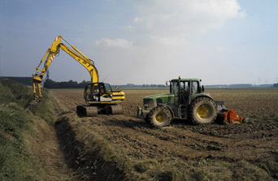
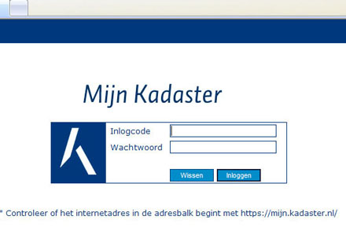
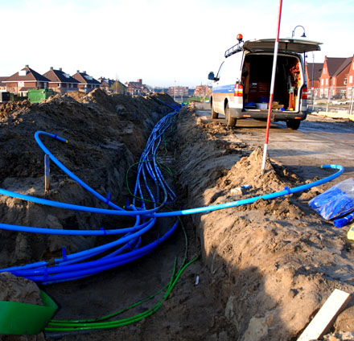
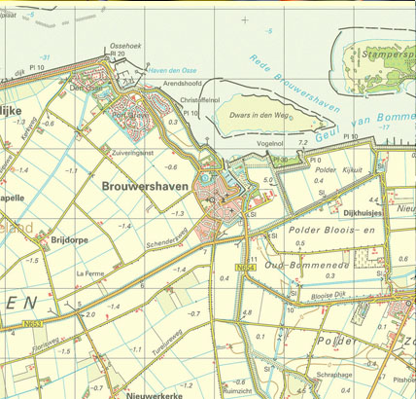
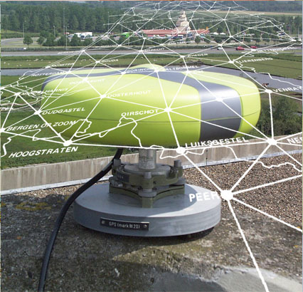
Land registry
Land registry
Cadastral surveying
Cadastral surveying
Landconsolidation
Landconsolidation
Information node/
Egovernment/NSDI
Information node/
Egovernment/NSDI
Key registers
Key registers
Information Services
Information Services
National geodetic
reference network
Topografic mapping
National geodetic
reference network
Topografic mapping
Cables & pipelines
Cables & pipelines
5 May 2017 – PCC & Eulis Malta: PDOK & BRK

Slide 3
PDOK in approach in relation with the distribution of and access to cadastral information
BRK
PDOK
Key Registers
5 May 2017 – PCC & Eulis Malta: PDOK & BRK

Slide 4
Key Registers in the Netherlands

Slide 5
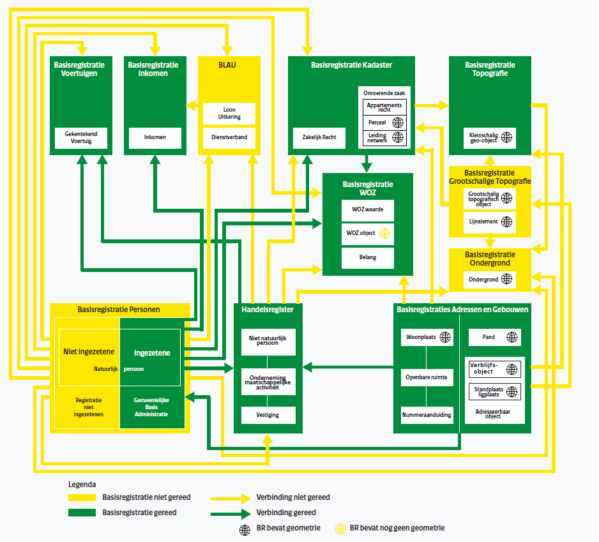
11 Key Registers in the Netherlands
What is a key register?
One entity of the government is responsible
Certified data
Collected once
Why necessary?
Improving information infrastructure government
5 May 2017 – PCC & Eulis Malta: PDOK & BRK

Slide 6
Goal: Modern and dynamic government
does not ask twice (relief of administrative burden)
is demand driven and pro-active (24 hrs)
is not fooled around with (fraud fighting)
is well informed about its targets (monitoring)
is properly organised and cost effective (efficient)
5 May 2017 – PCC & Eulis Malta: PDOK & BRK

Slide 7
12 Fundamental conditions of a key register
Established by Law
Obligation to report errors or other irregularities.
Obligation to use
Liability
Finance
Content well defined
Procedures and standards for data distribution
Accessibility
Quality Assurance
Obliged involvement
Relations between key registers
Control and responsibilities
5 May 2017 – PCC & Eulis Malta: PDOK & BRK

Slide 8
Key registries as national data facilities
SDI developments in the Netherlands are strongly related to the key registries of e-government policy (interrelated system).
Spatial key registries with Legal Acts for:
BRK – Cadastre
BRT - Topography
BGT – Large scale Topography
BAG - Addresses and Buildings
BRO – Soil and Geology
NHR – Chamber of commerce
WOZ - Real estate value
Non-spatial registries, like population, car license plates, income.
5 May 2017 – PCC & Eulis Malta: PDOK & BRK

Slide 9
System of Key Registers & Kadaster
Kadaster: information ‘hub’ in system key registers:
Key register cadaster (BRK)
Key register topography (BRT)
Distributor information building and addresses (BAG)
Distributor large scale base map (BGT)
Distributor information property values (WOZ)
5 May 2017 – PCC & Eulis Malta: PDOK & BRK

Slide 10
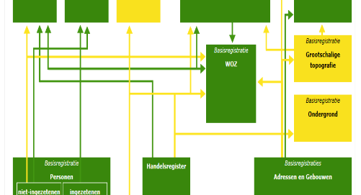
Example
Value
€ 375.000
Address & Building
Owner
Parcel
Map
98
5 May 2017 – PCC & Eulis Malta: PDOK & BRK

Slide 11
Key register cadaster (BRK)

Slide 12
Key register cadaster (BRK)
Cadastral Act (1 January 2008)
Land Registry
Cadastral Map
5 May 2017 – PCC & Eulis Malta: PDOK & BRK

Slide 13
Authentic data in key register cadaster
Land Registry
Parcel number
Ownership
Rights (eg Mortgages, usufruct, etc)
Size of the parcel
Cadastral Map
Parcel number
Parcel boundaries
Administrative boundaries
5 May 2017 – PCC & Eulis Malta: PDOK & BRK

Slide 14
Availability BRK as Open Data
2013: Administrative boundaries available as open data
2016: Cadastral Map available as open data with monthly updates
2018: Cadastral Map available as open data with daily updates
5 May 2017 – PCC & Eulis Malta: PDOK & BRK

Slide 15
BRK – Linked with other key registries
Key Registry Cadastre (BRK) & Key Registry Building and Adresses (BAG)
Key Registry Cadastre (BRK) & National Trade Register (NHR)
Key Registry Cadastre (BRK) & Key Registry of Persons (BRP)
5 May 2017 – PCC & Eulis Malta: PDOK & BRK

Slide 16
PDOK

Slide 17
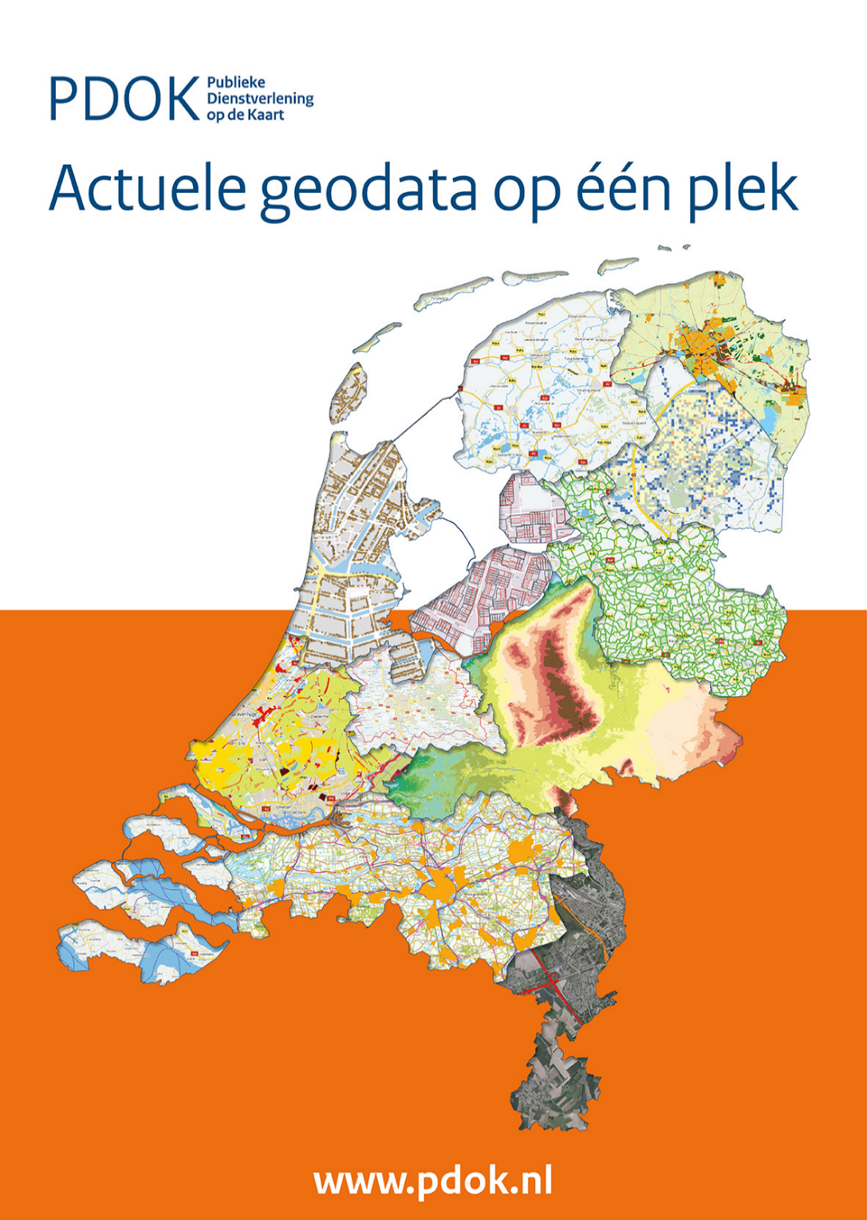
www.pdok.nl

Slide 18
What is PDOK?
PDOK is a central platform which stores and distributes (nationwide) datasets provided by government organizations
Datasets are distributed via webservices and via direct downloads.
Webservices contain online view- and downloadservices
Data is free to use
High update frequency
Almost 100% up and running
Data-owners are responsible for the content
Data-owners decide (if) when and how data is provided via PDOK
5 May 2017 – PCC & Eulis Malta: PDOK & BRK

Slide 19
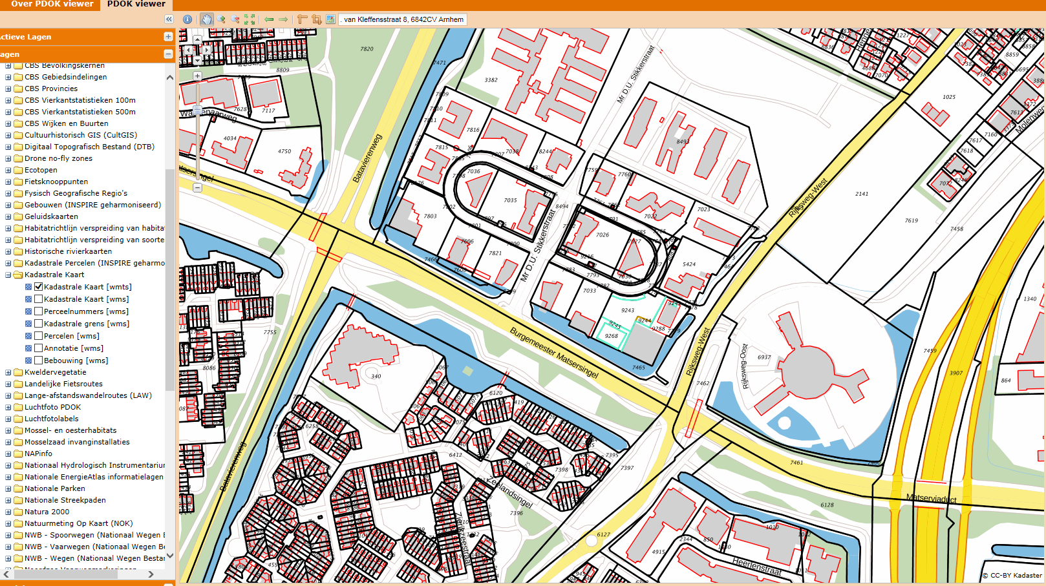
Cadastral Map in PDOK
5 May 2017 – PCC & Eulis Malta: PDOK & BRK

Slide 20
PDOK Partners
Partners:
Ministry of Infrastructure & Environment (commissioned by)
Department of Waterways and Public Works
Ministry of Economic Affairs, Agriculture & Innovation
Cadastre, Land Registry, Mapping Agency of NL
Geonovum (NSDI executive committee)
5 May 2017 – PCC & Eulis Malta: PDOK & BRK

Slide 21
PDOK: A few reasons why
INSPIRE
Open data
E-Government: delivering government information and services to the citizens via web-based technologies
A growing demand for geo-information by society
Working together in more efficient way, with more reliable information and to make it future proof
5 May 2017 – PCC & Eulis Malta: PDOK & BRK

Slide 22
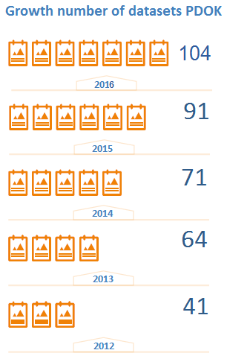
Statistics PDOK:
350 million hits per month (webservices)
105 datasets available april 2017
56 INSPIRE datasets
289 view- en downloadservices
450 governmental bodies are registred at PDOK
5 May 2017 – PCC & Eulis Malta: PDOK & BRK

Slide 23
Increase of usage of PDOK
5 May 2017 – PCC & Eulis Malta: PDOK & BRK

Slide 24
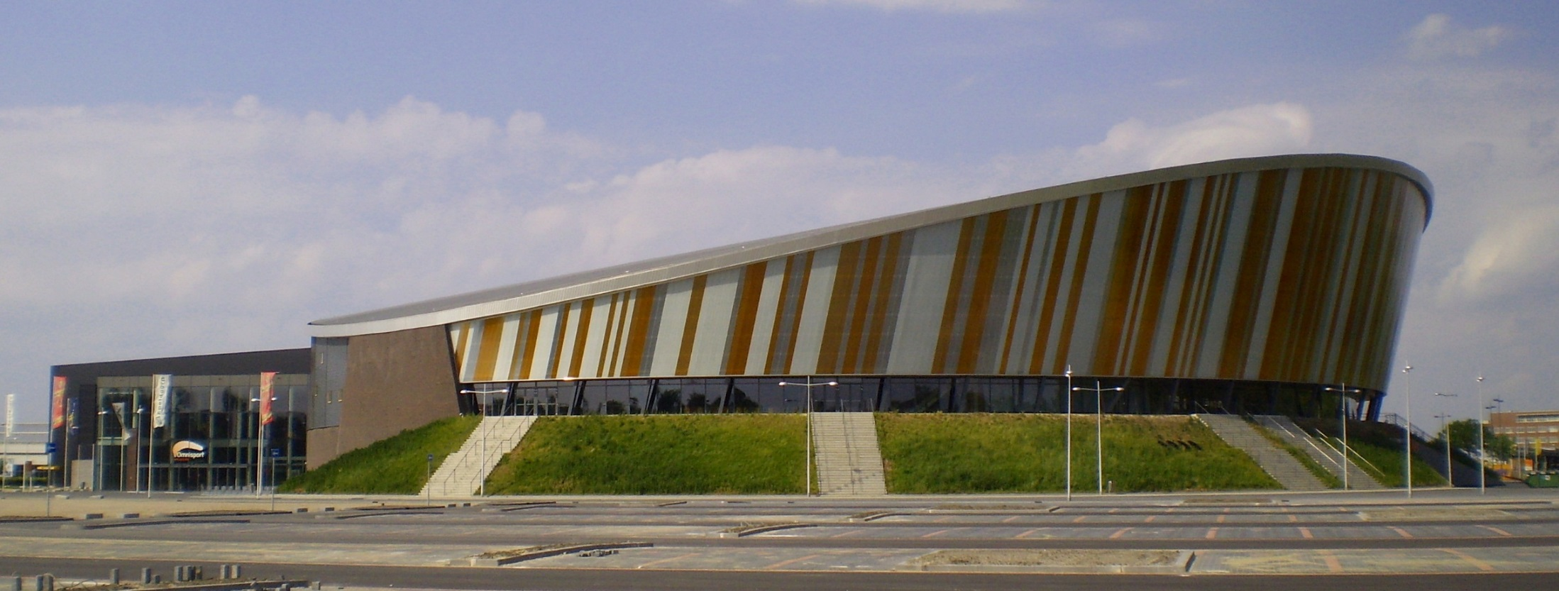
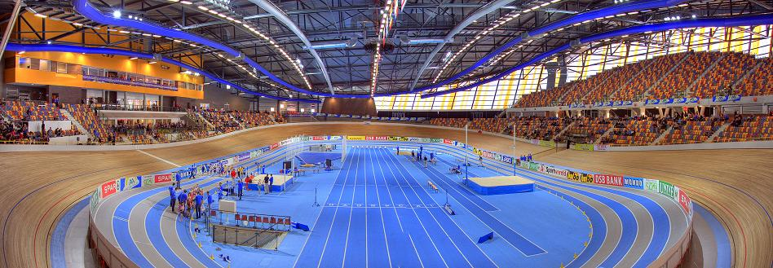
Omnisport in Apeldoorn, The Netherlands
Notes:
24242424242424

Slide 25
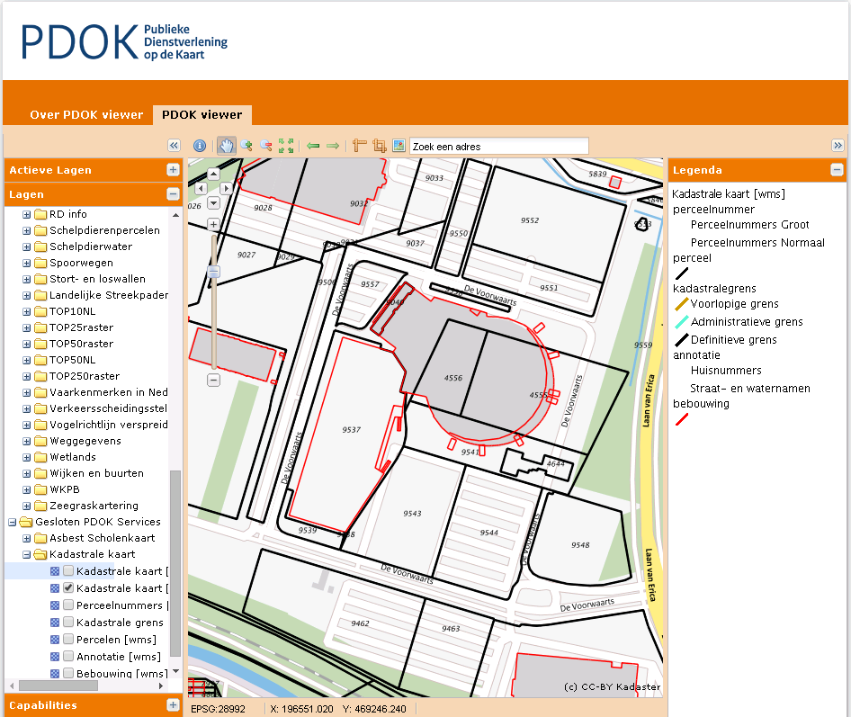
Cadastral map
Notes:
25252525252525

Slide 26
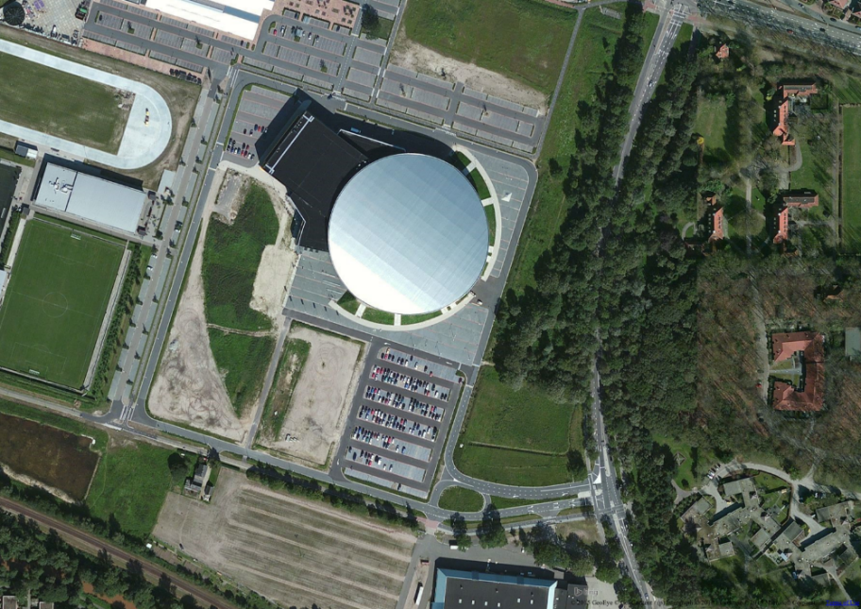
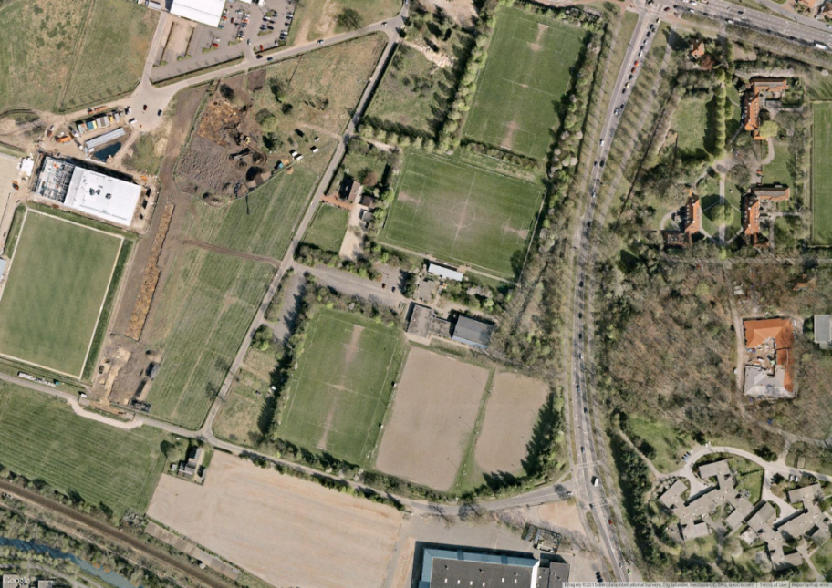
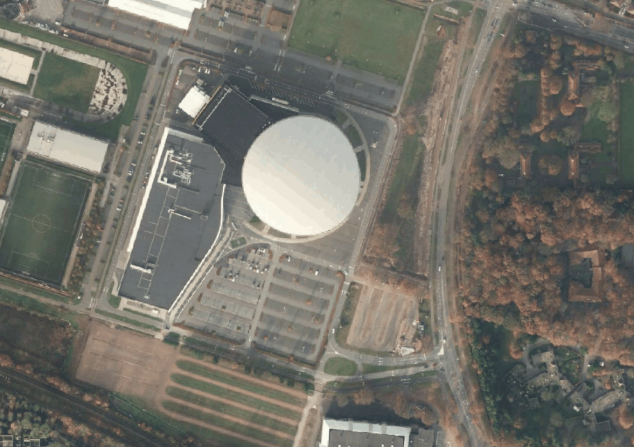
?
Bing
Google
PDOK
Notes:
26262626262626

Slide 27
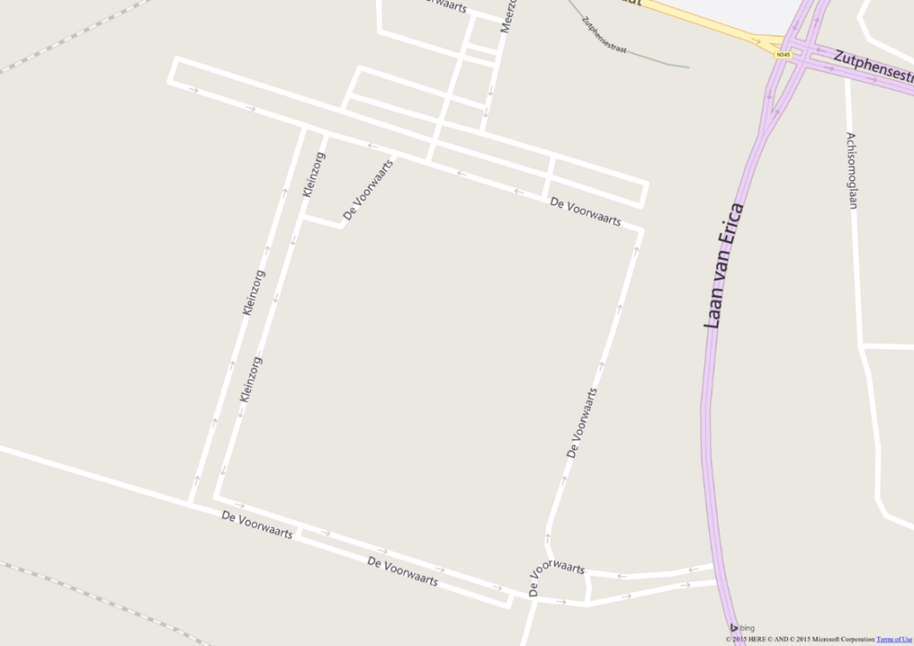
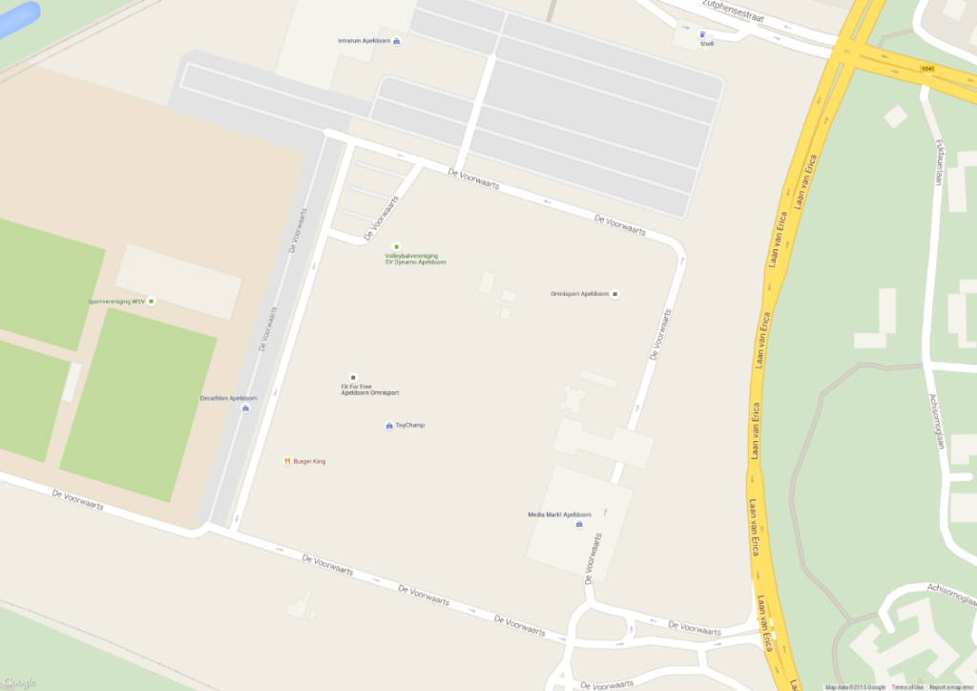
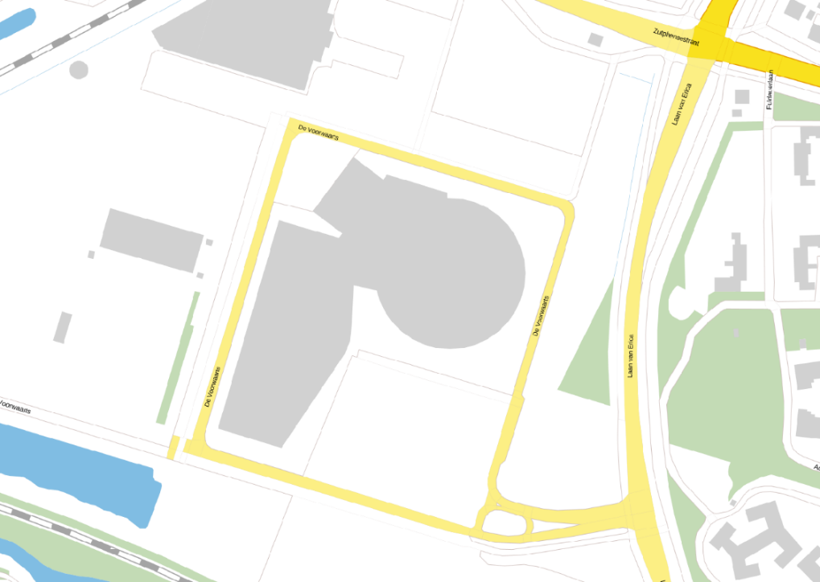
Bing
Google
PDOK
Notes:
27272727272727

Slide 28
In conclusion

Slide 29
PDOK in approach in relation with the distribution of and access to cadastral information
BRK
PDOK
Key Registers
5 May 2017 – PCC & Eulis Malta: PDOK & BRK

Slide 30
Points of attention
Having key registries in place made INSPIRE obligations much easier to implement
Making Key Registry Cadastre available in PDOK increased the usage of cadastral information
Provinding BRK as wfs for the whole country was a challenge. The data was made available at provincial level.
Projection of the data can cause some issues when combining BRK with other datasets
5 May 2017 – PCC & Eulis Malta: PDOK & BRK

Slide 31
Paula Dijkstra
Kadaster International
Regional Manager (Europe)
paula.dijkstra@kadaster.nl

Slide 32
What are the most important datasets for the cadastre key register and how are these linked?
BRK, BRP, BRT
Linked data
API
Monumenten
…
What are the next steps for the usage of cadastral information within PDOK?

