Slide 1
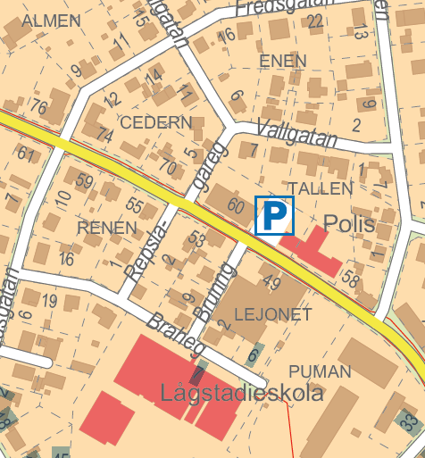
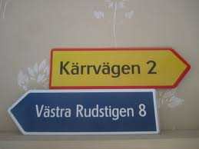
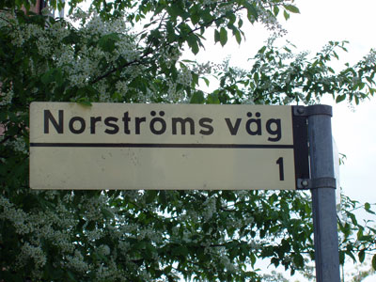
Addresses in Sweden
Update process and collaboration with the
Swedish municipalities
Ulrika Roos, Lantmäteriet, Sweden
ulrika.roos@lm.se
Notes:
My name is ….
Work as a business developer at Lantmäteriet, the Swedish mapping, cadastral and land registration authority.
Informationsförsörjning = Geographic and Land information

Slide 2
The Address Register, a part of the Real Property Register
Laws and regulations
Swedish standard for locational address
Collaboration with municipalities
Notes:
Agenda
I will talk about the Swedish Addressregister and the laws, regulations and standards around this.
And finally little about the cooperation and collaboration we have with the swedish municipalities.

Slide 3
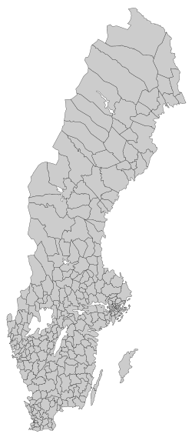
Sweden today!
Capital city: Stockholm
Total area: 449 964 km²
Population: 9.7 million
Properties: 3.3 million
Buildings: 7.5 million
Addresses: 3.6 million
Apartments: 5.1 million
290 municipalities
Notes:
But first! Some figures about Sweden !!

Slide 4
Some history
In towns streetnames and housenumbers have been assigned by council since > 100 years. In rural areas, cadastral names and placenames are most common.
No official registration of addresses until 20 years ago.
Possible to register addresses in the Real Property Register since 1994.
Links between addresses and buildings have been registered since 1994.
A Swedish standard for addresses since 1998.
Directly geo-referenced addresses since 2002.
In 2010 the apartments were linked to the addresses.
Notes:
Some history about how we have built up our addressregister.

Slide 5
Addresses – a part of the Real Property Register
Real Property Register
Notes:
Our Real Property Register content different parts, where addresses is one of them.
Disignations – Beteckningar
General section – Allmänna delen
Land register section – Inskrivningsdel
Adress section – Adressdelen
Building section – Byggnadsdelen
Tax assessment data section – Taxeringsuppgiftsdelen
Property units and joint property units – Fastigheter och samfälligheter
Coordinates – koordinater
Plans and regulations – Planer och bestämmelser
Joint facilities – Gemensamhetsanläggningar
Digital index map – Digital registerkarta
Mortgage certificates register – Pantbrevsregistret
Property price register – Fastighetsprisregistret
Register of joint property managment associations – Samfällighetsregistret
Apartment register – Lägenhetsregistret

Slide 6

Address Register
Addresses to housing
Addresses to industrial, commercial, social, cultural and
administrative functions
Address components
  Address area, e.g. Park Road
  Village address area, e.g. Berga
  Address number, e.g. 25, 27A
  Coordinates (position)
  Postal code
  Link to the real property and building
  Popular name (additional) e.g. Storkyrkan (Stockholm Cathedral)
Addresses 2013-12-31 3,6 million
Addresses link to building 3,5 million
Notes:
An address consists of the following components:

Slide 7
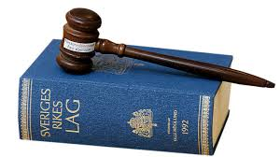
Agreements and laws
According to the Real Property Register Act, the address register is voluntary.
Therefore Lantmäteriet reaches an agreement with the municipality.
But: The new Housing Register Act from 2006 makes it compulsory for the municipalities to register addresses to housings

Slide 8
Cooperation with municipalities
(Addresses, Buildings, Topography)
Agreement on three levels for addresses.
The thing that mainly affect the three levels are
  quality
  completeness
  timeliness
Municipalities will receive compensation based on:
  the level in the agreement
  the number of inhabitants in the municipality
  the revenues of Lantmäteriet for geographic and property information
For 2014, about 3,8 million euro were paid to the municipalities
Notes:
Example of collaboration are the agreements that are about addresses, buildings and apartments that Lantmäteriet has with all municipalities.
Mainly affected are the three levels of quality, completeness and timeliness.
Inhabitants = invånare
Revenue = inkomst/intäkt
37 Mkr utbetalades för 2014.
8

Slide 9
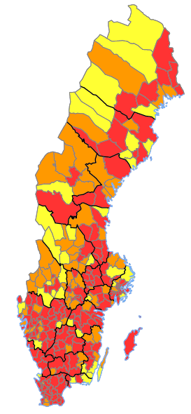
Levels of agreement 2014
- Addresses
Red = Level 3 = Highest level!
179 municipalities
Orange = Level 2
71 municipalities
Yellow=Level 1 = Lowest level!
40 municipalities
Notes:
Röd = nivå 3
Orange = nivå 2
Gul = nivå 1

Slide 10
Locational Address
The Swedish Address Standard
The standard is used to support the work with deciding addresses and for exchange of data.
The standard indicates how the locational address would look like and how to register.
A locational address indicates were a geographic location is placed.
Indicates the place and points out a fact that is situated at the specific place.
It´s necessary that the locational address is unique and only occurs once in the municipality. This address should point out only one place.
Notes:
In sweden we have an swedish standard for locational address.
Syftar till att vara ett stöd dels för arbete med adressättning och fastställande av belägenhetsadresser, dels för utbyte av data om belägenhetsadresser.
Standarden anger hur belägenhetsadresser byggs upp och registreras.
En belägenhetsadress anger var en geografisk plats är belägen. Anger platsen och pekar därigenom ut en företeelse som är belägen på platsen.
Nödvändigt att belägenhetsadressen är unik, bara förekommer en gång inom kommunen. Ska entydigt peka ut en enda plats.

Slide 11
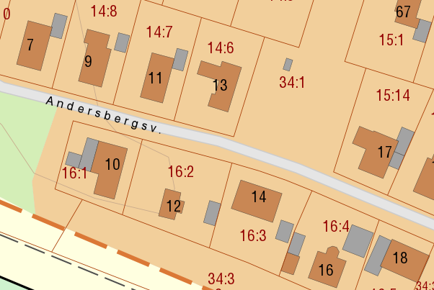
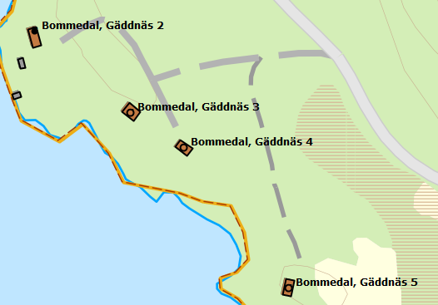
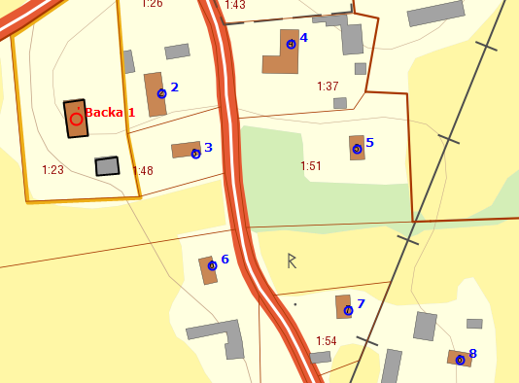
Types of addresses
Streetname
Area (village)
Area (village)
or …
Notes:
According to the standard you can chose between streetname or area/villagename. To these types of adresses you link an adressplace
Exempel Backa 1 = Gullspångs kommun, By + adressplats
Exempel Bommedal, Gäddnäs 3 = Linköpings kommun By + Gård + adressplats

Slide 12
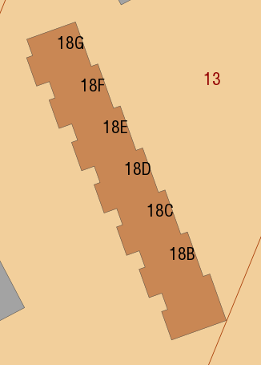
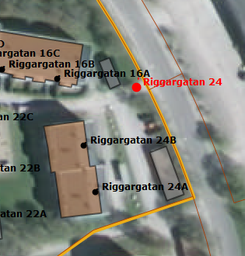
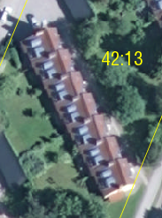
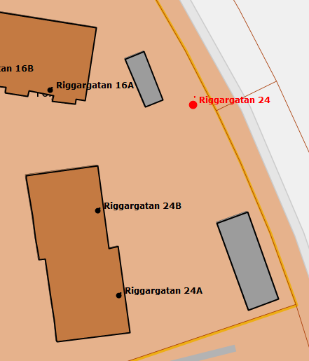
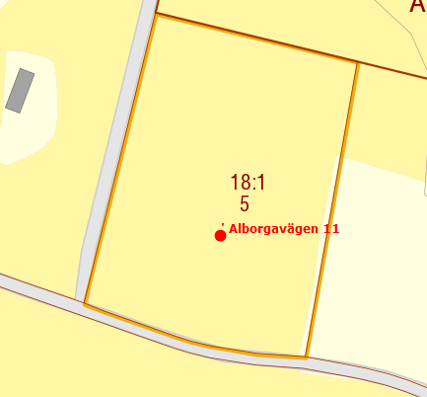
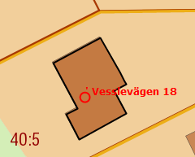
Location
Entrances
to the building
Entrance to the
property
18A
Building point
Plot location
Notes:
In Sweden you can choose between four different ways to indicate the location of an address.
- Entrance to the building
- Entrance to the property
- Building
- Plot Location

Slide 13
How to establish an address
The municipality has the over-all responsibility
Names are often decided by a committee of politicians, the numbering is normally delegated to an official.
Large expansive municipalities sometimes have a preparation board of experts and specialists in placenames, history or linguistics. This board proposing proper addressnames
You can´t appeal the name and number in an address
(but if you produce good reasons that the municipality have done wrong in their procedures, they could change the address).
Notes:
Linguistics = språkvetenskap

Slide 14
The address flow and involved authorities
Distribution of addresses connected
to real property and buildings.
Decision about address
and registration
Municipality
Lantmäteriet
Maintenance of the Address part of the Real Property Register
Address, postal code,
postal location, coordinates,
link to real property and
building
Swedish Post
Swedish Tax
Agency
Decision of the Postal address
(postal code, postal location)
Population Register
Distribution of information about individuals (including their home addresses) to banks, insurance companies and different authorities.
Population register (address to
individuals), real estate, apartmentnumber
Notes:
En beskrivning över hur adresserna ”flödar” mellan myndigheterna
First – descision and registration by the muncipality
Then the address gets into the national addressregister. Lantmäteriet have the responsibility for the maintenance of the register.
The swedish post decides the postal code and finally - one of the most important users – The Tax Agency – can use the addresses for the population register.
From the point when the municipality registers the address until a person can begin using the address, it takes about a week.

Slide 15
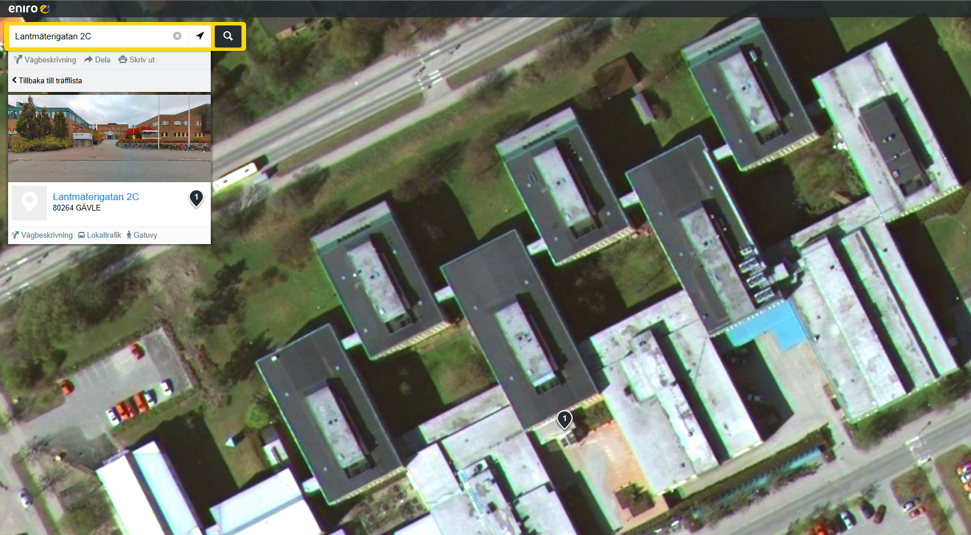
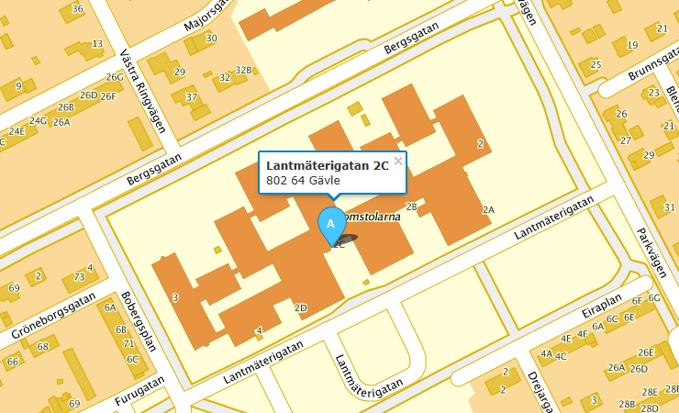
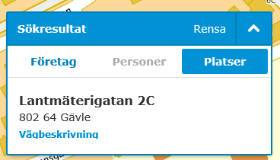

Addressinformation at the Internet

Slide 16
The future …
We must develop the address register so that we can deal with the Swedish minority languages, including the Sami language.
For example, this places demands for special characters in the street and village names.

Slide 17

Notes:
Grazie
Tack

